Slide 1
Media perception of transformations in the commemorative cityscape
Malgorzata Fabiszak, Isabelle Buchstaller,
Anna Weronika Brzezinska & Seraphim Alvanides

Slide 2
Commemorative street (re)naming
Cultural memory (Assmann 2010) is institutionalized and embedded in material objects and artefacts. Some are stored in archives, others - like buildings, monuments memorials and street names - can form implants of memory (Golka 2009, Fabiszak & Brzezińska 2016) and provide a “window” to the character of a society (Huebner 2006).
“Street names do not simply disclose a postal use; they are carriers of the collective memory of our city, of its past and its destiny. Whether they remind us of activities since disappeared, whether they commemorate important events in our history or pay homage to exceptional people, street and square names are fraught with significance” (Moszberger et al. 2002:5)
Street renaming for commemorative purposes is a hegemonic/ideological process serving as a public demonstration of changes in political identity while at the same time being part of it.

Slide 3
Commemorative street (re)naming
in Eastern Germany and Poland
After WWI: First democracies established
until end of WWII: Occupied and/or governed by Nazi Germany
Post-1945: USSR-aligned countries were ruled by socialist regimes
End of the cold war: Parliamentary democracy
Rapid succession of changes in state ideology left its mark on the LL:
Chemnitz > Karl-Marx-Stadt (1953) > Chemnitz (1989)
Katowice > Stalinogród (1953) > Katowice (1956)
Commemorative renaming can function as a powerful mechanism to obliterate “the memory of the former regime. [The public elimination of] the discredited past from the public sphere demonstrate[s] the end of [one regime] … and the beginning of a new era.” (Arazyahu 2012:387).
Commemorative renaming should be treated as an exercise in active forgetting (A. Assman 2010) or repressive erasure (Connerton 2008)

Slide 4
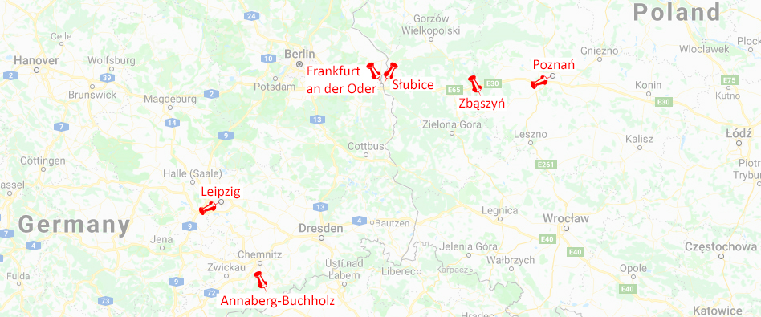
Commemorative street (re)naming
in Eastern Germany and Poland
MILL objectives:
Investigate the ongoing “battle for the representation” (Trumper-Hecht 2009:238) of competing state ideologies as they find expression on the street signs.
Comparatively examine changes in semiotic ecology of Poland & Eastern Germany
Two larger cities with regional importance (Leipzig and Poznań, ca. 560.000 pop)
Two small towns (Zbąszyń and Annaberg-Buchholz < 25.000 inhabitants)
Medium size city Frankfurt(Oder)/Słubice (together 74.000 inhabitants) divided into two towns as a result of new border established on the Oder river after WWII.
Notes:
Overall objective of this project:
Open new horizons about the complex ways in which “landscape and identity, social order and power” have been linked in the past hundred years in two countries in Eastern Europe (Rubdy 2015:2). To explore the “relations of power, language ideologies and [users’] views of their own and other’s identities” (Pavlenko & Blackledge 2004:1-2) in Eastern Germany and Poland.
- the dynamics of street renaming in Annaberg-Bucholtz (1916 – 2018)
- the press coverage of street renaming in Poznań (2005-2018)

Slide 5
Commemorative street (re)naming
in Eastern Germany and Poland
MILL objectives:
Investigate the ongoing “battle for the representation” (Trumper-Hecht 2009:238) of competing state ideologies as they find expression on the street signs.
Comparatively examine changes in semiotic ecology of Poland & Eastern Germany
Two larger cities with regional importance (Leipzig and Poznań, ca. 560.000 pop)
Two small towns (Zbąszyń and Annaberg-Buchholz < 25.000 inhabitants)
Medium size city Frankfurt(Oder)/Słubice (together 74.000 inhabitants) divided into two towns as a result of new border established on the Oder river after WWII.
MILL time frame:
1916– 2018: Longitudinal frame that examines the “wave[s] of renamings that swept” through time and space (Arazyahu 1986:590).
This talk: DHA analysis of newspapers
Scope: Zbąszyń 1989-2018; Poznań 2017-2018; Annaberg-Bucholtz 2006-2017
Focus: topoi, nominalizations and predications
Notes:
Overall objective of this project:
Open new horizons about the complex ways in which “landscape and identity, social order and power” have been linked in the past hundred years in two countries in Eastern Europe (Rubdy 2015:2). To explore the “relations of power, language ideologies and [users’] views of their own and other’s identities” (Pavlenko & Blackledge 2004:1-2) in Eastern Germany and Poland.
- the dynamics of street renaming in Annaberg-Bucholtz (1916 – 2018)
- the press coverage of street renaming in Poznań (2005-2018)

Slide 6
Frequency of articles on street name changes in Gazeta Wyborcza 2005-2017

Slide 7
Selected data
Zbąszyń | Poznań | Annaberg-Bucholtz
1989-2018 | 2017-2018 | 2006-2017
Zbąszynianin 1989-1991, 1996-1999, 1999-2006 monthly, 2011-2018 quarterly, town council | Gazeta Wyborcza appears since 1989; left-leaning, liberal Głos Wielkopolski appears since 1945; conservative | Freie Presse Since 1963, daily; Supraregional newspaper with regional focus No discernible political tendency
5+2 texts 5795 words | 23 texts; 12 600 words 23 texts; 11 100 words | 17 texts; 4527 words

Slide 8
Methods
Discourse Historical Approach (Reisigl and Wodak 2009): the micro-level linguistic analysis of
Nomination strategies >>> top-down
Predication strategies >>> top-down
Argumentation strategies >>> bottom-up
Mitigation/intensification/framing >>> top-down
Corpus Critical Discourse Analysis (Fabiszak 2007, Mautner 2009):
Keyword analysis >>> top-down
Collocation frequencies >>> top-down

Slide 9
Bottom-up street renamings:
Zbąszyń and Annaberg-Bucholtz
(and Poznań)
Changes instigated by local activists (e.g. journalists)
and local administration in consultation with inhabitants

Slide 10
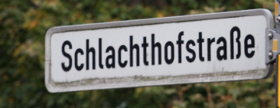
Media perspective on Bottom up processes: Argumentation strategies
Ideological arguments | Underrepresentation of women (FOR) | Z(LL) | AB
 | Legitimisation of instigators of change (FOR & AGAINST) | Z | AB(I)
 | Ideological instability of streetnames (AGAINST) | Z | AB(I)
 | Retaining traditional name (AGAINST) | Z | AB(I)
 | Commemoration of local heroes / argument from history (FOR) | Z | AB
 | Reversing the erasure of memory (FOR) | Z | -
Practical concerns | Cost of renamings (AGAINST) | Z | AB
 | Orientation aspects (AGAINST) | - | AB

Slide 11
Bottom-up street renamings: Zbąszyń 1990-1991, Annaberg-Bucholtz 2006-2017
Commemoration of local heroes/ argument from history (FOR CHANGE)
“At last the streets will receive the names of the people originating in the town and region, that deserve merit for their work for the Zbąszyń area.” (Z 1990)
“Annaberg. The 19th century is one of the most important eras in the history of the city. Liberation wars (1813/15) and revolution (1848/49) as well as the economic upswing and general social welfare left their traces on the face of the city. Two men were right in the middle of it all – the mayors Carl-Friedrich Reiche-Eisenstuck and Johann August Scheibner. Street names in the old town of Annaberg commemorate them“ (FP 2010)

Slide 12
Bottom-up street renamings: Zbąszyń 1990-1991, Annaberg-Bucholtz 2006-2017, Poznań 2017
Underrepresentation of women (ARGUING FOR CHANGE)
“Women as namesakes for streets and squares are few and far in-between in the ore mountains. […] ‘Freie Presse’ has consulted historians in museums and archives for potential female namesakes“ (FP 2011)
“We would like to remind that Poznań councillors made a decision to name new streets in 2018 with women – next year we will celebrate a 100th anniversary of women gaining suffrage in Poland” (GW, 2017)
Notes:
Underrepresentation of women:
Przypomnijmy, że niedawno poznańscy radni przyjęli stanowisko, by w 2018 r. patronami ulic zostawały przede wszystkim kobiety - w przyszłym roku przypada sto lat od chwili, gdy uzyskały w Polsce prawa wyborcze. (GW, 2017)
legitimisation of the change instigators through local identity/address
It is particularly painful that the people advocating the renaming – the representatives of associations and private – mostly have only shortly lived in Zbaszyń or not at all.”
“Szczególnie bolesny jest fakt, że o zmianę nazwy zabiegają głównie osoby – przedstawiciele stowarzyszeń i prywatne – stosunkowo krótko, bądź zgoła wcale w Zbąszyniu nie mieszkające.” [Renata Stawiańska, „Ulica dzieli”, Zbąszynianin, Nr 6 (76), Czerwiec 2001, str. 7]
“The bridge on the Obra river, joining the parts of the city today, as the facts show, was a foundation for a modern transport system. I therefore suggest to the town’s fathers to make a resolution naming the Obra bridge after Captain Franciszek Ferfet. It would be a token of gratitude expressed after years. I hope that my appeal, as a Zbąszyń inhabitant, will be considered by the councillors.”
„Most na Obrze, spinający części miasta dziś, jak wskazują fakty, był fundamentem pod nowoczesny system komunikacyjny. Sugeruję więc ojcom miasta podjęcie uchwały o nadanie mostowi na Obrze imienia kapitana Franciszka Ferfeta. Byłby to wyraz wdzięczności wyrażony po latach. Mam nadzieję, że mój apel, jako zbąszynianki, zostanie przez radnych podjęty.” [Ksawera Czajka-Szostak, „Most Ferfeta”, Zbąszynianin, Nr 9(20), listopad 1996, strona 5]

Slide 13
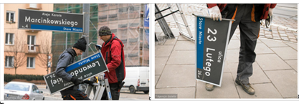
Top-down street renamings:
Poznań 2017-2018
Changes instigated by the national government
through a parliamentary bill

Slide 14
Top-down: The renaming of the Feb. 23rd Str. in Poznań
The Parliament
The Bill
Institute of National Memory
→ 149 street names for renaming
The Governor
→ Renames 4 streets
City Council
→ Rename 6 streets
Reg. Adm. Court declares the renaming invalid
Governor appeals to the Supreme Adm. Court (pending…)
”The court ruling shows how important is the separation of powers and how important are the independent and autonomous courts, [which – through the relevant opinions and rulings can curb the lawless actions of the executive power] -commented the mayor Jacek Jaśkowiak.” [Głos Wlkp, 28.03.2018., GW 23.03.2018]
Notes:
GłosWlkp, 28.03.2018.
„Wojewódzki Sąd Administracyjny w Poznaniu w czwartek uchylił zarządzenie wojewody wielkopolskiego dotyczące zmiany nazwy ul. 23 Lutego. – Wyrok pokazuje, jak ważny jest trójpodział władzy i jak ważne są niezależne, niezawisłe sądy – skomentował prezydent Jacek Jaśkowiak.”
Gazeta Wyborcza 23.03.2018.
- Ten wyrok pokazuje, jak ważny jest trójpodział władzy i jak ważne są niezależne, niezawisłe sądy, które - przez stosowne orzeczenia i wyroki - są w stanie uniemożliwić pozaprawne działania władzy wykonawczej - komentował prezydent Poznania Jacek Jaśkowiak.

Slide 15
Głos Wielkopolski, 02.11.2018
According to Zbigniew Hoffmann the street name of February 23rd is connected with the Soviet Army arrival in Poznań in 1945. The Governor is open to the suggestions of the inhabitants,…
– It is worthwhile to consider the achievements of the outstanding Poznań inhabitants, particularly important for our city. (…) – says the governor of Wielkopolska Zbigniew Hoffmann. (…) In Wielkopolska the local governments changed about 100 street names invoking the decommunisation bill.
Notes:
Głos: Zdaniem Zbigniewa Hoffmanna nazwa ulicy 23 Lutego jest związana z wejściem wojsk Armii Sowieckiej do Poznania w 1945 roku. Wojewoda jest otwarty na składane propozycje mieszkańców, które często odnoszą się do dorobku zasłużonych Wielkopolan. Jedną z propozycji jest osoba Stefana Stuligrosza, twórcy Chóru Chłopięco-Męskiego „Poznańskie Słowiki”. Drugą, postulat przywrócenia dawnej ulicy Pocztowej w Poznaniu. - Warto rozważyć docenienie dorobku wybitnych poznaniaków, szczególnie zasłużonych dla naszego miasta. Dlatego w przypadku 23 Lutego rozważamy uczynienie patronem ulicy profesora Stefana Stuligrosza. Inną możliwą propozycją jest ul. Pocztowa. Na ten moment to dwie prawdopodobne nazwy. Na bieżąco konsultujemy się również z Instytutem Pamięci Narodowej – mówi wojewoda wielkopolski Zbigniew Hoffmann. W Wielkopolsce samorządy zmieniły około 100 nazw ulic, powołując się na ustawę dekomunizacyjną.
Głos Wlkp 02.11.2017.

Slide 16
Gazeta Wyborcza, 02.11.2017
Who can be the patron of an important communication artery in the centre? „The governor Zbigniew Hoffmann is open to the suggestions of new names. He believes that it is worthwhile to appreciate the achievement of outstanding Poznań inhabitants, particularly important for the city. (…)” – wrote us the Speaker of the Governor.
But it may be a smokescreen.
Notes:
GW: Kto może zostać nowym patronem tej ważnej arterii komunikacyjnej w centrum? "Wojewoda Zbigniew Hoffmann jest otwarty na propozycje nowych nazw. Uważa, iż warto rozważyć docenienie dorobku wybitnych poznaniaków, szczególnie zasłużonych dla naszego miasta. Wśród propozycji składanych Wojewodzie wskazywano przykładowo na prof. Stefana Stuligrosza. Postulowano także przywrócenie dawnej ulicy Pocztowej" - napisał nam rzecznik wojewody.
Ale może to być zasłona dymna. Według naszych informacji Zbigniew Hoffmann nosi się z zamiarem nadania tej ulicy nazwy Lecha Kaczyńskiego, tragicznie zmarłego prezydenta RP, który zginął w katastrofie smoleńskiej w 2010 r.
GW 02.11.2017.

Slide 17
Keyword analysis
Głos Wielkopolski | Gazeta Wyborcza
bats | street
capital | governor
Czujkow | Institute of National Memory
defenders | sessions
Russians | withdrew

Slide 18
Collocation analysis: predications about the Governor
Głos Wielkopolski N=40 | Gazeta Wyborcza N=94 (101)
appealed (8) | changed/renamed (13)
issued an ordinance (7) | referred to Institute of National memory (11)
said (7) | said (11)
changed (7) | decommunised (5)
decided (3) | aggressive behaviour (5): fights, will not let off; couldn’t prove himself; will press for change

Slide 19
Frequency analysis: The meaning of February 23rd - nominalisations
 | Głos Wielkopolski | Gazeta Wyborcza
End of the battle of Poznań / occupation | 21 | 10
Polish Citadel fighters | 10 | 19
Glorification of the Red Army | 0 | 14
Arrival (invasion) of the Red Army | 9 | 19

Slide 20
Media perspective on top-down processes: nominalizations, predications and framing
No of articles
hotly debated issue
Gazeta Wyborcza:
focuses on the actions of the governor and frame them in a negative light
emphasizes the ideological power struggle between the governer and the mayor/city council
appropriates the most emotionally loaded words of the Law and Justice discourse and uses them to create the negative representations of its functionaries (glorification)
Głos Wielkopolski
uncritically prints the governor’s office press releases
creates and image of the region strong regional identity and uniform views on the public issues.

Slide 21
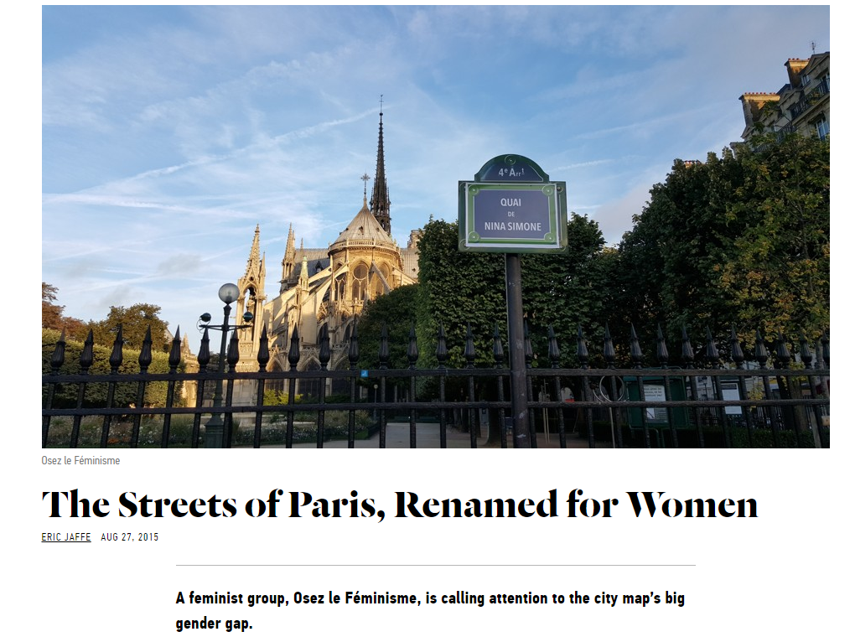
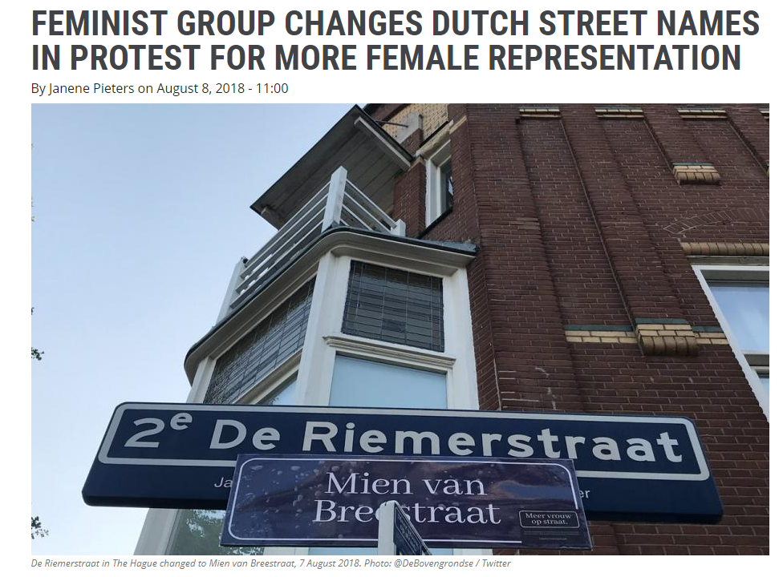
Media perception: Similarities and differences
Practical concerns (cost) mentioned in all three localities; Orientation in Annaberg-Buchholz only;
Commemorating women reported in Annaberg-Buchholz and Poznań, but implemented also in Zbąszyń.
More overtly ideological discourses in Poland:
Topoi in Zbąszyń newspaper reporting on street name (changes)
Reversing the erasure of memory
Ideological instability of streetnames
Overtly more ideological debate in Poznań about February 23rd street
In Annaberg-Buchholz no political debate in the press, mainly information dissemination on practicality of change and historical background
Ideological arguments in AB only find a voice in the interviews (to be analysed in detail in future work).

Slide 22
Media perception: Similarities and differences
Practical concerns (cost) mentioned in all three localities; Orientation in Annaberg-Buchholz only;
Commemorating women reported in Annaberg-Buchholz and Poznań, but implemented also in Zbąszyń.
More overtly ideological discourses in Poland:
Topoi in Zbąszyń newspaper reporting on street name (changes)
Reversing the erasure of memory
Ideological instability of streetnames
Overtly more ideological debate in Poznań about February 23rd street
In Annaberg-Buchholz little political debate in the press, mainly information dissemination on practicality of change and historical background
Ideological arguments in AB only find a voice in the interviews (to be analysed in detail in future work).

Slide 23
Overall conclusions
Commemorative street (re)naming
Street renaming for commemorative purposes is a hegemonic / ideological process serving as a public demonstration of changes in political identity while at the same time being part of it.
Different versions of history exist – and are replaced across time: Subversive potential of street namings to create a “natural order of things” (Fairclough 2003:2).
Therefore, “it is not surprising that [streets have been called] propaganda carriers [since] … major political changes are reflected in the renaming of streets” (Azaryahu 1986:581-7).
Following Zieliński (1994:195) we argue that street names form an important part of “the ideological robe of the city” and can be used as a measurement of political change.

Slide 24
Bottom-up street renamings: Zbąszyń 1990-1991, Annaberg-Bucholtz 2006-2017
Ideological instability of street names (AGAINST CHANGE)
“Today one party rules, others may come after them: the green, the red, the ecological. Does that mean that we should expect other revolutions in street naming? Who cares for the inhabitants’ expenses and lost time?” (Z, 2001) (Also: AB- interviews)
Retaining traditional names (AGAINST CHANGE)
“This street has its history – says one of the inhabitants. Years ago the wonderful teacher, MS. Śmidoda, together with her pupils planted the poplar trees here. Miss Śmidodzianka is gone, her pupils are gone. Only one poplar tree remains standing – a keepsake and a symbol!” (Z, 2001) (Also: AB – interviews)
Notes:
Retainig the traditional name
“This street has its history – says one of the inhanitants. Years ago the wonderful teacher, MS. Śmidoda, together with her pupils planted the poplar trees here. Miss Śmidodzianka is gone, her pupils are gone. Only one poplar tree remains standing – a keepsake and a symbol!”
„Ta ulica ma swoją historię – mówi jedna z mieszkanek. Przed laty wspaniała nauczycielka, Pani Śmidoda, wspólnie ze swoimi wychowankami sadziła tu topole. Nie ma już Pani Śmidodzianki, Pomarli uczniowie. Pozostała tylko jedna topola – pamiątka i symbol!” [Renata Stawiańska, „Ulica dzieli”, Zbąszynianin, Nr 6 (76), Czerwiec 2001, str. 7]
Cost and time of replacing documents (and street palques)
Ideological instability of street names
“Today one party rules, others may come after them: the green, the red, the ecological. Does that mean that we should expect other revolutions in street naming? Who cares for the inhabitants’ expenses and lost time?”
“Dziś rządzi jedna opcja, po nich mogą przyjść inni : zieloni, czerwoni, ekologiczni. Czy to oznacza, że możemy się spodziewać kolejnych przewrotów w nazewnictwie ulic? Kto się liczy z kosztami i straconym czasem mieszkańców?” [Renata Stawiańska, „Ulica dzieli”, Zbąszynianin, Nr 6 (76), Czerwiec 2001, str. 7]

Slide 25
Bottom-up street renamings: Zbąszyń 1990-1991, Annaberg-Bucholtz 2006-2017
Returning to the old historical names/Reversing the erasure of memory (FOR CHANGE)
“The new names a grounded in the town’s history, they have a medieval origin – this is particularly true about the small streets and alleys in the old town.” (Z, 1991) (Also: AB – interviews)
Legitimisation of change instigators through local identity (FOR AND AGAINST CHANGE)
“It is particularly painful that the people advocating the renaming – the representatives of associations and private – mostly have only shortly lived in Zbąszyń or not at all.” (Z, 1996, 2001)
Notes:
The DHA-based qualitative analysis of the argumentation strategies used in the articles allowed us to identify the following topoi:
Local heroes deserve commemoration
“At last the streets will receive the names of the people originating in the town and region, that deserve merit for their work for the Zbąszyń area.”
„Wreszcie bowiem ulice otrzymały miana ludzi wywodzących się z miasta i regionu, zasłużonych dla Ziemi Zbąszyńskiej” [E. Kurzawa „Kiedy wróci Senatorska” Zbąszynianin Nr 2, marzec 1990 s. 9-10.]
Returning to the old historical names / Reversing the erasure of memory
“The new names a grounded in the town’s history, they have a medieval origin – this is particularly true about the small streets and alleys in the old town.”
„Nowe określenia wynikają z historii miasta, mają średniowieczny rodowód – dotyczy to szczególnie uliczek i zaułków w obrębie starego miasta.” [Ob. „Nasze ulice: Wreszcie nowe nazwy”, Zbąszynianin, Nr 5, marzec 1991, str. 5-6]
“In the other cases all the names are historically motivated, they existed in the past, but were forgotten or purposefully erased from our memory. Now they came back.”
„W pozostałych przypadkach wszystkie nazwy mają uzasadnienie historyczne; istniały w przeszłości i zostały zapomniane lub celowo wymazane z naszej pamięci. Teraz wróciły.” .” [Ob. „Nasze ulice: Wreszcie nowe nazwy”, Zbąszynianin, Nr 5, marzec 1991, str. 5-6]

Slide 26
Bottom-up street renamings: Zbąszyń 1990-1991, Annaberg-Bucholtz 2006-2017
Cost and time of replacing documents (and street plaques) (Z, AB) (AGAINST)
“I understand that the change of the name of Border Str. is not convenient for the ‘Romeo’ textile factory, because they would have to change headed paper, stamps, addresses, and it all costs.” (Z, 1990)
“The city government follows clear guidelines: ‘While it would be desirable to change the name into Felix-Weiße Straße, it would also mean unreasonable hardship for our citizens’, they say. ‘Identification, passports, addresses, documents, contracts etc. would have to be changed following the street name change’, Matthias Förster explains. This would be difficult to convey to citizens”. (FP 2013)
Orientation (mainly for tourists and ambulances) (AGAINST)
“’Within the city we already do have different Bleichen [bleacheries] which only differ in preposition. This is a real problem for ambulances‘, councillor Karl-Heinz Vogel (FWG) pointed out.“ (FP 2009)

Slide 27
The socio-political context
Bottom-up process
1990s: Spontaneous changes of street names by local authorities,
generally return to names from interwar period
or commemorating local personages in Poland and East Germany.
Top-down process
Poland: April 1, 2016 (announced June 02, 2016, in power Sept 2nd, 2016) Parliamentary bill banning the propagation of communism
No such recent top-down processes in Germany
Notes:
Ustawa z dnia 1 kwietnia 2016 r. o zakazie propagowania komunizmu lub innego ustroju totalitarnego przez nazwy jednostek organizacyjnych, jednostek pomocniczych gminy, budowli, obiektów i urządzeń użyteczności publicznej oraz pomniki

Slide 28
The process: Nominalizations
 | Głos Wielkopolski | Gazeta Wyborcza
street name change | 51 | 63
renaming | 2 | 9
decommunization | 43 Decommunisation bill* (9) Street decommunization (13) | 75 Decommunisation bill (24) Decommunization of streets (3)
*A bill banning the propagation of communism and other totalitarian systems … requires the local governments to change the names … commemorating persons, organizations, events or dates symbolising communism or another totalitarian system or propagating this system in another way.
Notes:
upamiętniających osoby, organizacje, wydarzenia lub daty symbolizujących komunizm lub inny ustrój totalitarny lub propagujących taki ustrój w inny sposób.

