Slide 1
To rename or not to rename ….
Investigating the complex interplay of forces resulting or preventing commemorative street renaming in Eastern Germany
Carolin Schneider
Isabelle Buchstaller
University of Duisburg-Essen
MILL (Memory and Ideology in the Linguistic Landscape)

Slide 2
Commemorative street (re)naming
Cultural memory is institutionalized and embedded in material objects and artefacts (Assmann 2010). Some are stored in archives, others - like buildings, monuments memorials and street names - can form implants of memory (Golka 2009, Fabiszak & Brzezińska 2016) and provide a “window” to the character of a society (Huebner 2006).
“Street names do not simply disclose a postal use; they are carriers of the collective memory of our city, of its past and its destiny.
Whether they remind us of activities since disappeared, whether they commemorate important events in our history or pay homage to exceptional people, street and square names are fraught with significance” (Moszberger et al. 2002:5)

Slide 3
Commemorative street (re)naming
Street renaming for commemorative purposes is a hegemonic/ideological process serving as a public demonstration of changes in political identity while at the same time being part of it.
Commemorative renaming can function as a powerful mechanism to obliterate “the memory of the former regime. [The public elimination of] the discredited past from the public sphere demonstrate[s] the end of [one regime] … and the beginning of a new era.” (Arazyahu 2012:387).
Commemorative renaming should be treated as an exercise in active forgetting (A. Assman 2010) or repressive erasure (Connerton 2008)

Slide 4
Commemorative street (re)naming
in Eastern Germany
Until end of WWII:
Nazi Germany
End of the cold war:
Parliamentary democracy
After WWI:
First democracy established
Post-1945:
USSR-aligned country
ruled by socialist regime
Rapid succession of changes in state ideology left its mark on the LL:
Chemnitz > Karl-Marx-Stadt (1953) > Chemnitz (1989)
Katowice > Stalinogród (1953) > Katowice (1956)

Slide 5
Commemorative street (re)naming
in Eastern Germany
Until end of WWII:
Nazi Germany
End of the cold war:
Parliamentary democracy
After WWI:
First democracy established
Post-1945:
USSR-aligned country
ruled by socialist regime
MILL investigates the ongoing “battle for the representation” (Trumper-Hecht 2009: 238) of competing state ideologies during the waves of ideological re-orientation.

Slide 6
Commemorative street (re)naming
in Eastern Germany
Until end of WWII:
Nazi Germany
End of the cold war:
Parliamentary democracy
After WWI:
First democracy established
Post-1945:
USSR-aligned country
ruled by socialist regime
MILL time frame:
1916– 2018: Longitudinal frame that examines the “wave[s] of renamings that swept” through time and space (Arazyahu 1986:590).

Slide 7
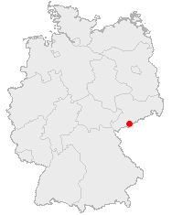
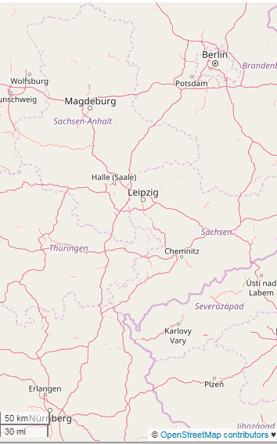
Commemorative street (re)naming
in Eastern Germany
Comparatively examine changes in semiotic ecology of Eastern Germany
One small town (Annaberg-Buchholz < 25.000 inhabitants)
One large city with regional importance (Leipzig ca. 560.000 pop)
… and Frankfurt (Oder)

Slide 8
Arguments for and against street (re)naming
Processes of change in the officially sanctioned public semiotics:
Values
Personnages
Dates
Place names
Re-naming is often accompanied by debates and discourses.
Exploring the “connection between power relations, public memory, identity formation and commemorative” naming (Azaryahu 2012: 388).
Method: Critical discourse analysis (Weiss & Wodak 2003, Van Dijk 2008)
Discourse historical analysis (Reisigl and Wodak 2016, Fabiszak 2007)

Slide 9
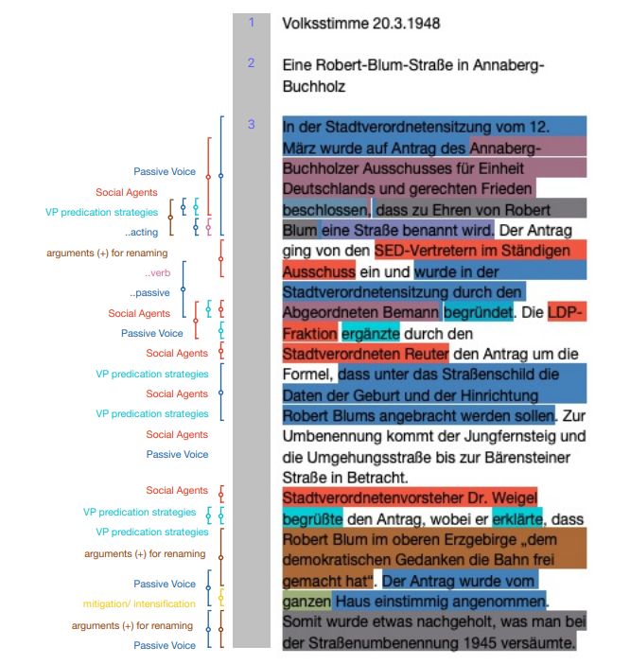
During the city council meeting on 12 March and by request of the Annaberg-Buchholz committee for German unity and just peace, a decision has been made to name a street in honour of Robert Blum. The request was issued by the representatives of the SED to the resident committee and was justified by delegate Bergmann during the city council meeting. City councillor Reuter of the LDP fraction added a section to the request according to which Robert Blum’s date of birth and date of execution are to be added below the street sign. Jungfernsteig (Maiden Climb) and the bypass up to Bärensteiner Straße (Bärenstein Street [a neighbouring community]) are considered for renaming.
Head of the city council Dr. Weigel welcomed the request, explaining that Robert Blum “paved the way for the idea of democracy” in the upper Ore Mountains. The bill was accepted unanimously by the whole house, thus rectifying something that had been neglected during the street renaming in 1945.
Notes:
a German democratic politician, publicist, poet, publisher, revolutionist and member of the National Assembly of 1848.
He was a pacifist and In his fight for a strong, unified Germany he opposed ethnocentrism and it was his strong belief that no one people should rule over another.
He was an opponent of the Prussian occupation of Poland. Blum was a critic of antisemitism and agitated for the equality of the sexes.
Although claiming immunity as a member of the National Assembly, he was arrested and executed for his role in the Revolutions of 1848, which stressed pan-Germanism and demonstrated discontent with the traditional, largely autocratic political structure of the Confederation that inherited the German territory of the former Holy Roman Empire.

Slide 10
Arguments for and against street (re)naming
Archival research
Local Newspapers:
Annaberg-Buchholz:
Tageblatt Annaberger Wochenblatt (1807-1945),
Volksstimme (1946-1963),
Freie Presse (since 1963).
Interviews with city councillors and local historians
Leipzig:
Leipziger Volkszeitung (2000-2018)
Kreutzer
Leipziger Internet Zeitung
Interviews with city councillors and local historians

Slide 11
Arguments for and against street (re)naming
Overall
52 articles
2 interviews
47 articles
Archival research
Local Newspapers:
Annaberg-Buchholz:
Tageblatt Annaberger Wochenblatt (1807-1945),
Volksstimme (1946-1963),
Freie Presse (since 1963).
Interviews with city councillors and local historians
Leipzig:
Leipziger Volkszeitung (2000-2018)
Kreutzer
Leipziger Internet Zeitung
Interviews with city councillors and local historians

Slide 12
Arguments for and against street (re)naming
Pro Contra
Moral-ideological arguments X X
Practical arguments X X
Instability of street names X X
Didactical arguments X X
Historical-factural arguments X X
N=45 N= 152
33% 77%
This talk: Focus on arguments contra commemorative street renaming, which have been neglected in the literature on the topic (see Pöppinghege 2013).
Notes:
Commemorative street (re -)naming results from the perceived need to encode and thus to semiotically perpetuate in the streetscape certain personages or values other ideological referents deemed important for the ideological needs of the present regime (see Fabiszak et al under review). The moral-ideological arguments in favour of commemorative street (re-)naming are well known, including the institutionalization of cultural memory (Assmann 2010) and the indexing of officially sanctioned identity and ideology (Scollon & Scollon 2003). Our analysis of press articles, interviews with city officials and interested citizens, in conjunction with the relevant literature on street name change juxtaposes this traditionalist point of view with a wealth of arguments contra commemorative street renaming which have been largely neglected in the relevant literature (see Pöppinghege 2012).

Slide 13
Arguments against street (re)naming
Ideological instability of street names (N=4, 2%)
Consternation about the semantic unsteadiness of the streetscape
“After 1990 role models such as Ernst Thälmann or Wilhelm Pieck disappeared quickly from the streetscape. After the Wende (turn) they were considered as out dated, because they represented an old regime” (LVZ 01.05.2010)

Slide 14
Arguments against street (re)naming
Ideological instability of street names (N=4, 2%)
Consternation about the semantic unsteadiness of the streetscape
Acute sensitivity of Eastern Germans to the ideological nature of recent history.
Different approaches:
Annaberg-Buchholz: connotational instablity of street names is the main argument against commemorative street renaming of historical persons.
Leipzig:
List of personnages to be commemorated ((all political parties elected into the city council have right to vote))
“There is some sort of consensus -- because we have had some bad experiences -- to avoid the names of … historical personages, because they tend not to have the same staying power during political turnovers because the interpretation of events can always differ and someone finds out that this and that person has maybe done something bad at some point in time and so the decision [to commemorate] becomes tenuous. Hence, [we try] to search for neutral denominations, because they simply have more longevity”. ((city councilor))

Slide 15
Arguments against street (re)naming
Didactical arguments (N=3)
Didactical elements in commemorative street naming:
Many Eastern German cities add information plaques to their street signs
“… all streets that are named after persons should be fitted with a supplementary sign containing a short characterisation of the person concerned.”
(AB city council decision 1945)
“It is not the role of street names to replace history books.”
(LVZ, 05.09.2007)
Notes:
Didactical arguments
he only candid way to address the issue of street naming is to confront rather than purge the commemorative remnants of one’s history. Taken to a moralising extreme, which we have not come across in Annaberg-Buchholz, this position results in the total rejection of street renaming as an attempt to do away with an uncomfortable era of history. However, as Pöppinghege (2012) points out, it is unreasonable to expect that passers-by or unsuspecting flâneurs would be reflective on the meaning of every street they happen to transverse, actively differentiating between commemoration and memorial. This is even less the case for GPS-navigated vehicles making their way through the traffic arteries. And while many Eastern German cities, including Annaberg-Buchholz, have resorted to adding information plaques to their street signs, we need to point out that it is impossible to provide this pedagogical contextualisation at every instance a pedestrian is entering a street (and this is less so the case with readers of navigation systems, address books etc.).
Didactical arguments in favour of retaining the streetscape to remind the public of the painful past are under-represented in present-day Annaberg-Buchholz . Note in this respect, however, that the avowedly anti-Nazi, anti-fascist stance of the GDR regime resulted in a street naming policy whereby persons who suffered as a consequence of their resistance to right-wing ideology have become prime targets for didactic commemoration. Hence, in contrast to Pöppinghege’s findings that didactical arguments tend to oppose street renaming, in Annaberg-Buchholz, they were given as a rationale for changes in public semioticisation. We illustrate this case with Kurt Löser, whose commemoration was amply justified by appealing to didactic arguments (example 4).
(4) “The city councillors’ meeting ((Stadtverordnetenversammlung)) decided on 28th November 1961] to rename Stalinplatz. At the same time, it decided to name this square after the Annaberg unionist and workers’ sportsman ((Arbeitersportler)) Kurt Löser …. In 1925 Kurt Löser became a member of the [communist] organisation ‘red worker’s children’ and he joined the communist youth federation. Kurt Löser became a member of the communist party in 1932 …. also as a dedicated footballer [he was] a member of the workers’ exercise and sports club. There he led the youth team. He greatly distinguished himself in the construction of the football pitch of the workers’ sports union ‘Storm 1939-Opp’ and during the construction of the swimming pool in the Humpe Valley. During Nazi times Kurt Löser remained true to the workers’ cause. After having been imprisoned several times, and having been sentenced to jail, the Gestapo sent him to the concentration camp Sachsenburg. Because he continued to be politically active, he received increased penalty in the so-called ‘sports commando’. On December 22, 1935, he contracted pneumonia as a result of the chicanery of [having to work] in the wet and cold snow drift, of which he died shortly after. The decision of the city councillors’ meeting to rename the hitherto Stalinpatz as Kurt-Löser-Kampfbahn was endorsed by the DTSB [German gymnastics and sports club] local committee. The sportsmen suggested further to instate a Kurt Löser commemoration sports event and to unveil a memorial stone. Kurt Löser’s brother … the approval of whom has been recently recorded, wrote ‘the naming of a sports ground as Kurt-Löser-Kampfbahn is a commitment of the sportsmen in the Annaberg local authority to pour all their energy into peacekeeping and into the defense of our DDR – if needs be with their life – as Kurt Löser has done in his fight against fascism’”.
As pointed out above, the didactical potential of such namings is reinformed by the decision to add – as much as feasible – explanatory information about the personage commemorated on a supplementary sign. Example (5) contains a relevant decision which was taken as early as 1945 by the Annaberg-Buchholz city council.
(5) “… all streets that are named after persons should be fitted with a supplementary sign containing a short characterisation of the person concerned.”
Note in this respect that didactic arguments, together with expository information, can already be found during the Nazi era. Example (6) illustrates the official state law which was issued by the Nazi government on 15th July 1939:
(6) “If possible, the sign is to have an explanation underneath the traditional street name so as to instruct the inhabitant as well as the foreigner of a piece of history of the respective city – such explanations are also requested for address books, but only if experts can provide a really reliable explanation for the street name.
“Die Stadtverordnetenversammlung faßte in ihrer Tagung am 28. November einen Beschluß, den Stalinplatz umzubenennen. Gleichzeitig wurde beschlossen, diesen Platz nach einem Annaberger Arbeitersportler, nämlich Kurt Löser, zu benennen. Kurt Löser wurde im April 1911 als Sohn eines Arbeiters in Geyersdorf geboren. Der Vater fiel 1916 in Frankreich. Die Mutter übersiedelte mit ihren Kindern nach Annaberg und bezog eine Wohnung in der Seminargasse. 1925 wurde Kurt Löser Mitglied der Organisation ‚Rote Arbeiterkinder‘ und 1928 trat er dem Kommunistischen Jugendverband bei. Mitglied der KPD wurde Kurt Löser 1932. Außerdem war er Mitglied der Roten Hilfe, der Roten Gewerkschaftsopposition und der Internationalen Arbeiterhilfe, sowie als begeisterter Fußballer Mitglied des Arbeiter-Turn- und Sportbundes. Dort führte er die Jugendmannschaft. Er erwarb sich große Verdienste beim Bau des Fußballplatzes des Arbeitersportvereins ‚Sturm 1939-Opp.‘ und beim Bau des Schwimmbades im Humpetal. Während der Nazizeit blieb Kurt Löser der Sache der Arbeiterklasse treu. Nachdem er mehrmals inhaftiert und zu Zuchthaus verurteilt wurde, schaffte ihn die Gestapo 1935 ins KZ Sachsenburg. Weil er auch dort politische Arbeit leistete, bekam er Strafverschärfung in dem sogenannten Sportkommando. Am 22. Dezember 1935 zog er sich als Folge der Schikanen im naß-kalten Schneetreiben eine Lungenentzündung zu, an deren Verlauf er innerhalb kürzester Zeit verstarb. Der Vorschlag der Stadtverordnetenversammlung, den bisherigen Stalinplatz in ‚Kurt-Löser-Kampfbahn‘ umzubenennen, fand die Zustimmung des DTSB-Kreisvorstandes. Die Sportler schlugen weiterhin vor, im kommenden Jahr ein Kurt-Löser-Gedächtnis-Sportfest durchzuführen und einen Gedenkstein zu enthüllen. Der in Ronneburg lebende Bruder von Kurt Löser, dessen Zustimmung zur Platzbenennung seit kurzer Zeit vorliegt, schrieb u.a.: ‚Die Benennung einer Sportstätte ‚Kurt-Löser-Kampfbahn‘ ist eine Verpflichtung der Sportler im Kreis Annaberg, ihre ganze Kraft für die Erhaltung des Friedens und Verteidigung unserer DDR einzusetzen – wenn es sein muß, mit dem Leben – wie es Kurt Löser im Kampf gegen den Faschismus tat‘.“ (Volksstimme 28.12.1961).
“… daß bei allen Straßen, die nach Personen benannt sind, Ergänzungsschilder mit kurzer Charakteristik über die betreffende Person angebracht werden.“ (source: Annaberg Buchholz und seine Straßennamen (1969). (In: Akten des Rates der Stadt Annaberg-Buchholz Hauptakten – Umbenennung von Straßen und Plätzen. Ergangen: 1945. Abt. Industrie und Verkehr. Aktenzeichen: Rep. V Lit. St Nr. 75 Bd. – . Locat III / 33 / 333 – Stadtarchiv Annaberg-Buchholz, p. 237)
“Unter dem alten Straßennamen wird auf dem Schilde möglichst eine Erklärung desselben angebracht und damit den Einheimischen wie den Fremden ein Stück Geschichte der Stadt vermittelt. – Auch für die Adreßbücher sind solche Erklärungen der Straßennamen erwünscht, aber nur dann, wenn Fachleute diese Erklärungen wirklich zuverlässig zu geben vermögen.“ (B No 2941 RdErl. Des RWdJ. Vom 15.7.1939 betreffend Ausf.-Anw. Zur BD. über die Benennung von Straßen, Plätzen und Brücken. V a 5141 IX 39-1002 B. – RMBliB. S. 1521. In: Sammlung von wichtigen Gesetzesabdrucken und Verordnungen des Deutschen Reichs. Ausgabe B. source: Akten des Rates der Stadt Annaberg – Straßenbenennung. Ergangen: 1933. Aktenzeichen: Rep. IV. Lit. St Nr. 363 Bd. I – Stadtarchiv Annaberg-Buchholz, p. 86)
Reference?
Under-represented in relation to what?
Compared to what Pöppinghege’s argument that these are found in parts of Westen Germany
Grundsätzliche Frage: Wie gehen wir damit um, wenn nur Teile des Originals übersetzt warden? Im Original dann auch die entsprechenden Teile weglassen (auch im Interesse nicht zu sehr ausufernder Fußnoten)?
Und wie halten wir es mit eher freien Übersetzungen (wie im Beispiel, das ich dem Original angepasst habe)?
Ja, im Original dann auch die Teile weglassen, da damit ja kein Erkenntnisgewinn verbunden ist
explain

Slide 16
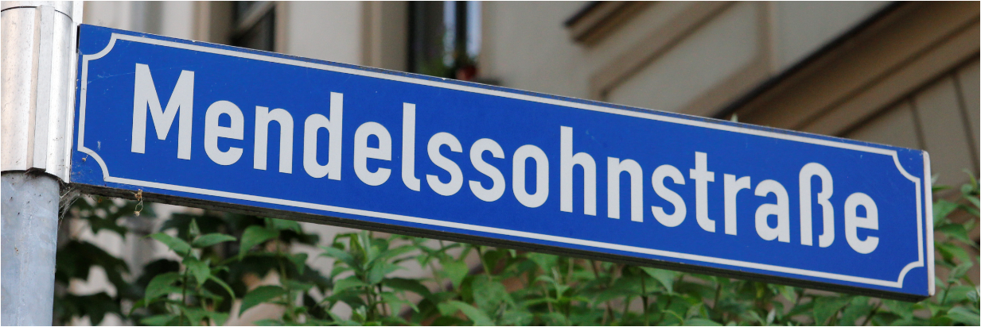
Arguments against street (re)naming
Moral ideological arguments (N=37, 24%)
Perceived need to encode / semiotically perpetuate certain referents (personages, values, dates, etc.) deemed important for the ideological needs of the present regime (see Fabiszak et al under review).
Institutionalisation of cultural memory:
Encoding of cultural and local values in urban space (i.e. music, art, folklore, see Assmann 2010)
N= 3
„Thus we were all baffled [by the suggested name change to Mercedes-Benz-Ring] because the name … would be better suited to Stuttgart, which is its home“
(interview with AB city council)
Notes:
Commemorative street (re -)naming results from the perceived need to encode and thus to semiotically perpetuate in the streetscape certain personages or values other ideological referents deemed important for the ideological needs of the present regime (see Fabiszak et al under review). The moral-ideological arguments in favour of commemorative street (re-)naming are well known, including the institutionalization of cultural memory (Assmann 2010) and the indexing of officially sanctioned identity and ideology (Scollon & Scollon 2003). Our analysis of press articles, interviews with city officials and interested citizens, in conjunction with the relevant literature on street name change juxtaposes this traditionalist point of view with a wealth of arguments contra commemorative street renaming which have been largely neglected in the relevant literature (see Pöppinghege 2012).

Slide 17
Arguments against street (re)naming
Moral ideological arguments (N=37, 24%)
Perceived need to encode / semiotically perpetuate certain referents (personages, values, dates, etc.) deemed important for the ideological needs of the present regime (see Fabiszak et al under review).
Institutionalisation of cultural memory:
Encoding of cultural and local values in urban space (i.e. music, art, folklore, see Assmann 2010)
Indexing of officially sanctioned identity and ideology:
Encoding of political-Weltanschauung / state ideologies in a larger scale (Scollon & Scollon 2003)
N= 3
N= 12
“There is no room for Arndt’s racist- and anti-semitic as well as nationalistic statements in our democratic body.” (LVZ ﻿10.09.2013)
Notes:
Commemorative street (re -)naming results from the perceived need to encode and thus to semiotically perpetuate in the streetscape certain personages or values other ideological referents deemed important for the ideological needs of the present regime (see Fabiszak et al under review). The moral-ideological arguments in favour of commemorative street (re-)naming are well known, including the institutionalization of cultural memory (Assmann 2010) and the indexing of officially sanctioned identity and ideology (Scollon & Scollon 2003). Our analysis of press articles, interviews with city officials and interested citizens, in conjunction with the relevant literature on street name change juxtaposes this traditionalist point of view with a wealth of arguments contra commemorative street renaming which have been largely neglected in the relevant literature (see Pöppinghege 2012).

Slide 18
Arguments against street (re)naming
Moral ideological arguments (N=37, 24%)
Perceived need to encode / semiotically perpetuate certain referents (personages, values, dates, etc.) deemed important for the ideological needs of the present regime (see Fabiszak et al under review).
Institutionalisation of cultural memory:
Encoding of cultural and local values in urban space (i.e. music, art, folklore, see Assmann 2010)
Indexing of officially sanctioned identity and ideology:
Encoding of political-Weltanschauung / state ideologies in a larger scale (Scollon & Scollon 2003)
Over- and under representation of groups and individuals:
Arguments that certain groups or individuals or events ought to be represented but have not been enough.
N= 3
N= 12
N= 6
“There are enough monuments in the city commemorating the events of fall 1989 in Leipzig, such as a part of the wall, the Bell of Democracy, the pillar in front of Nikolai Church and the Church itself.” (LVZ , 11.10.2011)
Notes:
Commemorative street (re -)naming results from the perceived need to encode and thus to semiotically perpetuate in the streetscape certain personages or values other ideological referents deemed important for the ideological needs of the present regime (see Fabiszak et al under review). The moral-ideological arguments in favour of commemorative street (re-)naming are well known, including the institutionalization of cultural memory (Assmann 2010) and the indexing of officially sanctioned identity and ideology (Scollon & Scollon 2003). Our analysis of press articles, interviews with city officials and interested citizens, in conjunction with the relevant literature on street name change juxtaposes this traditionalist point of view with a wealth of arguments contra commemorative street renaming which have been largely neglected in the relevant literature (see Pöppinghege 2012).

Slide 19
Arguments against street (re)naming
Moral ideological arguments (N=37, 24%)
Perceived need to encode / semiotically perpetuate certain referents (personages, values, dates, etc.) deemed important for the ideological needs of the present regime (see Fabiszak et al under review).
Institutionalisation of cultural memory:
Encoding of cultural and local values in urban space (i.e. music, art, folklore, see Assmann 2010)
Indexing of officially sanctioned identity and ideology:
Encoding of political-Weltanschauung / state ideologies in a larger scale (Scollon & Scollon 2003)
Over- and under representation of groups and individuals:
Arguments that certain groups or individuals or events ought to be represented but have not been enough.
Legimitization of instigators of change:
Those arguments when instigators have the legal power to change street names but citizens question this right of top down naming.
N= 3
N= 12
N= 6
N= 12
“The stubborn and arrogantly self-aggrandizing way in which the city council and administration cling to the name change is beyond comprehension.” (LVZ 19.12.2000)

Slide 20
Arguments against street (re)naming
Historical-preservative arguments (N= 17)
Arguments levelled in favour of a retaining traditional names
﻿“Lime boulevard is not simply a street name but a designation for a part of the cityscape. [The street] is lined by 4 rows of lime trees which mark the transition to the Marianne Park. Changing the street to Schoenefeld Boulevard is territorial, semantically totally erroneous and superfluous.“ (LVZ 19.12.2000)

Slide 21
Arguments against street (re)naming
Practical concerns (N= 108, 71%):
arguments related to the burden for individual citizens, businesses, city districts but also the town as a whole.
Notes:
The vast majority of arguments against street renaming reported in the Annaberg-Buchholz press are pragmatic-administrative in nature and as such not primarily concerned with commemoration. Apart from the cost of changing street signs – an imporant argument in towns as small as Annaberg-Buchholz (see (1)) – the act of renaming also incurs a significant adminstrative burden for businesses and private citizens situated on this partcular street, as expressed in example (2).
(1) Depending on the length and number of intersections of the respective street, the costs for new street signs in Annaberg-Buchholz can vary from 800 to 2000 Euros, not taking into account further costs for installation, material and administrative work such as updating plans and informing several further departments (p.c. Christian Sieber, Public construction office).
(2) “While it would be desirable to change the name into Felix-Weiße Straße, it would also mean unreasonable hardship for our citizens …. Identification, passports, addresses, documents, contracts etc….. This would be difficult to convey to citizens”.

Slide 22
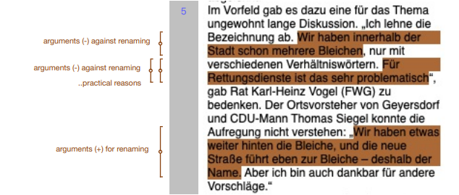
Arguments against street (re)naming
Practical concerns (N= 108, 71%):
Orientational aspects.
Avoidance of disorientation (for example after city expansions and planning strategies in Germany since WWII, see Sohn 2007).
→ two Goethestraße or two Bahnhofstraße ‘train stration street’.
N= 22
“Street remains nameless” Before that there was an unsually lengthy discussion about this topic. “I disapprove of the denomination. Within the city, we already have a few [streets called] bleachery, only with variable prepositions. This is very problematic for the emergency medical services” demurred councillor Heinz Vogel. The city councillor of Geyersdorf and CDU-politician Thomas Siegel could not understand the disconcertment. „We have further back the bleachery , and the new street leads there – hence the name. But I am grateful for other suggestions“.
Notes:
The vast majority of arguments against street renaming reported in the Annaberg-Buchholz press are pragmatic-administrative in nature and as such not primarily concerned with commemoration. Apart from the cost of changing street signs – an imporant argument in towns as small as Annaberg-Buchholz (see (1)) – the act of renaming also incurs a significant adminstrative burden for businesses and private citizens situated on this partcular street, as expressed in example (2).
(1) Depending on the length and number of intersections of the respective street, the costs for new street signs in Annaberg-Buchholz can vary from 800 to 2000 Euros, not taking into account further costs for installation, material and administrative work such as updating plans and informing several further departments (p.c. Christian Sieber, Public construction office).
(2) “While it would be desirable to change the name into Felix-Weiße Straße, it would also mean unreasonable hardship for our citizens …. Identification, passports, addresses, documents, contracts etc….. This would be difficult to convey to citizens”.

Slide 23
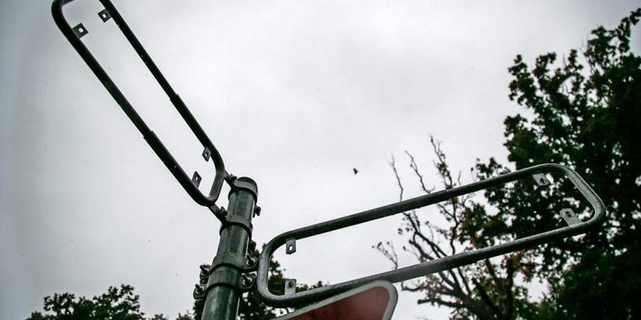
Arguments against street (re)naming
Practical concerns (N= 108, 71%):
Orientational aspects.
Cost of changing street signs: Imporant argument in small towns
“Depending on the length and number of intersections of the respective street, the costs for new street signs in Annaberg-Buchholz can vary from 800 to 2000 Euros, not taking into account further costs for installation, material and administrative work such as updating plans and informing several further departments”
(p.c. Christian Sieber, Public construction office).
N= 22
N= 17
Notes:
The vast majority of arguments against street renaming reported in the Annaberg-Buchholz press are pragmatic-administrative in nature and as such not primarily concerned with commemoration. Apart from the cost of changing street signs – an imporant argument in towns as small as Annaberg-Buchholz (see (1)) – the act of renaming also incurs a significant adminstrative burden for businesses and private citizens situated on this partcular street, as expressed in example (2).
(1) Depending on the length and number of intersections of the respective street, the costs for new street signs in Annaberg-Buchholz can vary from 800 to 2000 Euros, not taking into account further costs for installation, material and administrative work such as updating plans and informing several further departments (p.c. Christian Sieber, Public construction office).
(2) “While it would be desirable to change the name into Felix-Weiße Straße, it would also mean unreasonable hardship for our citizens …. Identification, passports, addresses, documents, contracts etc….. This would be difficult to convey to citizens”.

Slide 24
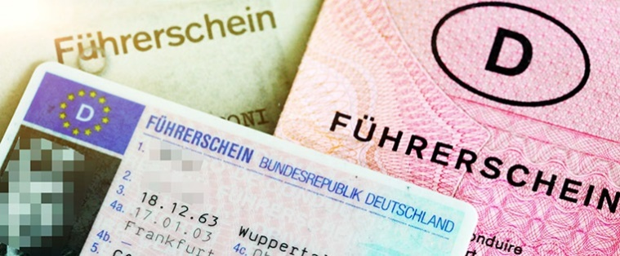
Arguments for and against street (re)naming
Practical concerns (N= 108, 71%):
Orientational aspects.
Cost of changing street signs: Imporant argument in small towns
Adminstrative burden
for businesses and private citizens situated on a particular street
“While it would be desirable to change the name into Felix-Weiße Straße, it would also mean unreasonable hardship for our citizens …. Identification, passports, addresses, documents, contracts etc….. This would be difficult to convey to citizens”.
N= 22
N= 17
N= 54
Notes:
The vast majority of arguments against street renaming reported in the Annaberg-Buchholz press are pragmatic-administrative in nature and as such not primarily concerned with commemoration. Apart from the cost of changing street signs – an imporant argument in towns as small as Annaberg-Buchholz (see (1)) – the act of renaming also incurs a significant adminstrative burden for businesses and private citizens situated on this partcular street, as expressed in example (2).
(1) Depending on the length and number of intersections of the respective street, the costs for new street signs in Annaberg-Buchholz can vary from 800 to 2000 Euros, not taking into account further costs for installation, material and administrative work such as updating plans and informing several further departments (p.c. Christian Sieber, Public construction office).
(2) “While it would be desirable to change the name into Felix-Weiße Straße, it would also mean unreasonable hardship for our citizens …. Identification, passports, addresses, documents, contracts etc….. This would be difficult to convey to citizens”.

Slide 25
Arguments against street (re)naming
Practical concerns (N= 108, 71%):
Orientational aspects.
Cost of changing street signs: Imporant argument in small towns
Adminstrative burden
for businesses and private citizens situated on a particular street
Avoidance of disgruntlements
and potential future complaints:
Complaint letters, citizen-led surveys and letters to newspaper editors:
Individuals, businesses or neighbourhood groups complain about specific persons being commemorated, often suggesting alternative candidates who they deem more suitable for this honour.
N= 22
N= 17
N= 54
N= 3
Notes:
The vast majority of arguments against street renaming reported in the Annaberg-Buchholz press are pragmatic-administrative in nature and as such not primarily concerned with commemoration. Apart from the cost of changing street signs – an imporant argument in towns as small as Annaberg-Buchholz (see (1)) – the act of renaming also incurs a significant adminstrative burden for businesses and private citizens situated on this partcular street, as expressed in example (2).
(1) Depending on the length and number of intersections of the respective street, the costs for new street signs in Annaberg-Buchholz can vary from 800 to 2000 Euros, not taking into account further costs for installation, material and administrative work such as updating plans and informing several further departments (p.c. Christian Sieber, Public construction office).
(2) “While it would be desirable to change the name into Felix-Weiße Straße, it would also mean unreasonable hardship for our citizens …. Identification, passports, addresses, documents, contracts etc….. This would be difficult to convey to citizens”.

Slide 26
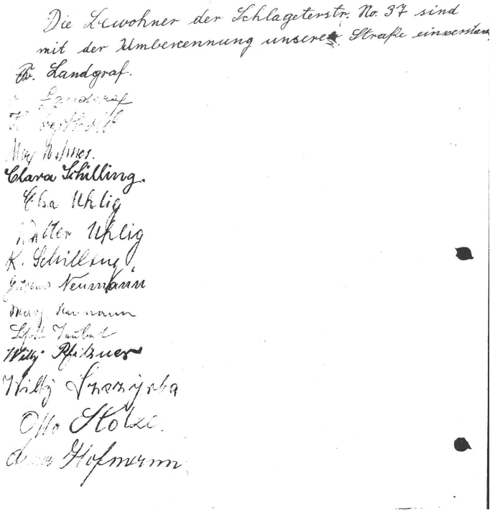
The name Schlageter Street is for the antifaschist West is a disgrace and an ingononymity….
Schlageter was one of the first Nazis.…
One of the first leaders and the best and most brave fighter in the battle against Hitler … was an inhabitant of this street, the metal worker, the former unionist, the saxonian regional councillor Georg Schwarz.
He epitomises the battle against Nazi terror and against these perpetrators. In this battle he was sentenced to death in Dresden and he died at the guillotine on 12. January 1944.

Slide 27
Arguments against street (re)naming
Practical concerns (N= 108, 71%):
Orientational aspects.
Cost of changing street signs: Imporant argument in small towns
Adminstrative burden
for businesses and private citizens situated on a particular street
Avoidance of disgruntlements
and potential future complaints:
Linguistic reasoning
Arguments related to pronunciation, practicability and semantics
N= 22
N= 17
N= 54
N= 3
N= 10
“If you already have to replace a short, concise and easily articulated street name
by a monstrosity of a word, at least be precise!” (LVZ, 05.09.2007)
Notes:
The vast majority of arguments against street renaming reported in the Annaberg-Buchholz press are pragmatic-administrative in nature and as such not primarily concerned with commemoration. Apart from the cost of changing street signs – an imporant argument in towns as small as Annaberg-Buchholz (see (1)) – the act of renaming also incurs a significant adminstrative burden for businesses and private citizens situated on this partcular street, as expressed in example (2).
(1) Depending on the length and number of intersections of the respective street, the costs for new street signs in Annaberg-Buchholz can vary from 800 to 2000 Euros, not taking into account further costs for installation, material and administrative work such as updating plans and informing several further departments (p.c. Christian Sieber, Public construction office).
(2) “While it would be desirable to change the name into Felix-Weiße Straße, it would also mean unreasonable hardship for our citizens …. Identification, passports, addresses, documents, contracts etc….. This would be difficult to convey to citizens”.

Slide 28
Arguments against street (re)naming
Practical concerns (N= 108, 71%):
Orientational aspects.
Cost of changing street signs: Imporant argument in small towns
Adminstrative burden
for businesses and private citizens situated on a particular street
Avoidance of disgruntlements
and potential future complaints:
Linguistic reasoning
Arguments related to pronunciation, practicability and semantics
Legal issues
N= 22
N= 17
N= 54
N= 3
N= 10
N= 2
“Ms Kruse is still alive and street renamings only take place after the death of a person.” (Bild, 28.11.2015)
Notes:
The vast majority of arguments against street renaming reported in the Annaberg-Buchholz press are pragmatic-administrative in nature and as such not primarily concerned with commemoration. Apart from the cost of changing street signs – an imporant argument in towns as small as Annaberg-Buchholz (see (1)) – the act of renaming also incurs a significant adminstrative burden for businesses and private citizens situated on this partcular street, as expressed in example (2).
(1) Depending on the length and number of intersections of the respective street, the costs for new street signs in Annaberg-Buchholz can vary from 800 to 2000 Euros, not taking into account further costs for installation, material and administrative work such as updating plans and informing several further departments (p.c. Christian Sieber, Public construction office).
(2) “While it would be desirable to change the name into Felix-Weiße Straße, it would also mean unreasonable hardship for our citizens …. Identification, passports, addresses, documents, contracts etc….. This would be difficult to convey to citizens”.

Slide 29
Arguments against street (re)naming
Concurrence of categories:
Practical concerns: Avoiding potential future complaints
Practical concerns: Cost
Practical concerns: Administrative burden
Practical concerns: Orientation
Overlap of categories:
Legimitization of instigators of change (LI)
Historical-preservative arguments (HP)
﻿“The street name change causes […] a lot of frustration: ‘We are carrying the costs of this commemoration’, states Anke Löser, whose flower shop now is not located on Beethovenstreet anymore. ‘That implies new stamps, letterheads. My husband, who owns an advertising agency next door had to contact 300 costumers because of the name change.’ Bothersome: While the old name is crossed out at the corner of Münzgasse, at the corner of Harkortstraße a clue of the new name is missing.” (LVZ 18.06.2003)
﻿”[Please let the people of Leipzig decide but do so in an appropriate manner … [and don’t just serve them historical half-facts and political exuberance.] _{HP} ] _{LI} ” (LVZ 05.09.2007)

Slide 30
Moral-Ideological arguments |  | Poland | Germany
 | a) Institutionalization of cultural memory: | X | 3
 | b) Indexing of off. sanctioned identity and ideology | X | 12
 | c) Over vs. under-representation | X | 6
 | f) Legitimization of instigators of change: argents |  | 12
instability | Ideological instability of streetnames | X | 4
Didactical | Streets as memorial | ? | 3
Historical- factual | Reversing / retaining traditional name |  | 17
Practical concerns | a) Cost of renamings | X | 17
 | b) Orientation aspects | - | 22
 | c) Administrative burden | ?? | 54
 | d) Avoidance of disgruntlement |  | 3
 | e) Linguistic reasons |  | 10
 | f) Legal issues |  | 2

Slide 31
Conclusions
Street renaming for commemorative purposes is a hegemonic process
“Ruptures in political history” (Arazyahu 1997:481)
→ “Battle for the representation” (Trumper-Hecht 2009: 238) of competing state ideologies
Different versions of history are replaced across time
subversive potential of street namings to create a “natural order of things” (Fairclough 2003:2).
Street names form an important part of “the ideological robe of the city” and can be used as a measurement of political change (Zieliński 1994:195).
Discourses surrounding commemorative street (re-)naming:
Historical record of memory creation.

Slide 32
Conclusions
Longitudinal case study of the discursive practices that accompany the ideological appropriation of the urban landscape for the purpose of constructing and reconstructing national identities (see Fabiszak et al. under review, Vuolteenaho and Berg 2016).
Complex and contested nature of the consecutive renaming processes:
Competing argumentation strategies result in complex decision-making practices concerning the inclusion or exclusion of commemorative semantics.
Analysist’s assumptions of what constitutes reasons for/against street naming might not be the same as a layperson’s rationale of their own semiotic practices.
Focus on arguments against (re-)namings:
Holistic understanding of the ways in which socio-political change is manifested and indeed accomplished through the representational choices encoded in the “ideological robe” of the city (Zieliński 1994:195).

Slide 33
Thanks to:
Our project partners:
Frauke Griese
Seraphim Alvanides
Malgorzata Fabiszak
Anna Brzezińska
Patryk Dobkiewicz
Annaberg-Buchholz and Leipzig city councillors, archivists, historians
Our funders:

Slide 34
Arguments for and against street (re)naming
Often overlap of categories:
Avoiding potential future complaints about the selection of street names
Adhering to moral-ideological mandate
Competition held in 1994 asking citizens for new street name ideas in AB.
Ideenwettbewerb zu neuen Straßen im Stadtgebiet.
Stadtanzeiger Annaberg-Buchholz, 02.06.1994.
More than 200 suggestions of names:
people who made contributions to the city historically
Reveals AB’s understanding of the ephemeral nature of what we consider “history”.

Slide 35
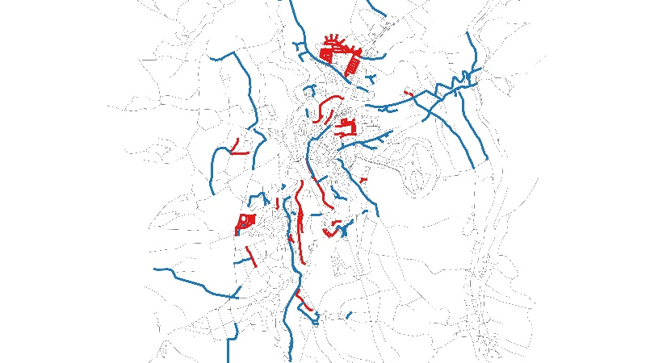
Lay concepts versus researchers‘ concepts ….
Interviews with Annaberg-Buchholz city officials: Ideological instability of streetnames
aims to purge ideology from the streetscape by avoiding personal names
The outcome of street
name changes since 1989
(red = ideological,
blue = non-ideological)
Attempt to avoid “overtly ideological street names” (p.c. AB councillor): Naming new streets after mining-related referents (Kobaltweg ‘Cobalt path‘ and Nickelweg ‘Nikel path‘, 1995)
These streets celebrate the regional cultural heritage & commemorate local cultural ideology and cultural authenticity (Vuolteenaho and Ainiala 2016, Fabiszak et al. under review)
marketing opportunity for planners and the tourism board (see Modan 2013).

Slide 36
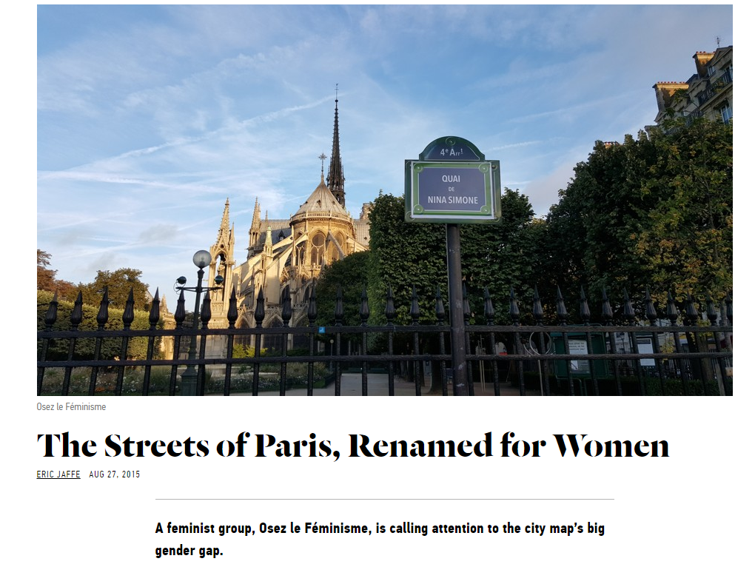
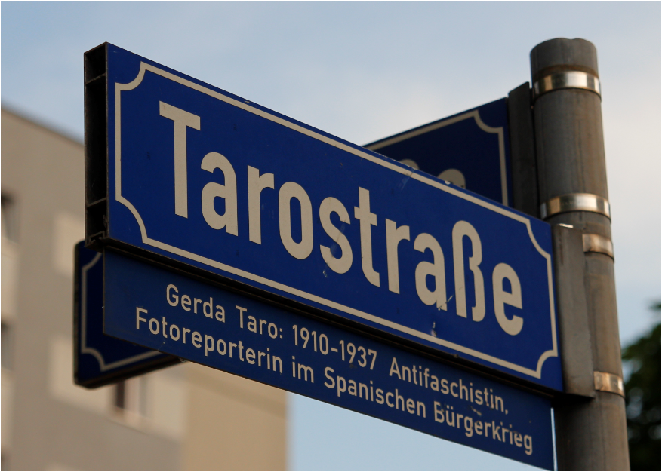
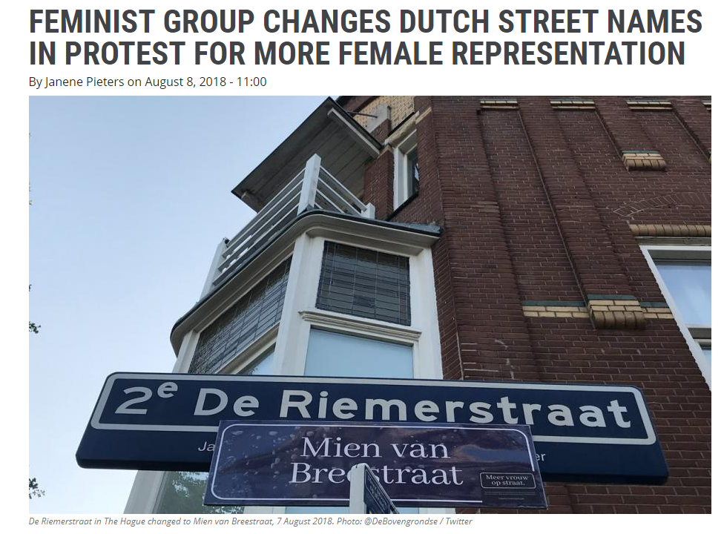
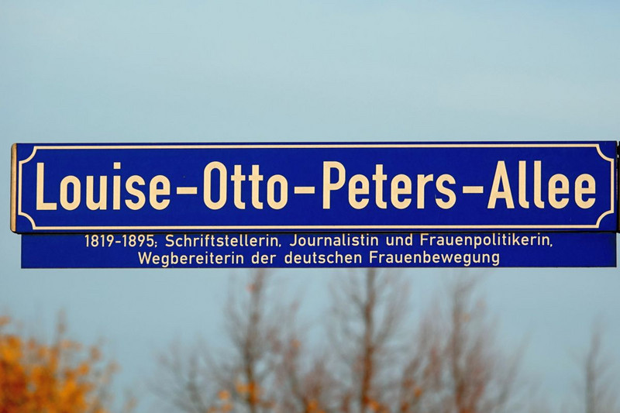

Slide 37
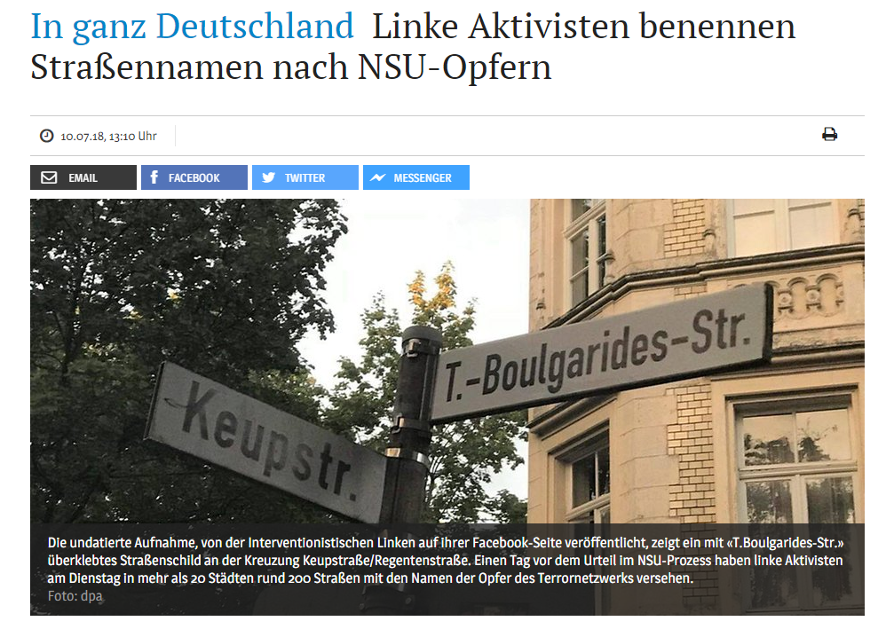
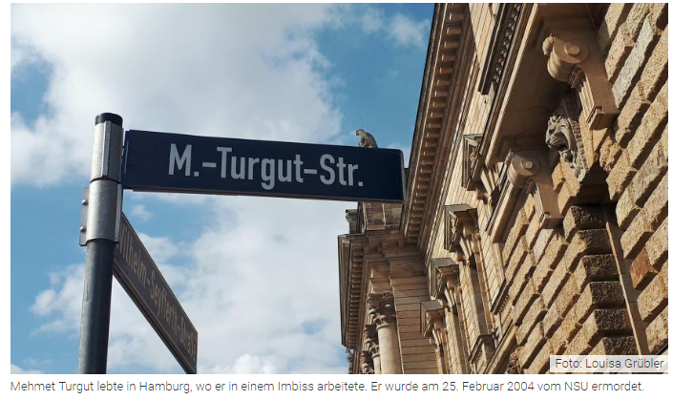
In the whole of Germany: Left activists are naming streets after the victims of the NSU

Slide 38
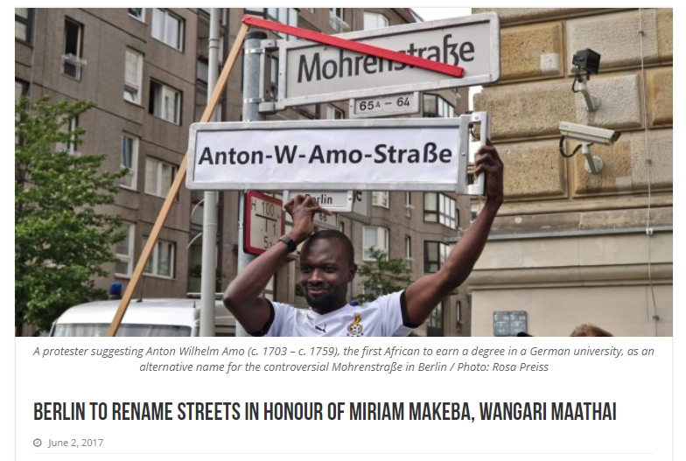

Slide 39
Arguments for and against street (re)naming
Pragmatic-administrative arguments
Not primarily concerned with commemoration.
Cost of changing street signs: Imporant argument in small towns
Adminstrative burden for businesses and private citizens situated on this partcular street, as expressed in example (2).
Orientational aspects play an important role.
Avoidance of disgruntlements and potential future complaints:
Orientational aspects tend to be used as arguments against street renaming.
Lion‘s share of arguments
Notes:
The vast majority of arguments against street renaming reported in the Annaberg-Buchholz press are pragmatic-administrative in nature and as such not primarily concerned with commemoration. Apart from the cost of changing street signs – an imporant argument in towns as small as Annaberg-Buchholz (see (1)) – the act of renaming also incurs a significant adminstrative burden for businesses and private citizens situated on this partcular street, as expressed in example (2).
(1) Depending on the length and number of intersections of the respective street, the costs for new street signs in Annaberg-Buchholz can vary from 800 to 2000 Euros, not taking into account further costs for installation, material and administrative work such as updating plans and informing several further departments (p.c. Christian Sieber, Public construction office).
(2) “While it would be desirable to change the name into Felix-Weiße Straße, it would also mean unreasonable hardship for our citizens …. Identification, passports, addresses, documents, contracts etc….. This would be difficult to convey to citizens”.

Slide 40
Arguments for and against street (re)naming
Moral ideological arguments:
Perceived need to encode / semiotically perpetuate certain referents (personages, values, dates, etc.) deemed important for the ideological needs of the present regime (see Fabiszak et al under review).
Arguments in favour of renaming:
Institutionalization of cultural memory (Assmann 2010)
Indexing of officially sanctioned identity and ideology (Scollon & Scollon 2003).
Representation of under-represented groups
Arguments against renaming: Retaining traditional names
Reticence of Nazi regime to change “good old German names that had grown over the years and commemorated German sons”
“Every old and historically meaningful denomination of streets, squares, bridges, houses and whole districts is to be protected in all cases and to be safeguarded, the more so the more unique and meaningful it is”. (1933)
Aim to enshrine the durability of its noble heritage in a stable, steadfast urban streetscape.
Notes:
Commemorative street (re -)naming results from the perceived need to encode and thus to semiotically perpetuate in the streetscape certain personages or values other ideological referents deemed important for the ideological needs of the present regime (see Fabiszak et al under review). The moral-ideological arguments in favour of commemorative street (re-)naming are well known, including the institutionalization of cultural memory (Assmann 2010) and the indexing of officially sanctioned identity and ideology (Scollon & Scollon 2003). Our analysis of press articles, interviews with city officials and interested citizens, in conjunction with the relevant literature on street name change juxtaposes this traditionalist point of view with a wealth of arguments contra commemorative street renaming which have been largely neglected in the relevant literature (see Pöppinghege 2012).

Slide 41
Arguments for and against street (re)naming
Moral ideological arguments:
Perceived need to encode / semiotically perpetuate certain referents (personages, values, dates, etc.) deemed important for the ideological needs of the present regime (see Fabiszak et al under review).
Arguments in favour of renaming:
Institutionalization of cultural memory (Assmann 2010)
Indexing of officially sanctioned identity and ideology (Scollon & Scollon 2003).
Representation of under-represented groups
Arguments against renaming: Retaining traditional names
Other arguments pro and contra commemorative street renaming have been largely neglected in the relevant literature (see Pöppinghege 2012).
Notes:
Commemorative street (re -)naming results from the perceived need to encode and thus to semiotically perpetuate in the streetscape certain personages or values other ideological referents deemed important for the ideological needs of the present regime (see Fabiszak et al under review). The moral-ideological arguments in favour of commemorative street (re-)naming are well known, including the institutionalization of cultural memory (Assmann 2010) and the indexing of officially sanctioned identity and ideology (Scollon & Scollon 2003). Our analysis of press articles, interviews with city officials and interested citizens, in conjunction with the relevant literature on street name change juxtaposes this traditionalist point of view with a wealth of arguments contra commemorative street renaming which have been largely neglected in the relevant literature (see Pöppinghege 2012).

Slide 42
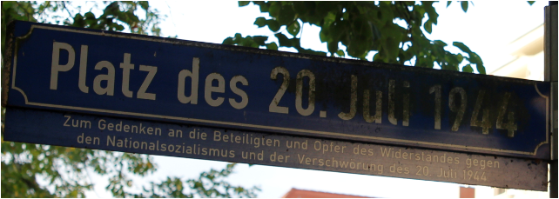
Arguments against street (re)naming
Didactical arguments (N=3)
Unreasonable to expect that passers-by reflect on the meaning of every street.
Didactical elements in commemorative street naming:
Many Eastern German cities add information plaques to their street signs
“… all streets that are named after persons should be fitted with a supplementary sign containing a short characterisation of the person concerned.” (AB city council decision 1945)
„Straßennamen haben nicht die Aufgabe, Geschichtsbücher zu ersetzen.”
(LVZ, 05.09.2007)
Notes:
Didactical arguments
he only candid way to address the issue of street naming is to confront rather than purge the commemorative remnants of one’s history. Taken to a moralising extreme, which we have not come across in Annaberg-Buchholz, this position results in the total rejection of street renaming as an attempt to do away with an uncomfortable era of history. However, as Pöppinghege (2012) points out, it is unreasonable to expect that passers-by or unsuspecting flâneurs would be reflective on the meaning of every street they happen to transverse, actively differentiating between commemoration and memorial. This is even less the case for GPS-navigated vehicles making their way through the traffic arteries. And while many Eastern German cities, including Annaberg-Buchholz, have resorted to adding information plaques to their street signs, we need to point out that it is impossible to provide this pedagogical contextualisation at every instance a pedestrian is entering a street (and this is less so the case with readers of navigation systems, address books etc.).
Didactical arguments in favour of retaining the streetscape to remind the public of the painful past are under-represented in present-day Annaberg-Buchholz . Note in this respect, however, that the avowedly anti-Nazi, anti-fascist stance of the GDR regime resulted in a street naming policy whereby persons who suffered as a consequence of their resistance to right-wing ideology have become prime targets for didactic commemoration. Hence, in contrast to Pöppinghege’s findings that didactical arguments tend to oppose street renaming, in Annaberg-Buchholz, they were given as a rationale for changes in public semioticisation. We illustrate this case with Kurt Löser, whose commemoration was amply justified by appealing to didactic arguments (example 4).
(4) “The city councillors’ meeting ((Stadtverordnetenversammlung)) decided on 28th November 1961] to rename Stalinplatz. At the same time, it decided to name this square after the Annaberg unionist and workers’ sportsman ((Arbeitersportler)) Kurt Löser …. In 1925 Kurt Löser became a member of the [communist] organisation ‘red worker’s children’ and he joined the communist youth federation. Kurt Löser became a member of the communist party in 1932 …. also as a dedicated footballer [he was] a member of the workers’ exercise and sports club. There he led the youth team. He greatly distinguished himself in the construction of the football pitch of the workers’ sports union ‘Storm 1939-Opp’ and during the construction of the swimming pool in the Humpe Valley. During Nazi times Kurt Löser remained true to the workers’ cause. After having been imprisoned several times, and having been sentenced to jail, the Gestapo sent him to the concentration camp Sachsenburg. Because he continued to be politically active, he received increased penalty in the so-called ‘sports commando’. On December 22, 1935, he contracted pneumonia as a result of the chicanery of [having to work] in the wet and cold snow drift, of which he died shortly after. The decision of the city councillors’ meeting to rename the hitherto Stalinpatz as Kurt-Löser-Kampfbahn was endorsed by the DTSB [German gymnastics and sports club] local committee. The sportsmen suggested further to instate a Kurt Löser commemoration sports event and to unveil a memorial stone. Kurt Löser’s brother … the approval of whom has been recently recorded, wrote ‘the naming of a sports ground as Kurt-Löser-Kampfbahn is a commitment of the sportsmen in the Annaberg local authority to pour all their energy into peacekeeping and into the defense of our DDR – if needs be with their life – as Kurt Löser has done in his fight against fascism’”.
As pointed out above, the didactical potential of such namings is reinformed by the decision to add – as much as feasible – explanatory information about the personage commemorated on a supplementary sign. Example (5) contains a relevant decision which was taken as early as 1945 by the Annaberg-Buchholz city council.
(5) “… all streets that are named after persons should be fitted with a supplementary sign containing a short characterisation of the person concerned.”
Note in this respect that didactic arguments, together with expository information, can already be found during the Nazi era. Example (6) illustrates the official state law which was issued by the Nazi government on 15th July 1939:
(6) “If possible, the sign is to have an explanation underneath the traditional street name so as to instruct the inhabitant as well as the foreigner of a piece of history of the respective city – such explanations are also requested for address books, but only if experts can provide a really reliable explanation for the street name.
“Die Stadtverordnetenversammlung faßte in ihrer Tagung am 28. November einen Beschluß, den Stalinplatz umzubenennen. Gleichzeitig wurde beschlossen, diesen Platz nach einem Annaberger Arbeitersportler, nämlich Kurt Löser, zu benennen. Kurt Löser wurde im April 1911 als Sohn eines Arbeiters in Geyersdorf geboren. Der Vater fiel 1916 in Frankreich. Die Mutter übersiedelte mit ihren Kindern nach Annaberg und bezog eine Wohnung in der Seminargasse. 1925 wurde Kurt Löser Mitglied der Organisation ‚Rote Arbeiterkinder‘ und 1928 trat er dem Kommunistischen Jugendverband bei. Mitglied der KPD wurde Kurt Löser 1932. Außerdem war er Mitglied der Roten Hilfe, der Roten Gewerkschaftsopposition und der Internationalen Arbeiterhilfe, sowie als begeisterter Fußballer Mitglied des Arbeiter-Turn- und Sportbundes. Dort führte er die Jugendmannschaft. Er erwarb sich große Verdienste beim Bau des Fußballplatzes des Arbeitersportvereins ‚Sturm 1939-Opp.‘ und beim Bau des Schwimmbades im Humpetal. Während der Nazizeit blieb Kurt Löser der Sache der Arbeiterklasse treu. Nachdem er mehrmals inhaftiert und zu Zuchthaus verurteilt wurde, schaffte ihn die Gestapo 1935 ins KZ Sachsenburg. Weil er auch dort politische Arbeit leistete, bekam er Strafverschärfung in dem sogenannten Sportkommando. Am 22. Dezember 1935 zog er sich als Folge der Schikanen im naß-kalten Schneetreiben eine Lungenentzündung zu, an deren Verlauf er innerhalb kürzester Zeit verstarb. Der Vorschlag der Stadtverordnetenversammlung, den bisherigen Stalinplatz in ‚Kurt-Löser-Kampfbahn‘ umzubenennen, fand die Zustimmung des DTSB-Kreisvorstandes. Die Sportler schlugen weiterhin vor, im kommenden Jahr ein Kurt-Löser-Gedächtnis-Sportfest durchzuführen und einen Gedenkstein zu enthüllen. Der in Ronneburg lebende Bruder von Kurt Löser, dessen Zustimmung zur Platzbenennung seit kurzer Zeit vorliegt, schrieb u.a.: ‚Die Benennung einer Sportstätte ‚Kurt-Löser-Kampfbahn‘ ist eine Verpflichtung der Sportler im Kreis Annaberg, ihre ganze Kraft für die Erhaltung des Friedens und Verteidigung unserer DDR einzusetzen – wenn es sein muß, mit dem Leben – wie es Kurt Löser im Kampf gegen den Faschismus tat‘.“ (Volksstimme 28.12.1961).
“… daß bei allen Straßen, die nach Personen benannt sind, Ergänzungsschilder mit kurzer Charakteristik über die betreffende Person angebracht werden.“ (source: Annaberg Buchholz und seine Straßennamen (1969). (In: Akten des Rates der Stadt Annaberg-Buchholz Hauptakten – Umbenennung von Straßen und Plätzen. Ergangen: 1945. Abt. Industrie und Verkehr. Aktenzeichen: Rep. V Lit. St Nr. 75 Bd. – . Locat III / 33 / 333 – Stadtarchiv Annaberg-Buchholz, p. 237)
“Unter dem alten Straßennamen wird auf dem Schilde möglichst eine Erklärung desselben angebracht und damit den Einheimischen wie den Fremden ein Stück Geschichte der Stadt vermittelt. – Auch für die Adreßbücher sind solche Erklärungen der Straßennamen erwünscht, aber nur dann, wenn Fachleute diese Erklärungen wirklich zuverlässig zu geben vermögen.“ (B No 2941 RdErl. Des RWdJ. Vom 15.7.1939 betreffend Ausf.-Anw. Zur BD. über die Benennung von Straßen, Plätzen und Brücken. V a 5141 IX 39-1002 B. – RMBliB. S. 1521. In: Sammlung von wichtigen Gesetzesabdrucken und Verordnungen des Deutschen Reichs. Ausgabe B. source: Akten des Rates der Stadt Annaberg – Straßenbenennung. Ergangen: 1933. Aktenzeichen: Rep. IV. Lit. St Nr. 363 Bd. I – Stadtarchiv Annaberg-Buchholz, p. 86)
Reference?
Under-represented in relation to what?
Compared to what Pöppinghege’s argument that these are found in parts of Westen Germany
Grundsätzliche Frage: Wie gehen wir damit um, wenn nur Teile des Originals übersetzt warden? Im Original dann auch die entsprechenden Teile weglassen (auch im Interesse nicht zu sehr ausufernder Fußnoten)?
Und wie halten wir es mit eher freien Übersetzungen (wie im Beispiel, das ich dem Original angepasst habe)?
Ja, im Original dann auch die Teile weglassen, da damit ja kein Erkenntnisgewinn verbunden ist
explain

Slide 43
Arguments against street (re)naming
Didactical arguments (N=3)
Unreasonable to expect that passers-by reflect on the meaning of every street.
Didactical elements in commemorative street naming:
Many Eastern German cities add information plaques to their street signs
“… all streets that are named after persons should be fitted with a supplementary sign containing a short characterisation of the person concerned.” (AB city council decision 1945)
“If possible, the sign is to have an explanation underneath the traditional street name so as to instruct the inhabitant as well as the foreigner of a piece of history of the respective city – such explanations are also requested for address books, but only if experts can provide a really reliable explanation for the street name”
(Official state law issued by the Nazi government on 15th July 1939)
Notes:
Didactical arguments
he only candid way to address the issue of street naming is to confront rather than purge the commemorative remnants of one’s history. Taken to a moralising extreme, which we have not come across in Annaberg-Buchholz, this position results in the total rejection of street renaming as an attempt to do away with an uncomfortable era of history. However, as Pöppinghege (2012) points out, it is unreasonable to expect that passers-by or unsuspecting flâneurs would be reflective on the meaning of every street they happen to transverse, actively differentiating between commemoration and memorial. This is even less the case for GPS-navigated vehicles making their way through the traffic arteries. And while many Eastern German cities, including Annaberg-Buchholz, have resorted to adding information plaques to their street signs, we need to point out that it is impossible to provide this pedagogical contextualisation at every instance a pedestrian is entering a street (and this is less so the case with readers of navigation systems, address books etc.).
Didactical arguments in favour of retaining the streetscape to remind the public of the painful past are under-represented in present-day Annaberg-Buchholz . Note in this respect, however, that the avowedly anti-Nazi, anti-fascist stance of the GDR regime resulted in a street naming policy whereby persons who suffered as a consequence of their resistance to right-wing ideology have become prime targets for didactic commemoration. Hence, in contrast to Pöppinghege’s findings that didactical arguments tend to oppose street renaming, in Annaberg-Buchholz, they were given as a rationale for changes in public semioticisation. We illustrate this case with Kurt Löser, whose commemoration was amply justified by appealing to didactic arguments (example 4).
(4) “The city councillors’ meeting ((Stadtverordnetenversammlung)) decided on 28th November 1961] to rename Stalinplatz. At the same time, it decided to name this square after the Annaberg unionist and workers’ sportsman ((Arbeitersportler)) Kurt Löser …. In 1925 Kurt Löser became a member of the [communist] organisation ‘red worker’s children’ and he joined the communist youth federation. Kurt Löser became a member of the communist party in 1932 …. also as a dedicated footballer [he was] a member of the workers’ exercise and sports club. There he led the youth team. He greatly distinguished himself in the construction of the football pitch of the workers’ sports union ‘Storm 1939-Opp’ and during the construction of the swimming pool in the Humpe Valley. During Nazi times Kurt Löser remained true to the workers’ cause. After having been imprisoned several times, and having been sentenced to jail, the Gestapo sent him to the concentration camp Sachsenburg. Because he continued to be politically active, he received increased penalty in the so-called ‘sports commando’. On December 22, 1935, he contracted pneumonia as a result of the chicanery of [having to work] in the wet and cold snow drift, of which he died shortly after. The decision of the city councillors’ meeting to rename the hitherto Stalinpatz as Kurt-Löser-Kampfbahn was endorsed by the DTSB [German gymnastics and sports club] local committee. The sportsmen suggested further to instate a Kurt Löser commemoration sports event and to unveil a memorial stone. Kurt Löser’s brother … the approval of whom has been recently recorded, wrote ‘the naming of a sports ground as Kurt-Löser-Kampfbahn is a commitment of the sportsmen in the Annaberg local authority to pour all their energy into peacekeeping and into the defense of our DDR – if needs be with their life – as Kurt Löser has done in his fight against fascism’”.
As pointed out above, the didactical potential of such namings is reinformed by the decision to add – as much as feasible – explanatory information about the personage commemorated on a supplementary sign. Example (5) contains a relevant decision which was taken as early as 1945 by the Annaberg-Buchholz city council.
(5) “… all streets that are named after persons should be fitted with a supplementary sign containing a short characterisation of the person concerned.”
Note in this respect that didactic arguments, together with expository information, can already be found during the Nazi era. Example (6) illustrates the official state law which was issued by the Nazi government on 15th July 1939:
(6) “If possible, the sign is to have an explanation underneath the traditional street name so as to instruct the inhabitant as well as the foreigner of a piece of history of the respective city – such explanations are also requested for address books, but only if experts can provide a really reliable explanation for the street name.
“Die Stadtverordnetenversammlung faßte in ihrer Tagung am 28. November einen Beschluß, den Stalinplatz umzubenennen. Gleichzeitig wurde beschlossen, diesen Platz nach einem Annaberger Arbeitersportler, nämlich Kurt Löser, zu benennen. Kurt Löser wurde im April 1911 als Sohn eines Arbeiters in Geyersdorf geboren. Der Vater fiel 1916 in Frankreich. Die Mutter übersiedelte mit ihren Kindern nach Annaberg und bezog eine Wohnung in der Seminargasse. 1925 wurde Kurt Löser Mitglied der Organisation ‚Rote Arbeiterkinder‘ und 1928 trat er dem Kommunistischen Jugendverband bei. Mitglied der KPD wurde Kurt Löser 1932. Außerdem war er Mitglied der Roten Hilfe, der Roten Gewerkschaftsopposition und der Internationalen Arbeiterhilfe, sowie als begeisterter Fußballer Mitglied des Arbeiter-Turn- und Sportbundes. Dort führte er die Jugendmannschaft. Er erwarb sich große Verdienste beim Bau des Fußballplatzes des Arbeitersportvereins ‚Sturm 1939-Opp.‘ und beim Bau des Schwimmbades im Humpetal. Während der Nazizeit blieb Kurt Löser der Sache der Arbeiterklasse treu. Nachdem er mehrmals inhaftiert und zu Zuchthaus verurteilt wurde, schaffte ihn die Gestapo 1935 ins KZ Sachsenburg. Weil er auch dort politische Arbeit leistete, bekam er Strafverschärfung in dem sogenannten Sportkommando. Am 22. Dezember 1935 zog er sich als Folge der Schikanen im naß-kalten Schneetreiben eine Lungenentzündung zu, an deren Verlauf er innerhalb kürzester Zeit verstarb. Der Vorschlag der Stadtverordnetenversammlung, den bisherigen Stalinplatz in ‚Kurt-Löser-Kampfbahn‘ umzubenennen, fand die Zustimmung des DTSB-Kreisvorstandes. Die Sportler schlugen weiterhin vor, im kommenden Jahr ein Kurt-Löser-Gedächtnis-Sportfest durchzuführen und einen Gedenkstein zu enthüllen. Der in Ronneburg lebende Bruder von Kurt Löser, dessen Zustimmung zur Platzbenennung seit kurzer Zeit vorliegt, schrieb u.a.: ‚Die Benennung einer Sportstätte ‚Kurt-Löser-Kampfbahn‘ ist eine Verpflichtung der Sportler im Kreis Annaberg, ihre ganze Kraft für die Erhaltung des Friedens und Verteidigung unserer DDR einzusetzen – wenn es sein muß, mit dem Leben – wie es Kurt Löser im Kampf gegen den Faschismus tat‘.“ (Volksstimme 28.12.1961).
“… daß bei allen Straßen, die nach Personen benannt sind, Ergänzungsschilder mit kurzer Charakteristik über die betreffende Person angebracht werden.“ (source: Annaberg Buchholz und seine Straßennamen (1969). (In: Akten des Rates der Stadt Annaberg-Buchholz Hauptakten – Umbenennung von Straßen und Plätzen. Ergangen: 1945. Abt. Industrie und Verkehr. Aktenzeichen: Rep. V Lit. St Nr. 75 Bd. – . Locat III / 33 / 333 – Stadtarchiv Annaberg-Buchholz, p. 237)
“Unter dem alten Straßennamen wird auf dem Schilde möglichst eine Erklärung desselben angebracht und damit den Einheimischen wie den Fremden ein Stück Geschichte der Stadt vermittelt. – Auch für die Adreßbücher sind solche Erklärungen der Straßennamen erwünscht, aber nur dann, wenn Fachleute diese Erklärungen wirklich zuverlässig zu geben vermögen.“ (B No 2941 RdErl. Des RWdJ. Vom 15.7.1939 betreffend Ausf.-Anw. Zur BD. über die Benennung von Straßen, Plätzen und Brücken. V a 5141 IX 39-1002 B. – RMBliB. S. 1521. In: Sammlung von wichtigen Gesetzesabdrucken und Verordnungen des Deutschen Reichs. Ausgabe B. source: Akten des Rates der Stadt Annaberg – Straßenbenennung. Ergangen: 1933. Aktenzeichen: Rep. IV. Lit. St Nr. 363 Bd. I – Stadtarchiv Annaberg-Buchholz, p. 86)
Reference?
Under-represented in relation to what?
Compared to what Pöppinghege’s argument that these are found in parts of Westen Germany
Grundsätzliche Frage: Wie gehen wir damit um, wenn nur Teile des Originals übersetzt warden? Im Original dann auch die entsprechenden Teile weglassen (auch im Interesse nicht zu sehr ausufernder Fußnoten)?
Und wie halten wir es mit eher freien Übersetzungen (wie im Beispiel, das ich dem Original angepasst habe)?
Ja, im Original dann auch die Teile weglassen, da damit ja kein Erkenntnisgewinn verbunden ist
explain

Slide 44
Moral-Ideological arguments |  | Poland | Germany
 | a) Institutionalization of cultural memory: | X | 3
 | b) Indexing of officially sanctioned identity and ideology | X | 12
 | c) Over vs. under-representation of groups / individuals: | X | 6
 | d) Reversing the erasure of memory/ideology: | X
 | e) Retaining memory/ideology:
 | f) Legitimization of instigators of change: argents |  | 12
insta bility | Ideological instability of streetnames | X | 4
Dida ctical | Streets as memorial | ? | 3
Historical- factual | a) Reversing traditional name | X | 17
 | b) Retaining traditional name
Practical concerns | a) Cost of renamings | X | 17
 | b) Orientation aspects | - | 22
 | c) Administrative burden | ?? | 54
 | d) Avoidance of disgruntlement |  | 3
 | e) Linguistic reasons |  | 10
 | f) Legal issues |  | 2

