Slide 1

Exploring the commemorative streetscape through time and space
Malgorzata Fabiszak, Seraphim Alvanides,
Patryk Dobkiewicz and Isabelle Buchstaller

Slide 2
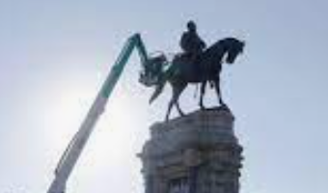
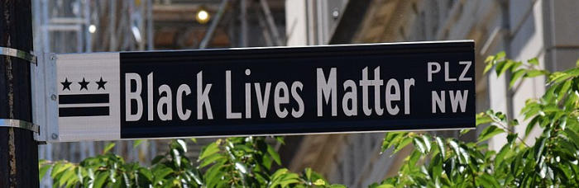
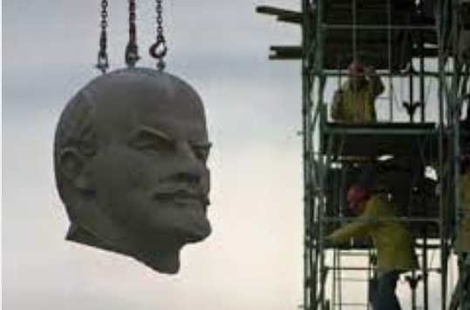
Introduction
#BlackLivesMatter:
Potent symbolism of commemoration as it is inscribed in the public cityscape.
debates about memorial hegemony in the citytext
public elimination of discredited ideology functions as a mechanism to obliterate the geographical traces of “the memory [and the legacy] of ... [a] former [world view and/or] regime” (Azaryahu 2012:387).
Most vivid turnover in the commemorative landscape at cusp of change in state ideology:
Civic linguistic acts of renaming simultaneously
demonstrate and contribute to the end of one bygone era
and the beginning of a new one.

Slide 3
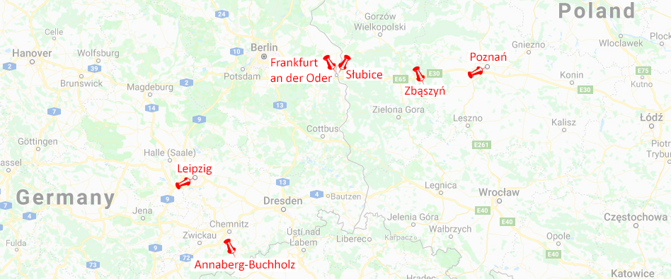
Introduction
Comparative analysis of changes in state-ideological identity politics in public space
Ongoing revision of the “ideological robe of the city” Zieliński (1994)
Two large regional centres:
Poznań (Poland):
pop, 535,000
2,582 streets
Leipzig (Germany):
pop. 587,000
2,325 streets

Slide 4
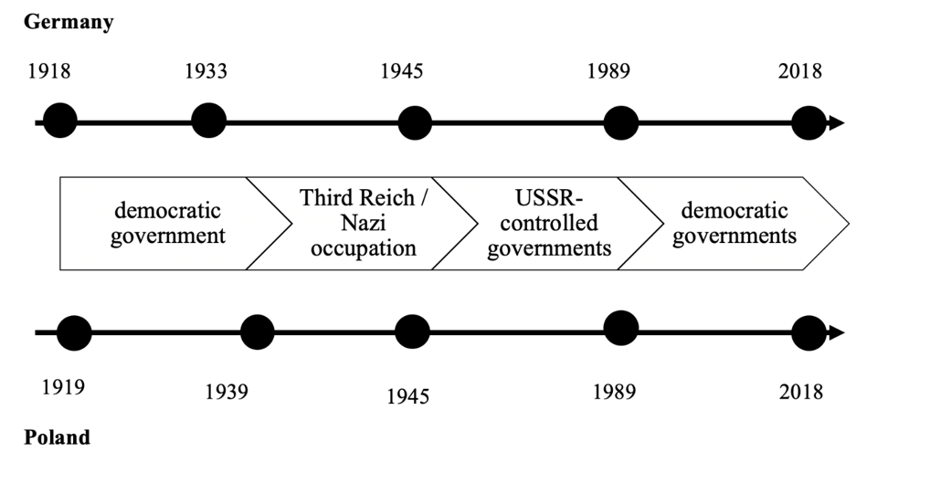
Introduction
Comparative analysis of changes in state-ideological identity politics in public space.
Ongoing revision of the “ideological robe of the city” Zieliński (1994)
Time: 1916-2016
East Germany
Poland
→ Analysis of "waves of renaming that sweep across ... the linguistic landscape" (Arazyahu 1986:590)

Slide 5
Commemorative street (re)naming
Street names
“site[s] of memory” (Winter 1998:102) our city, of its past and its destiny.
“Whether they remind us of activities since disappeared, whether they commemorate important events in our history or pay homage to exceptional people, street and square names are fraught with significance” (Moszberger et al. 2002:5)
Street names show “which visions of history are …. inscribed” (Azaryahu 2012:388) in public naming
Notes:
Umbenennung von städtischen Merkmalen (Brücken, Straßen, Stadtteile, sogar ganze Städte) als Konsequenz solcher Verschiebungen der Weltanschauung.
Kommemorative Umbenennungen sind ein wirksamer Mechanismus der Auslöschung der Erinnerung an des frühere Regime.
Spuren der nationalen Vergangenheit kanonisieren, die "die hegemoniale sozio-politische Ordnung unterstützen" (Azaryahu 1997:480)
„Aktives vergessen“ (Assman 2010)

Slide 6
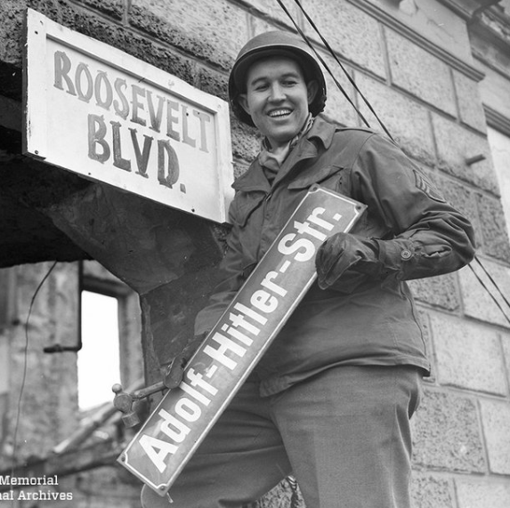
Commemorative street (re)naming
Street names
Research on politically-ideologically motivated (re)naming practices that examines the “wave[s] of renamings that swept” through time and space (Azaryahu 1986:590, Pavlenko and Mullen 2015).
Ruptures in political history (Azaryahu 1997:481).
Different commemorative needs of the new present which are played out in civic space
Commemorative renaming obliterates “the memory of the former
regime. [The public elimination of] the discredited past
from the public sphere demonstrate[s] the end of [one regime]
… and the beginning of a new era.” (Arazyahu 2012:387).
"Active forgetting" (Assman 2010, Mitchell 2003)
“Repressive erasure” (Connerton 2008)
Notes:
Umbenennung von städtischen Merkmalen (Brücken, Straßen, Stadtteile, sogar ganze Städte) als Konsequenz solcher Verschiebungen der Weltanschauung.
Kommemorative Umbenennungen sind ein wirksamer Mechanismus der Auslöschung der Erinnerung an des frühere Regime.
Spuren der nationalen Vergangenheit kanonisieren, die "die hegemoniale sozio-politische Ordnung unterstützen" (Azaryahu 1997:480)
„Aktives vergessen“ (Assman 2010)

Slide 7
Commemorative street (re)naming
Different versions of history encoded in street names and replaced across time: subversive potential of street names
→ natural order of things implanted into public memory.
Azaryahu (1986:581-7): streets are “propaganda carriers [since] … major political
changes are reflected in the renaming of streets”.
Overall objectives:
comparative analysis of naming practices in the streetscapes of Leipzig and Poznań through a century characterised by consecutive waves of political transformation
1) What were the longitudinal patterns of ideological and non-ideological changes in street names in Leipzig and Poznań between 1916-2018?
2) In which ways does the spatial distribution of street name changes in Leipzig and Poznań between 1916-2018 contribute to ongoing memory making via street names?

Slide 8
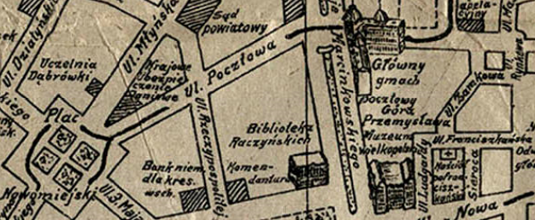
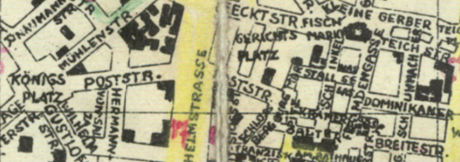
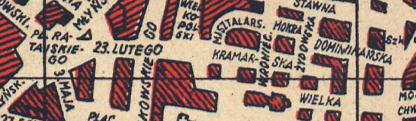
Project data and methods
Multidisciplinary approach: linguistic landscape research, collective memory studies and geographical information systems (Rose-Redwood et al. 2010).
to uncover the spatio-temporal patterns of change in the street renaming practices
to identify the spread of the ideologically marked cityscape in Leipzig and Poznań

Slide 9
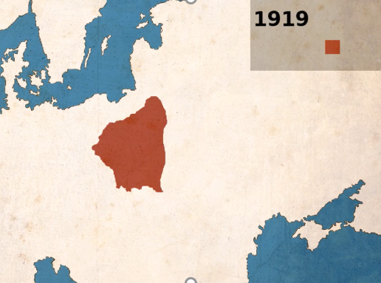


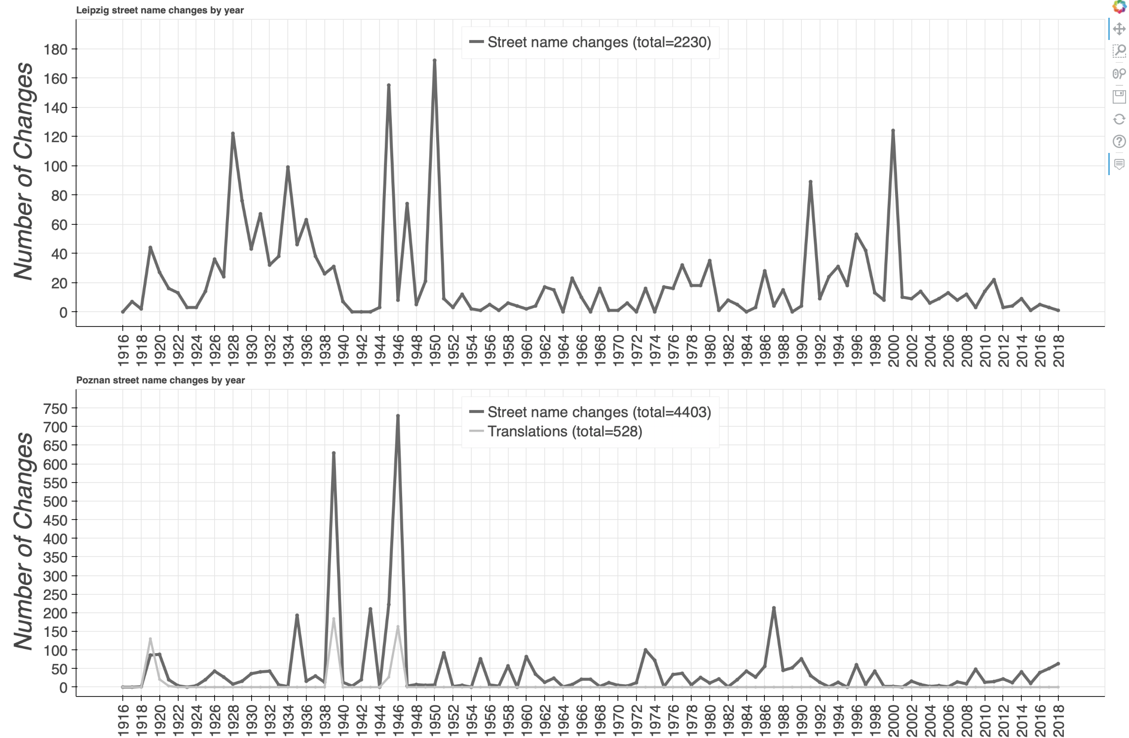
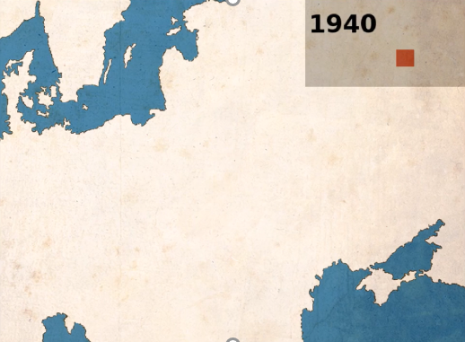
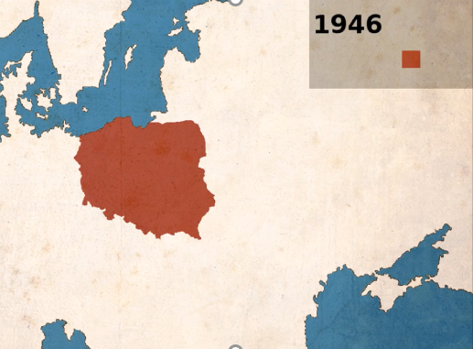
End of
WWI
Nazi
era
End of
WWII
Fall of Berlin wall
and transformation
x
Poznań
*
*
Leipzig
Magnitude of change
x
Poznań
Poznań
x
Poznań
Changes in
ethnolinguistic identity
*Peaks are at least partly due to urban expansion

Slide 10
End of
WWI
Nazi
era
End of
WWII
Fall of Berlin wall
and transformation
x
Poznań
*
*
Leipzig
Magnitude of change
x
Poznań
Poznań
x
Poznań
Changes in
ethnolinguistic identity
Unproblematic semantics
→ Word by word translations
Kiebitzstrasse “Lapwing Street” > ul. Czajcza “Lapwing Street”
Am Tempel “By the synagogue” > Bóżnicza “Synagogue Street”
Ringchaussee “Ring Road” > Szosa Okrężna “Ring Road”.

Slide 11
End of
WWI
Nazi
era
End of
WWII
Fall of Berlin wall
and transformation
x
Poznań
*
*
Leipzig
1919
44 changes
Magnitude of change
x
Poznań
1919
86 changes
130 translations
Poznań
x
Poznań
Changes in
ethnolinguistic identity
Problematic semantics
→ Change in denotation
Bismarckstrasse > ul. Kantaka (19th c. social activist)
Schillerpark > Park Marcinkowskiego (19th c. doctor)
Beethoven Allee > ul. Władysława Reymonta (writer, Nobel prize winner)

Slide 12
End of
WWI
Nazi
era
End of
WWII
Fall of Berlin wall
and transformation
x
Poznań
*
*
Leipzig
1919
44 changes
Magnitude of change
x
Poznań
1919
86 changes
130 translations
Poznań
x
Poznań
Changes in
ethnolinguistic identity

Slide 13
Project data and methods
Multidisciplinary approach, integrating insights from linguistic landscape research, collective memory studies and geographical information systems (Rose-Redwood et al. 2010).
Old street name New street name | Street Semantics
Ø → Am Teich (‚at the pond‘, naming: 1994) | XN
Ø → Straße der Solidarität (‚of solidarity‘ naming: 1982) | XI
Nordstraße (‚north street‘) → Hindenburgstraße (renaming: 1930) | NI
Hindenburgstraße → Friedrich-Ebert-Straße (renaming: 1945) | II
Drosselstraße (‚thush‘) → Goldammerstraße (‚yellowhammer‘ renaming: 1997) | NN
Adolf-Hitlerstraße → Südstraße (‘south street’, renaming: 1945) | IN
Moszberger, Rieger and Daul (2002:5): street names are “carriers of … collective memory”
Lefebvre (1991:54): "a social transformation, to be truly revolutionary in character, must ... show effects on daily life, on language, and on space.“

Slide 14
Absolute changes in Leipzig street names over 102 years
*
*
1919
44 changes

Slide 15
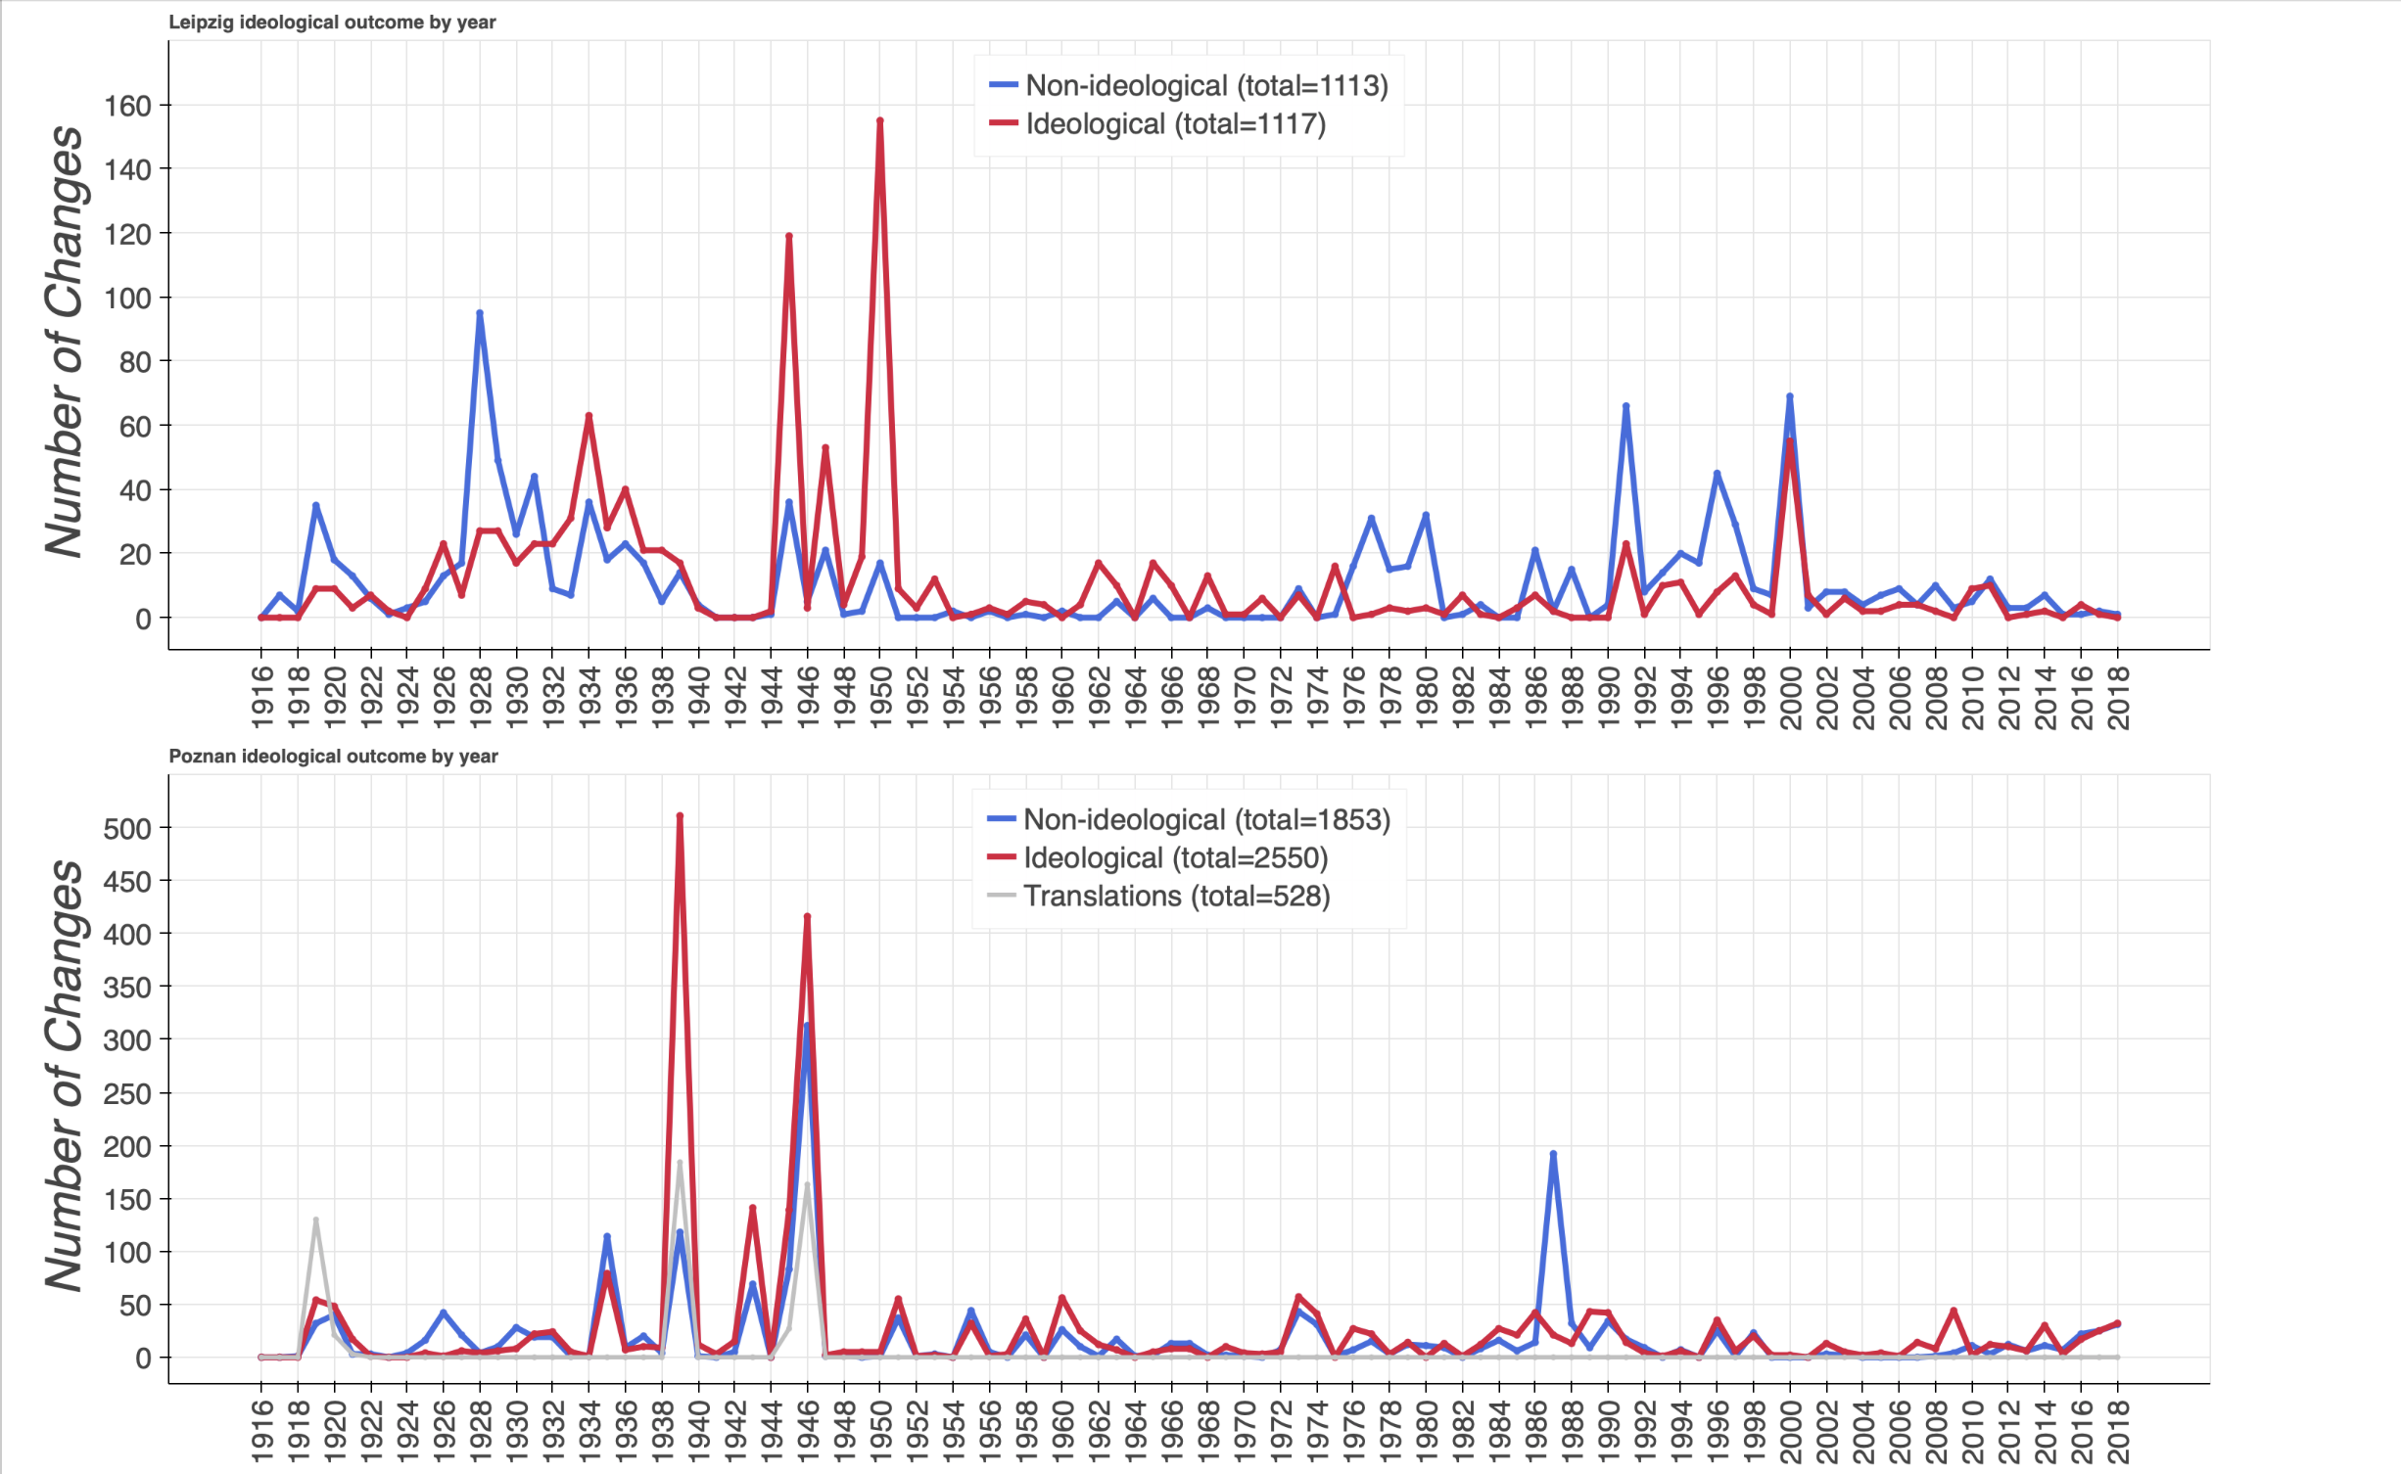
Ideological renaming by year
Leipzig
Successive regimes support hegemonic public memory and identity formation by inscribing and effectively canonising events, people, places as traces of the national past.
“Wave[s] of renamings that swept” through time and space in the Eastern European streetscapes (Azaryahu 1986:590).
end of WWII
Wende
end of WWI
Nazi era
Transformation
GDR
end of WWII
Poznań
end of WWI
Nazi era
PPR
Transformation

Slide 16
Ideological renaming by year
Leipzig
Weimar Republic: 16 years
III. Reich: 11 years
GDR: 44 years
Post-1989: 29 years
end of WWII
Wende
end of WWI
Nazi era
Transformation
GDR
end of WWII
2. Republic: 20 years
Nazi occupation: 5 years
Communist era: 44 years
Post-1989: 29 years
Poznań
end of WWI
Nazi era
PPR
Transformation

Slide 17
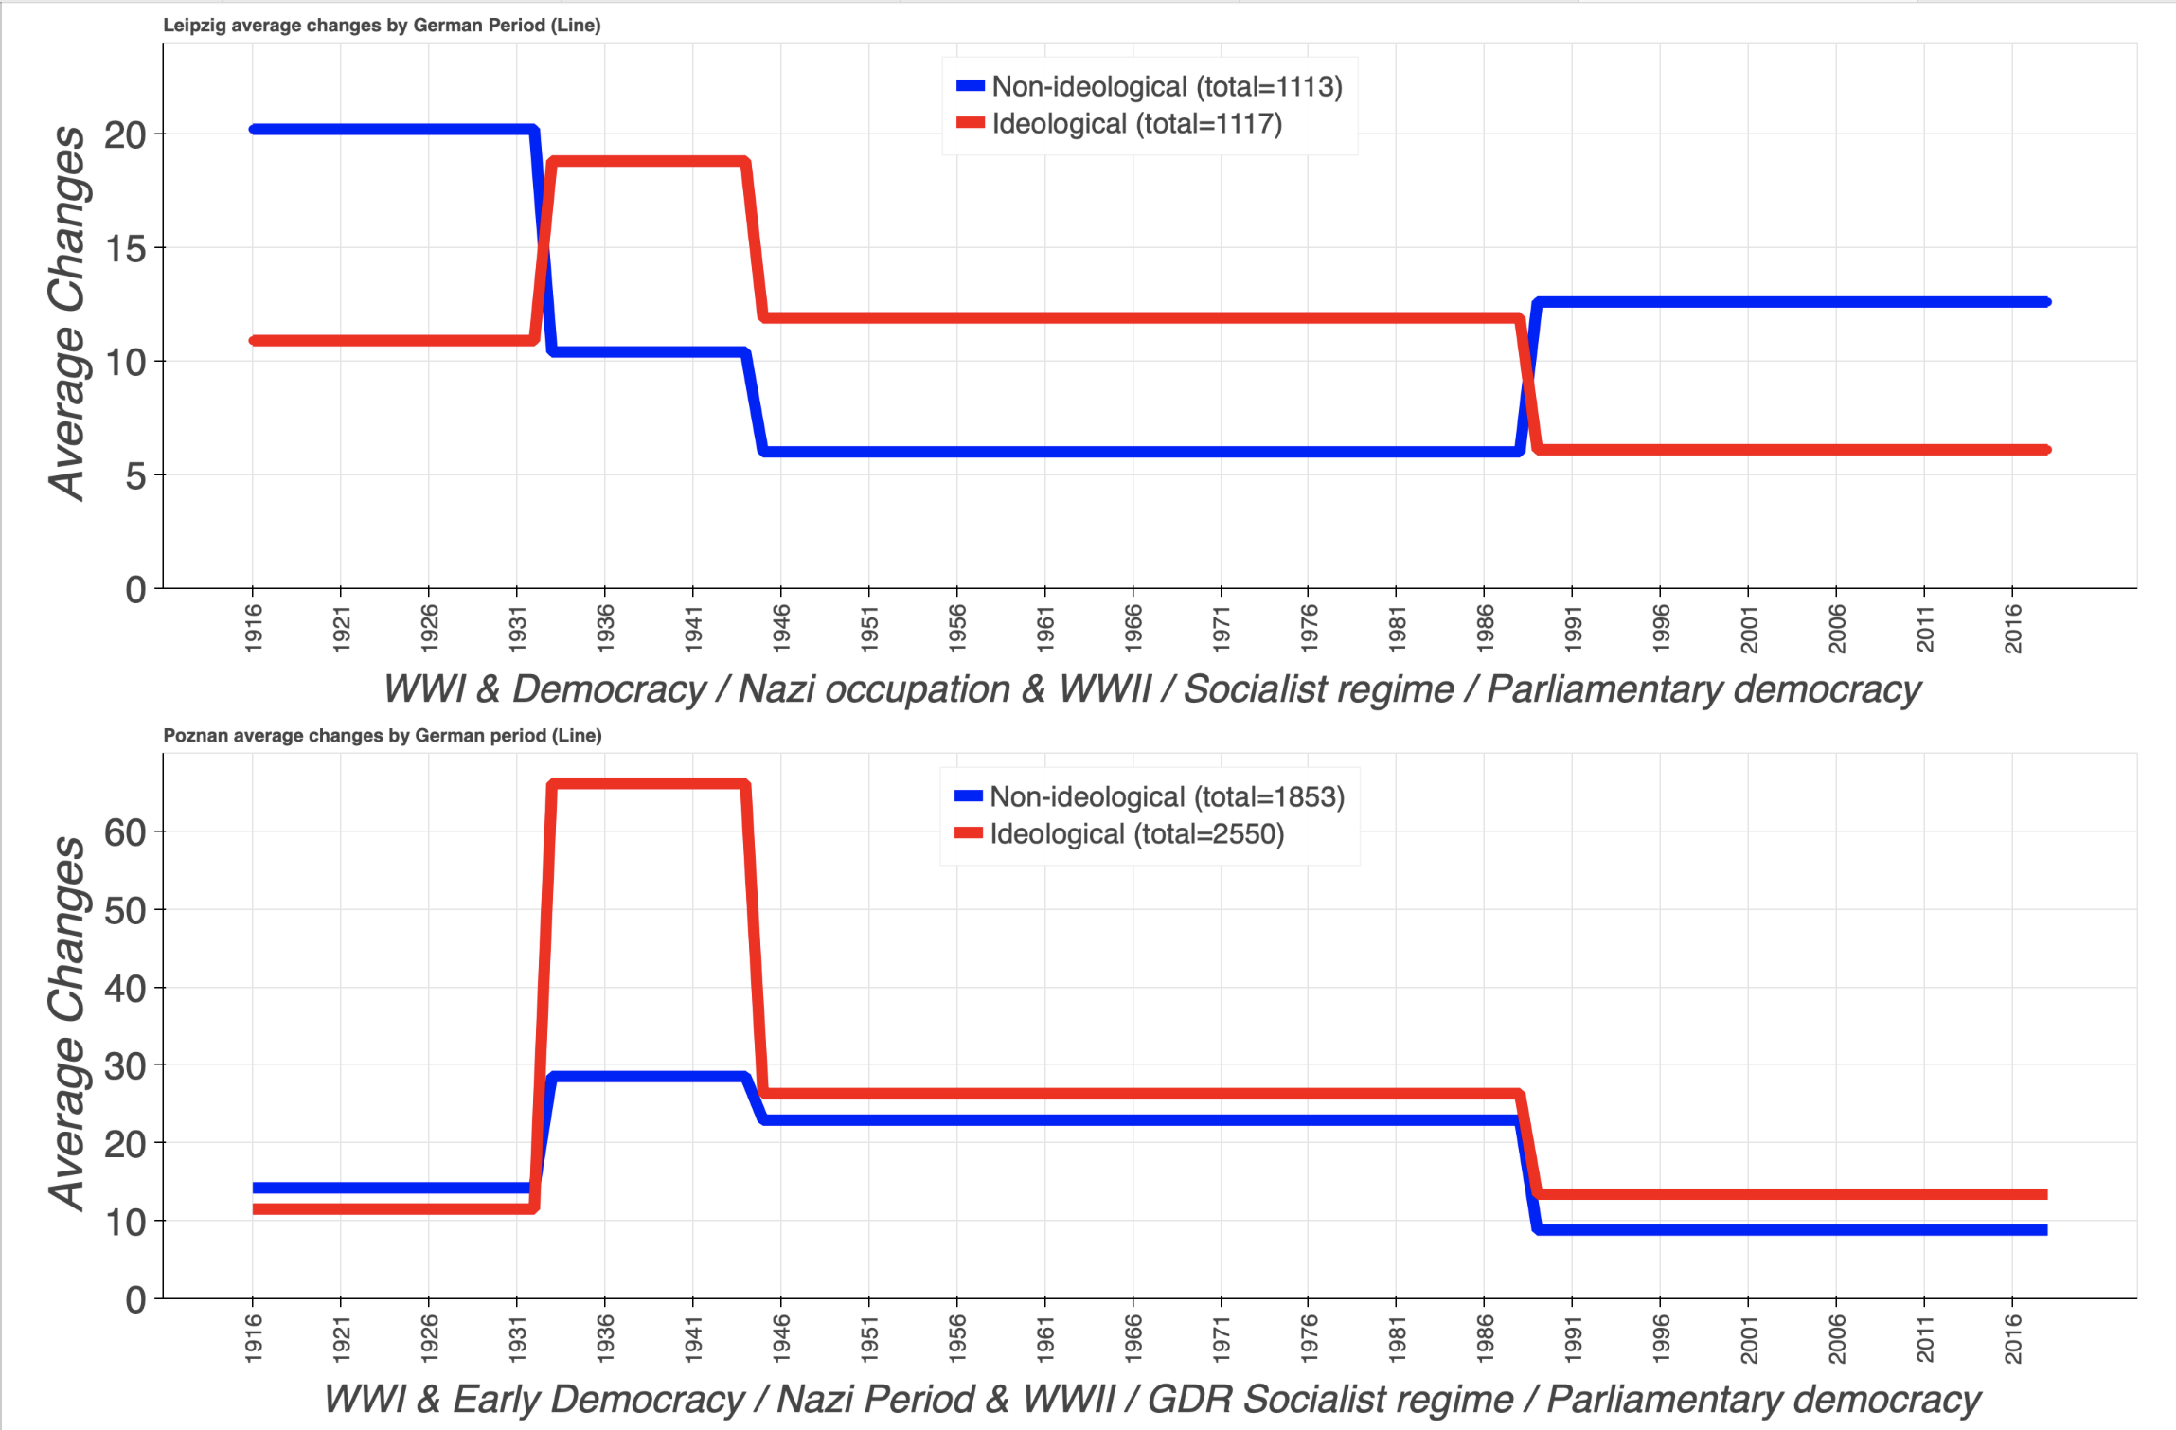
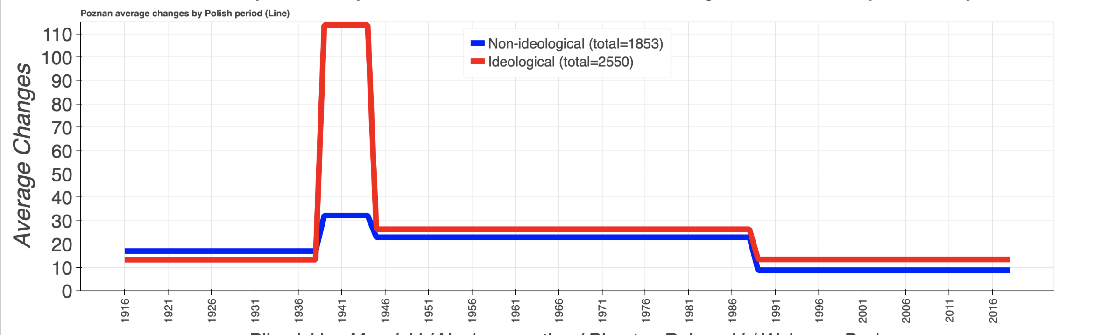
Average number of (re)namings by outcome
(normalised by length of regime in years)
Leipzig
Poznań

Slide 18
Average number of (re)namings by outcome
(normalised by length of regime in years)
Leipzig
Poznań

Slide 19
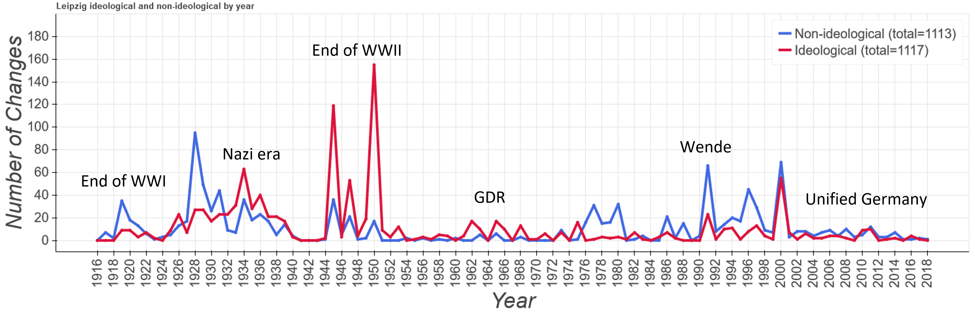
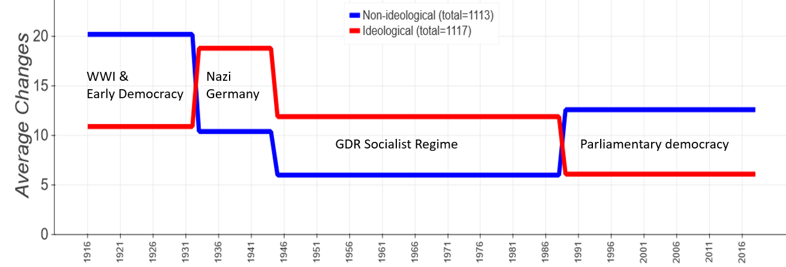
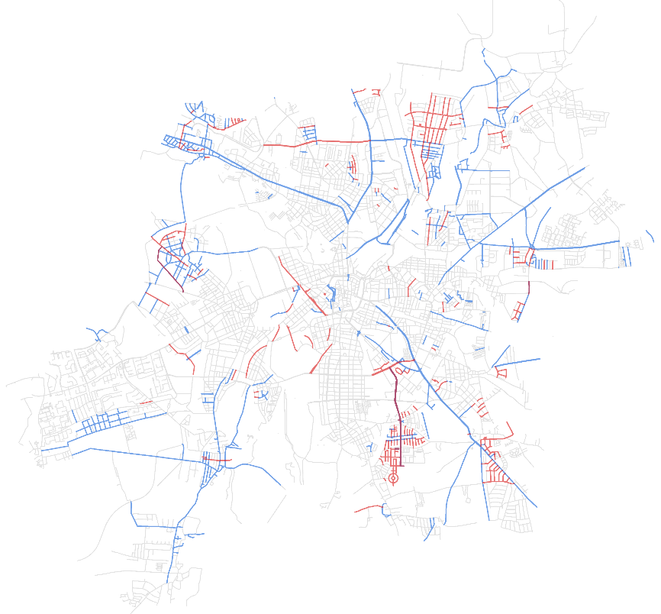
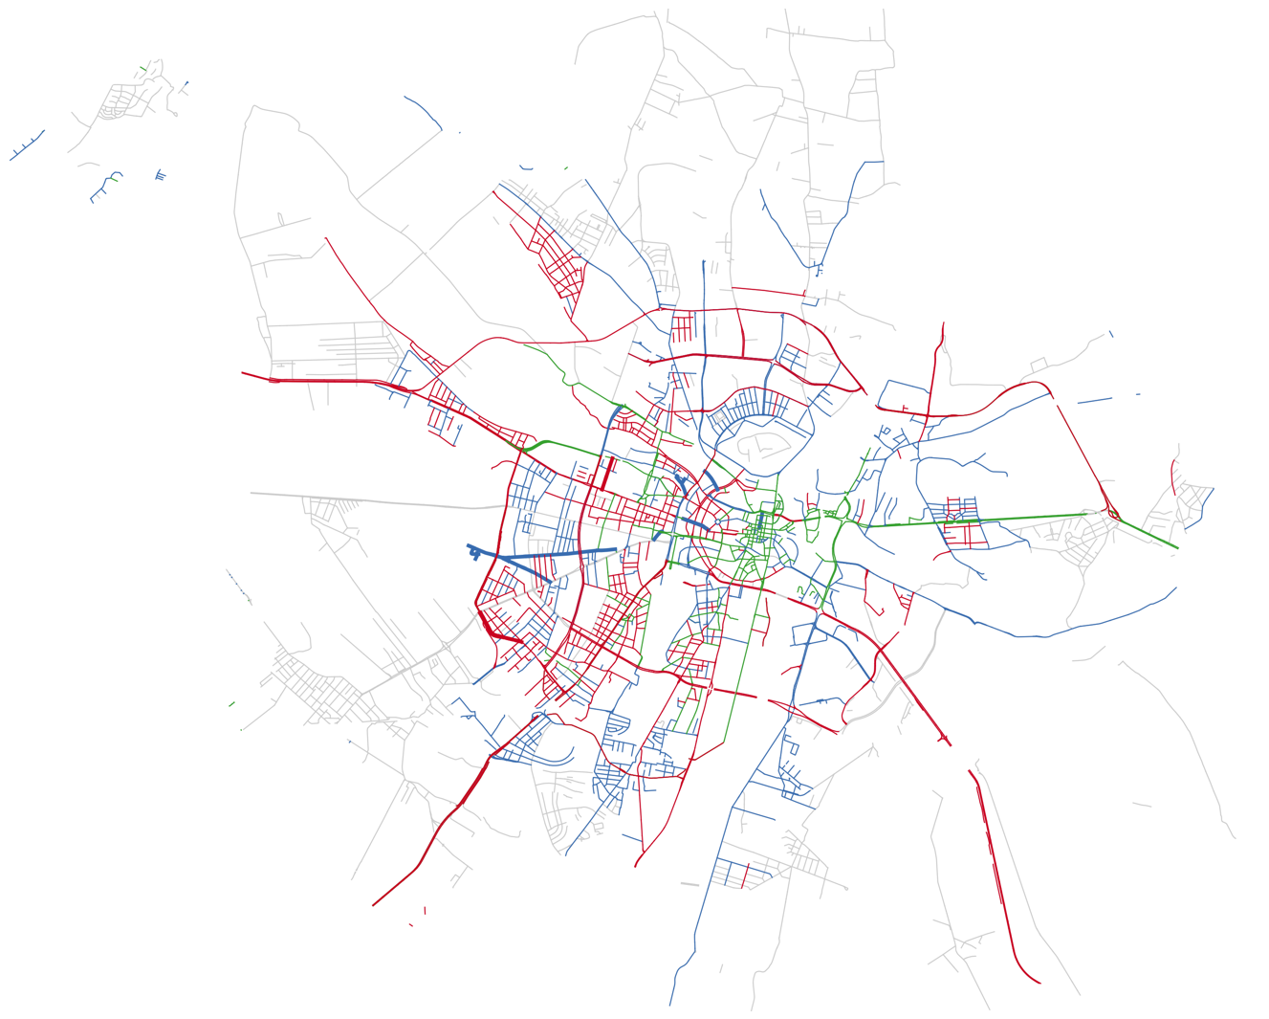
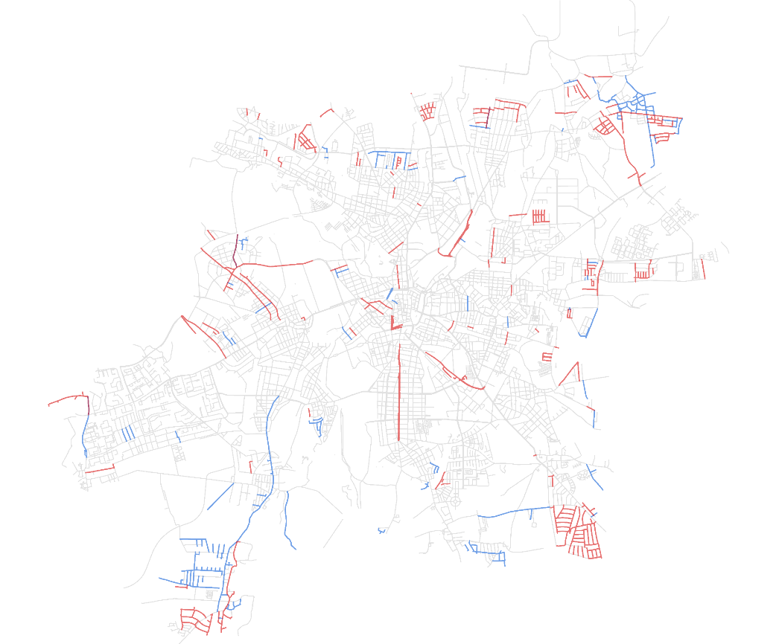
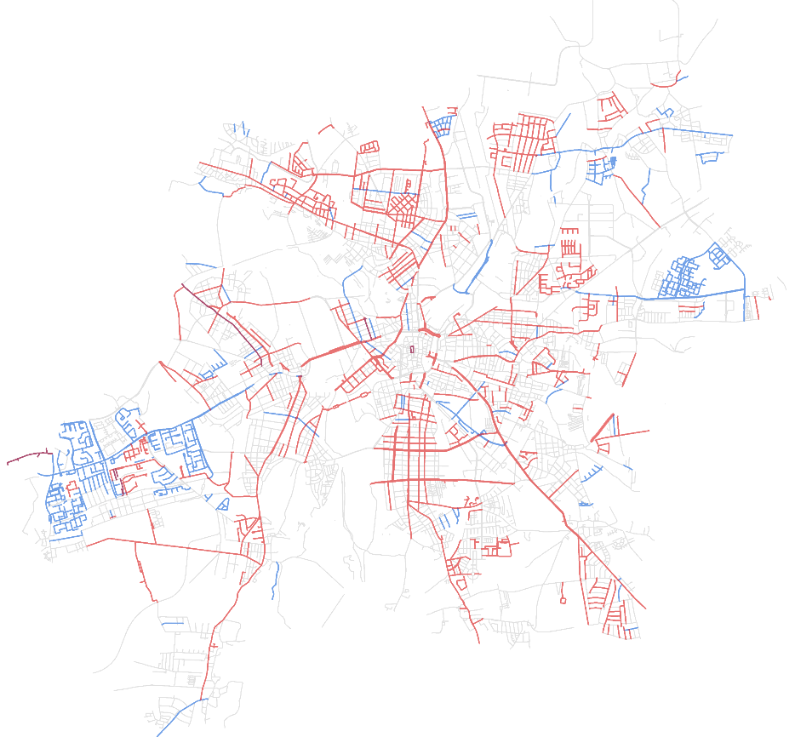
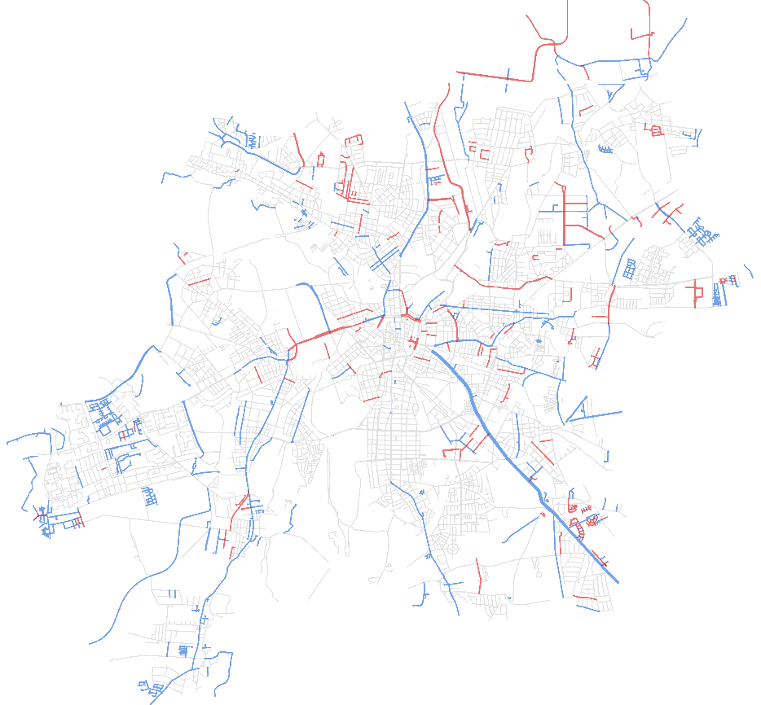
Temporal vs spatial visualisations -- Leipzig
1919 -1932
1933 -1944
1945 -1988
1989 - 2018

Slide 20
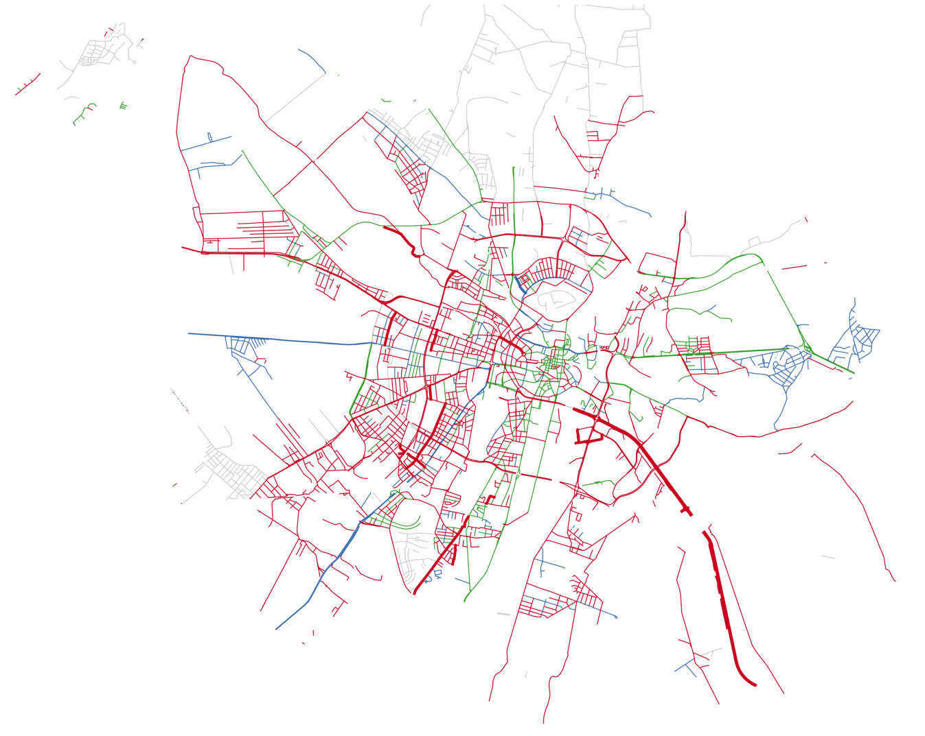
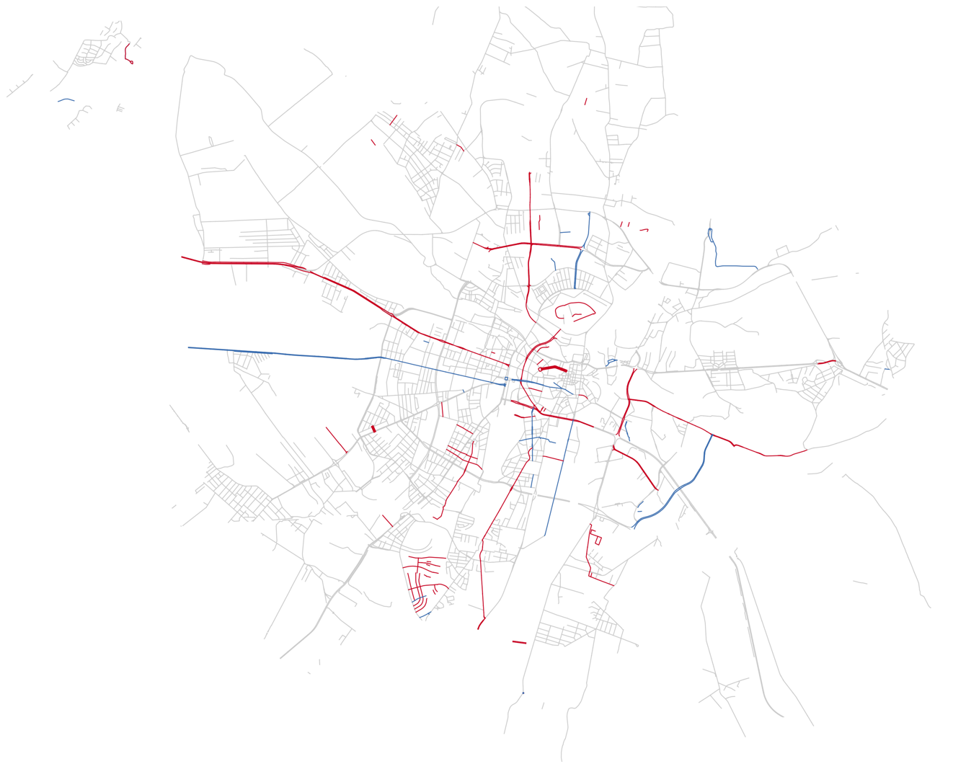
Temporal vs spatial visualisations -- Poznań
Changes in official language/
Ethnolinguistic orientation
Poznań
Polish
→German
German
→ Polish
German
→ Polish
Halbwachs (1925): social frame of reference of memory
1919 -1932
1939 -1944
1945 -1988
1989 - 2018

Slide 21
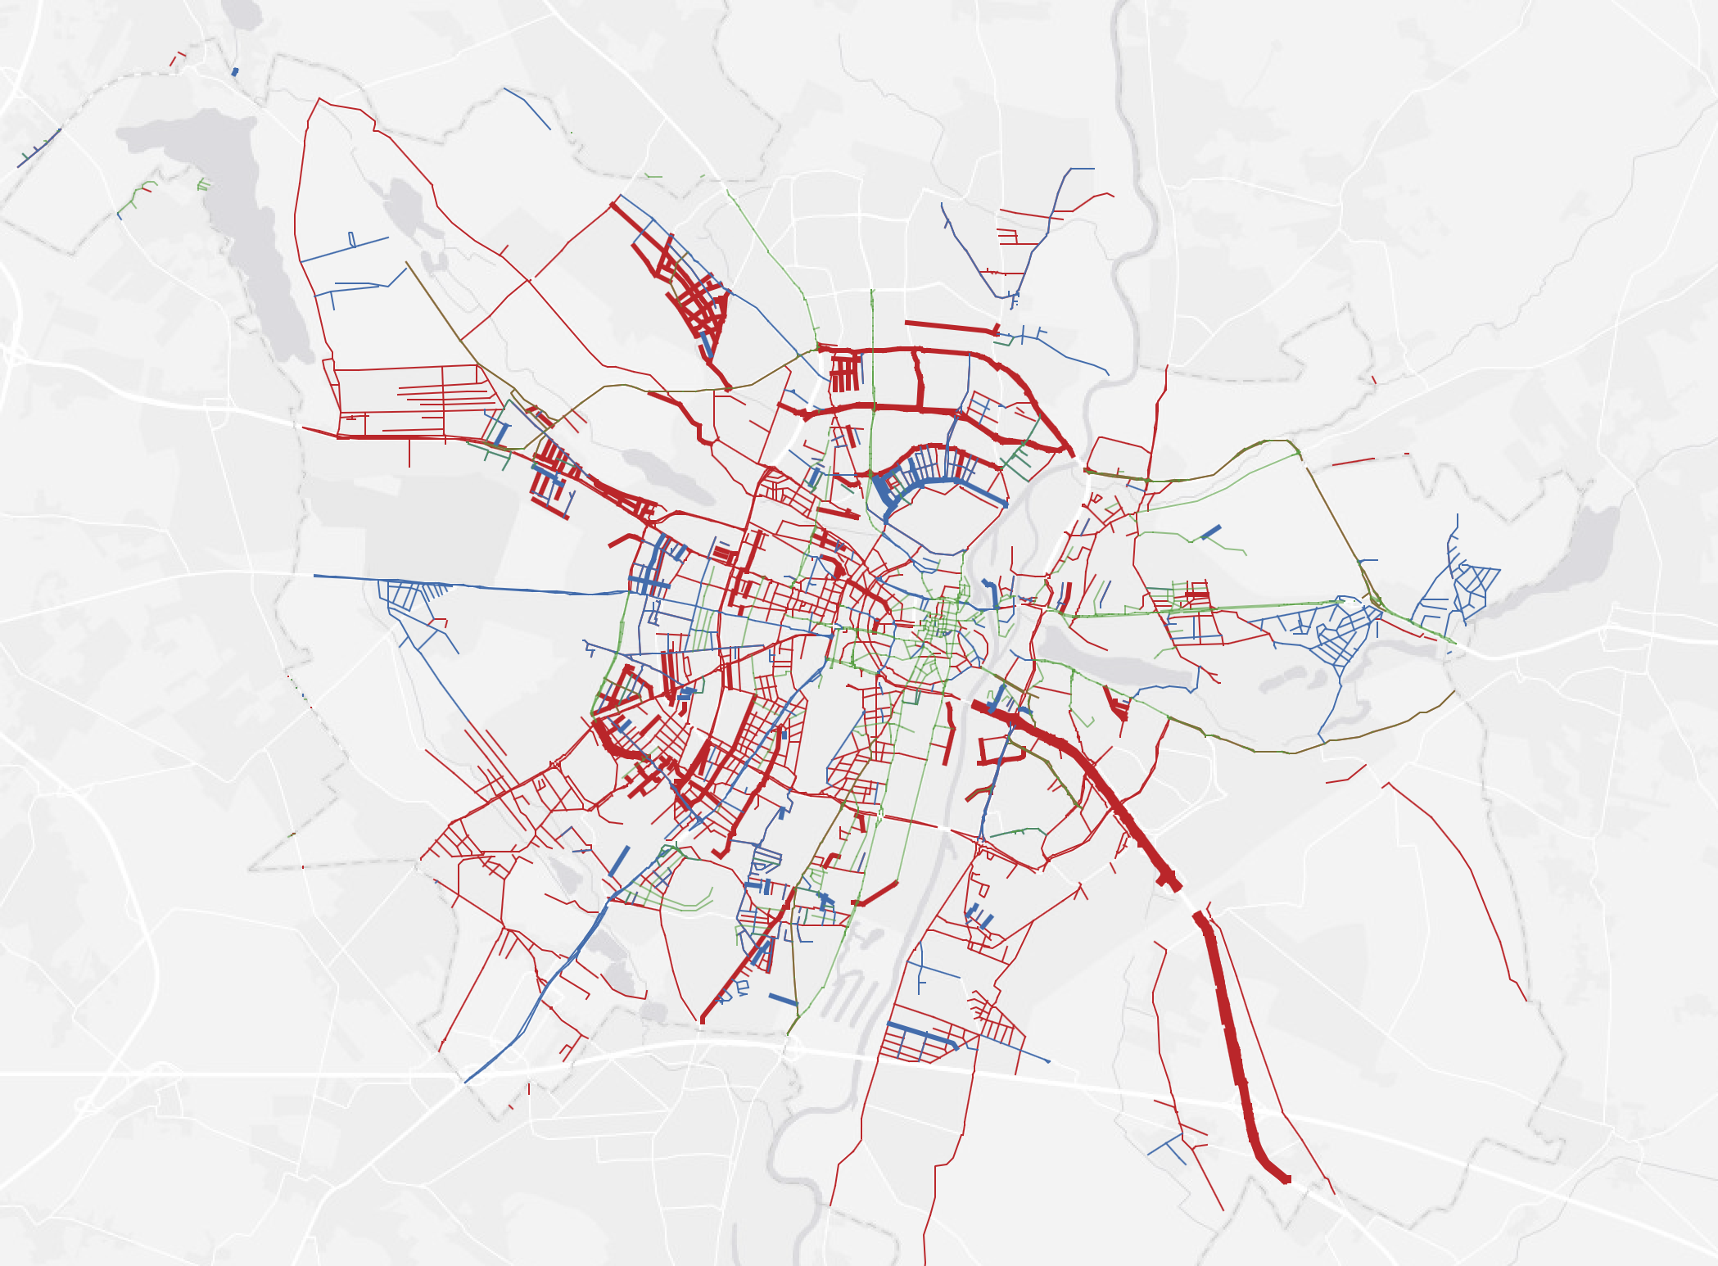
Nazi era at home and in the occupied territories
Leipzig (1933-1945)
N=351 changes
Poznań (1939-1945)
N=875

Slide 22
Poznań: additional variables in renamings:
National identity and language change
Change in official language/
Ethnolinguistic orientation
1916-1921
1921-1939
Prussian street names
Pattern I: translation into Polish
Badegasse > ulica Łazienna ‘Bath Street’
Pattern II: semantic change
Bismarckstrasse ‘Bismarck’s Street’ (first chancellor of post WWI Germany) > ulica Kantaka (Polish 19th century politician and activist)

Slide 23
Poznań: additional variables in renamings:
National identity and language change
Change in official language/
Ethnolinguistic orientation
1916-1921
1921-1939
Prussian street names
Pattern I: translation into Polish
Badegasse > ulica Łazienna ‘Bath Street’
Pattern II: semantic change
Bismarckstrasse ‘Bismarck’s Street’ (first chancellor of post WWI Germany) > ulica Kantaka (Polish 19th century politician and activist)
 | 1920-1921 Prussian >Polish
Pattern I: Translation | 111 (43%)
Pattern II: Semantic change | 146 (57%)
Total Ns | 257

Slide 24
Poznań: additional variables in renamings:
National identity and language change
Change in official language/
Ethnolinguistic orientation
1916-1921
1921-1939
Prussian street names
Pattern I: translation into Polish
Badegasse > ulica Łazienna ‘Bath Street’
Pattern II: semantic change
Bismarckstrasse ‘Bismarck’s Street’ (first chancellor of post WWI Germany) > ulica Kantaka (Polish 19th century politician and activist)
 | 1920-1921 Prussian >Polish
Pattern I: Translation | 111 (43%)
Pattern II: Semantic change | 146 (57%)
Total Ns | 257

Slide 25
Poznań: additional variables in renamings:
National identity and language change
Change in official language/
Ethnolinguistic orientation
Change in official language/
Ethnolinguistic orientation
1916-1921
1921-1939 →
1939-1944
Pattern I: translation into German
ul. Łazienna > Badegasse ‚Bath Street‘
Pattern II: semantic change
ul. Augusta Cieszkowskiego
> Dietrich-Eckhart-Strasse
Pattern III: recommemoration
Goethestrasse> ul. Marii Konopnickiej
> Goethestrasse
Prussian street names
Pattern I: translation into Polish
Badegasse > ul. Łazienna ‘Bath Street’
Pattern II: semantic change
Bismarckstrasse > ul. Kantaka
348 streets
 | 1920-1921 Prussian >Polish | 1939 Polish > Nazi
Pattern I: Translation | 111 (43%) | 175 (23%)
Pattern II: Semantic change | 146 (57%) | 502 (64%)
Pattern III: Reversal |  | 103 (13%)
Pattern I: Translation | 23.4% | 175
Pattern II: Semantic change | 64.3% | 502
Pattern III: Reversal | 13.2% | 103
Total Ns |  | 780

Slide 26
Poznań: additional variables in renamings: national identity and language change
1916-1921
1921-1939
1939-1944
No time for this unfortunately … we are already over time
I will delete the slide unless you insist … but then something else will need to go
Prussian street names
> renaming into Polish
(translation and change)
> new Polish names
> renaming Polish back to Prussian
> changing back to Prussian
> renaming new Polish to Nazi
Street name change | Change | Transl. | Total | % of change
1921 from Prussian to Polish | 166 | 149 | 315* | 53%
1919 Prussian to 1939 Nazi German | 134 | 191 | 325* | 41%
1939 Polish to Nazi German | 346 | 105 | 451 | 77%
*These two numbers should be identitcal, but Ring road has been divided into a bigger number of secions by the Polish administration, hence a different number of streets.

Slide 27
Conclusion 1: Similarities in the patterns of change
Semantics of street names:
Renamings focusses on personal names, in particular of political and military leaders
Geography of street names:
Long thoroughfares leading out of the city most prone to change
Timeline of changes:
Onset of a new regime: peaks of change
As the system stablizes: lower and more balanced rate of change
Relationship between type of regime and ideological marking:
Nazi and communist administration: more extensive ideological marking of the commemorative cityscape
Democratic governments post-WWI in both Leipzig and Poznań and post-1989 in Leipzig:
attempt to avoid inscribing political ideology

Slide 28
Conclusion 2: Idiosyncrasies
In Poznań:
2 additional variables influencing the spatio-temporal patterns of renamings:
change in the national identity of the city administration
→ change of the names of artists, poets, scientists, geographical names
(2) change in the language of administration
→ translation of landmark, nature related and topological names
Result:
emergence of an additional analytic category: Translated names
necessity to analyse the changes not only year by year, but across all periods.

Slide 29
Conclusion 3: Methodological remarks
Spatiotemporal maps:
+ extent of ideological marking of the city
- compression of eras of different length into one frame
Renamings by year:
+ clear representation of the peaks of ideological change
Normalisation of renamings by year within a specific period:
+ balanced representation of the intensity of ideological marking
- no spatial information

Slide 30
Thank you for listening
http://mill.wa.amu.edu.pl/beethoven_project

Slide 31
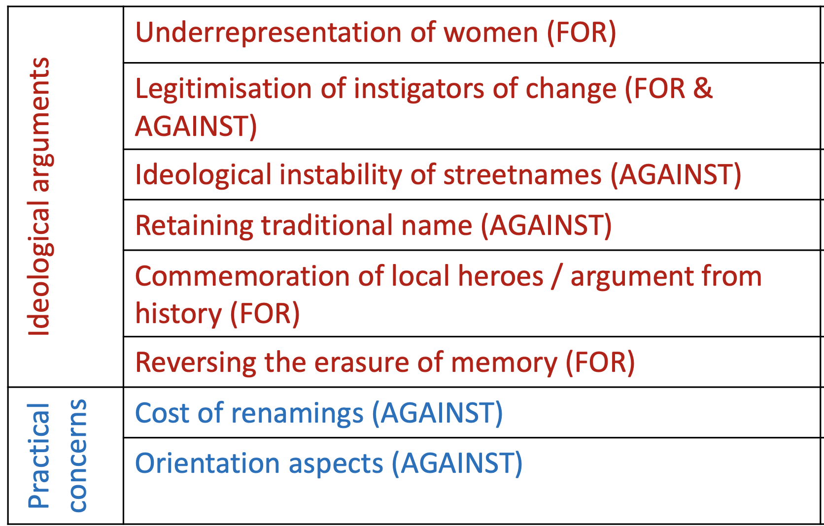
Methodological remarks
CDA of newspaper articles:
street renaming as a testing ground for other political issues
Only a combination of quantitative and qualitative analyses and different types of quantitative data analysis can give us an insight into the complex nature of the commemorative cityscapes.
Ethnographic interviews:
differences between small towns and big cities
local activists
semantic bleaching and normalisation of names
  Os. Kraju Rad > Kra Jurat
Fabiszak M. – R. Rubdy. 2021. ”Media debates over the renaming of the cityscape”. Linguistics Vanguard
Brzezińska A. W. – M. Fabiszak. 2020. “(Nie-)wiem, (nie-)widzę, (nie-)pamiętam: język i pamięć w mieście”. In: Smaradžić, A. – N. Radaković. (eds.) Widzę więc wiem. Poznań: Wydawnictwo UAM. Fabiszak, Małgorzata – Anna Weronika Brzezińska. 2020. „Konflikt pamięci czy konflikt władzy? Strategie językowe w dyskusji nad zmianą nazwy ulicy w Poznaniu”. Tekst i dyskurs 13: 81-99.

Slide 32
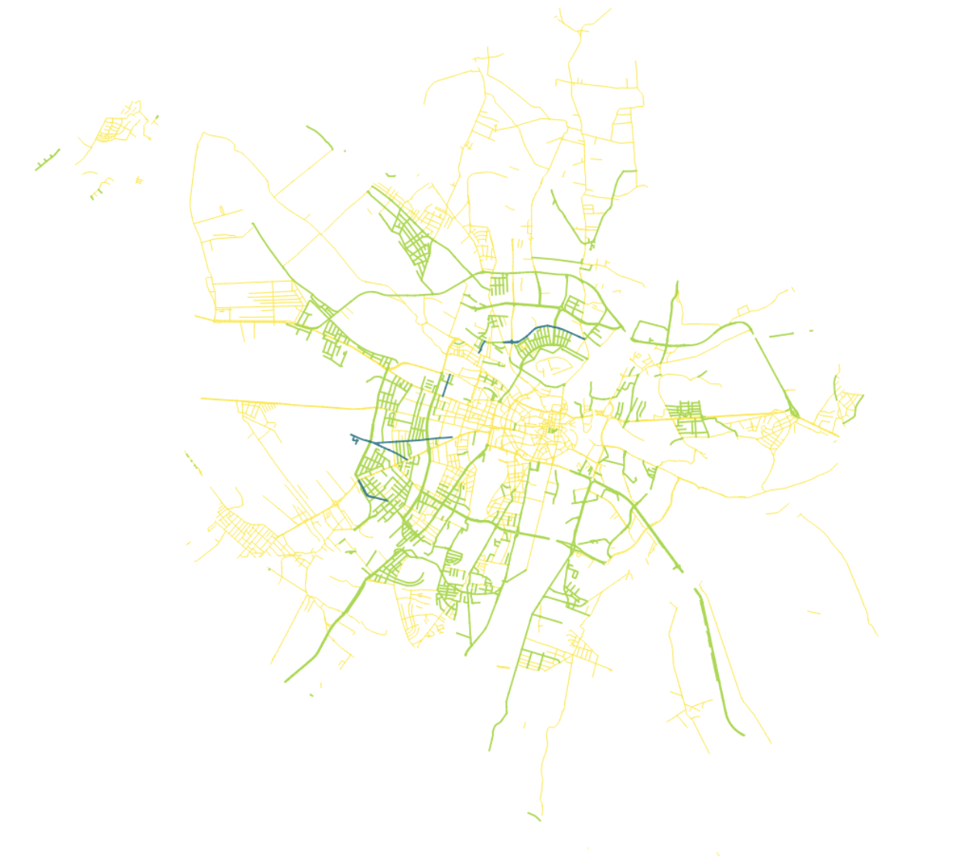
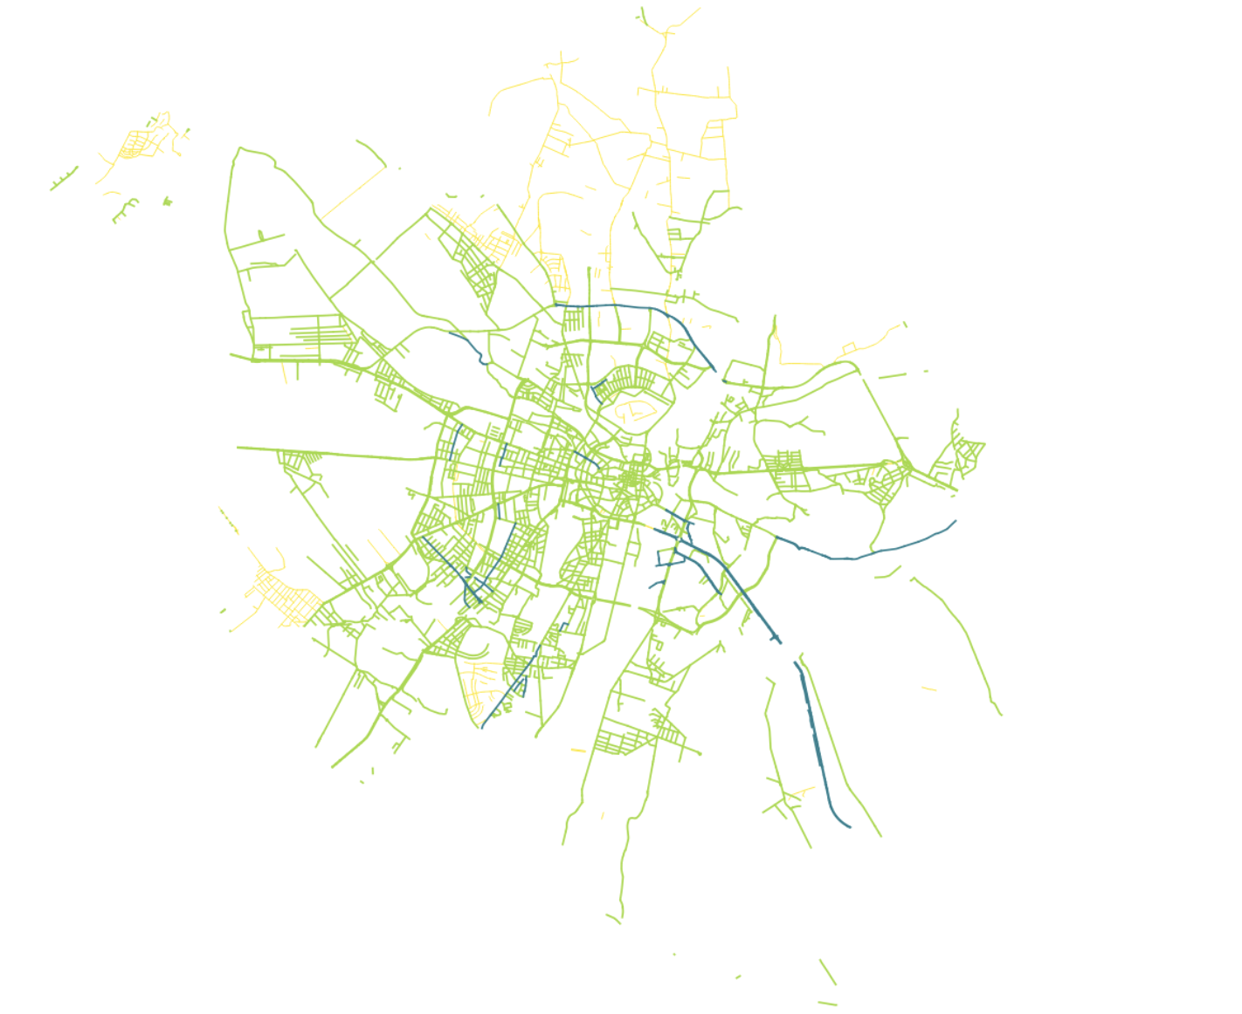
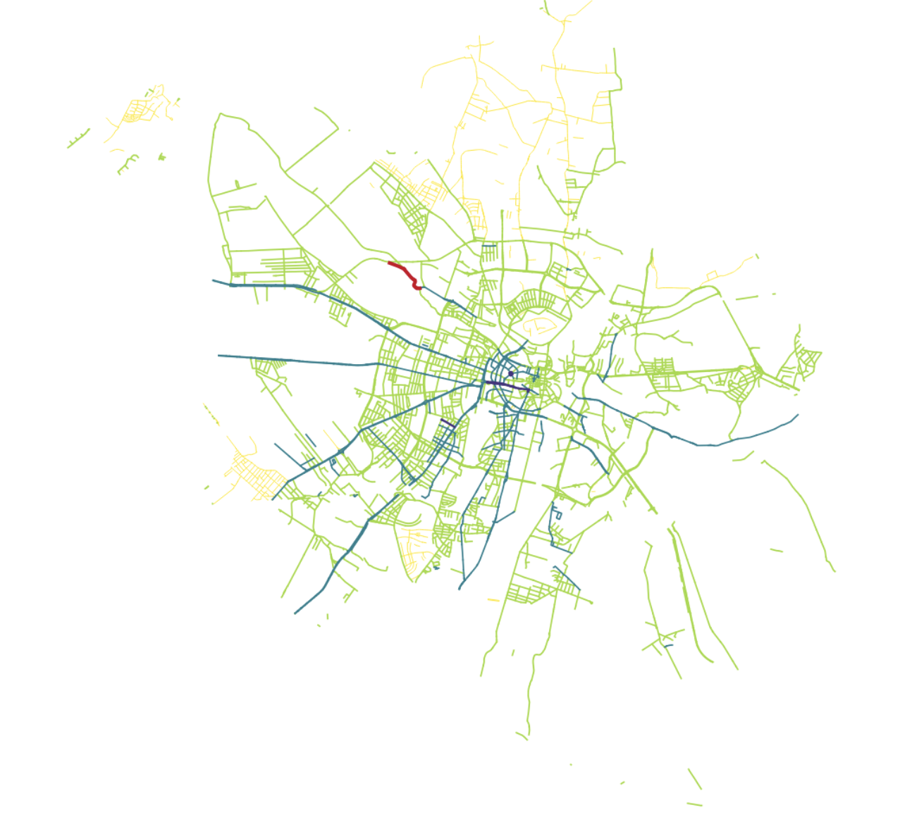
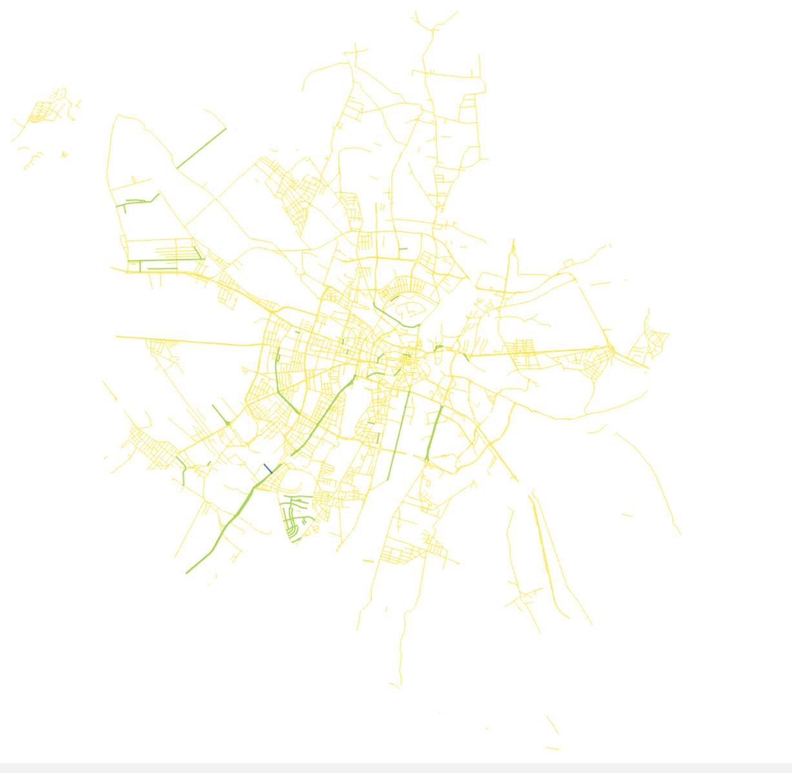
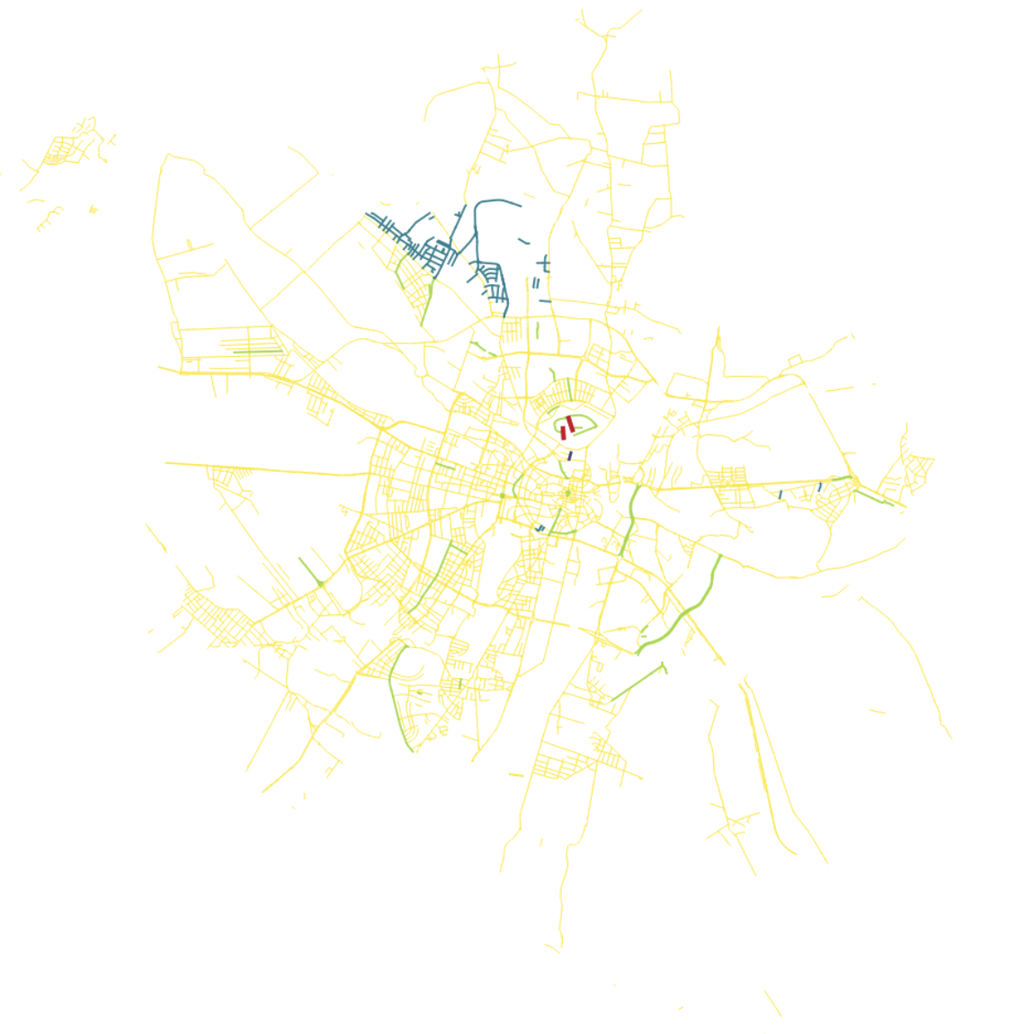
1916-1926
1927-
1938
1939-
1944
1945-
1955
1956-
1969
1970-
1979
http://mill.wa.amu.edu.pl/beethoven_project

Slide 33
Absolute changes in Leipzig street names over 102 years
“The commemorative renaming of streets in the context of regime change is a common strategy employed to signify the break with the past … [and as such a] measure of historical revision.” (Azaryahu 2012:385)
"Waves of renamings that swept“ through time and space in the Leipzig streetscape (Azaryahu 1986:590).

Slide 34
Absolute changes in Leipzig street names over 102 years
Weimar Republic: 16 years
III. Reich: 11 years
GDR: 44 years
Post-1989: 29 years

Slide 35
Absolute changes in Leipzig street names over 102 years
Average number of (re)namings in Leipzig (normalized by length of regime in years)

Slide 36
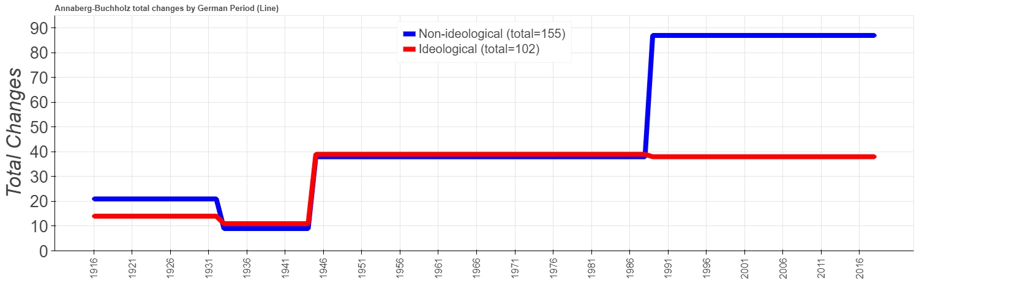
Average number of (re)namings in Leipzig (normalized by length of regime in years)
Average number of (re)namings in AB (normalized by length of regime in years)

Slide 37
Spatio-temporal changes
in Leipzig
1916-2018
Weimar Republic
Nazi era
GDR
Post-1989
Weimar R – 16 yrs
Nazi era – 11 yrs
GDR – 44 yrs
post 1989 – 29 yrs

Slide 38
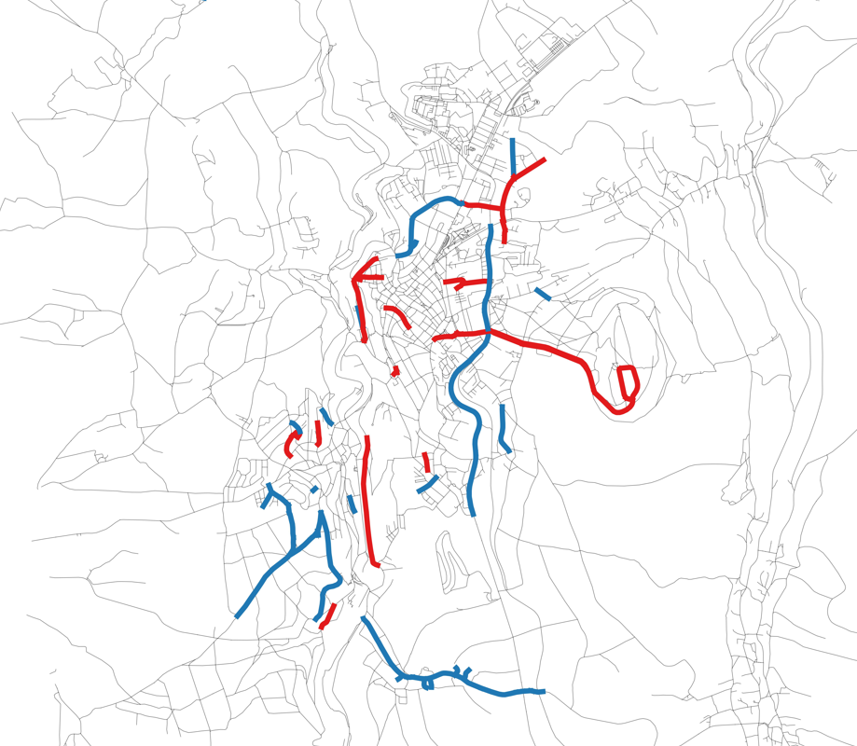
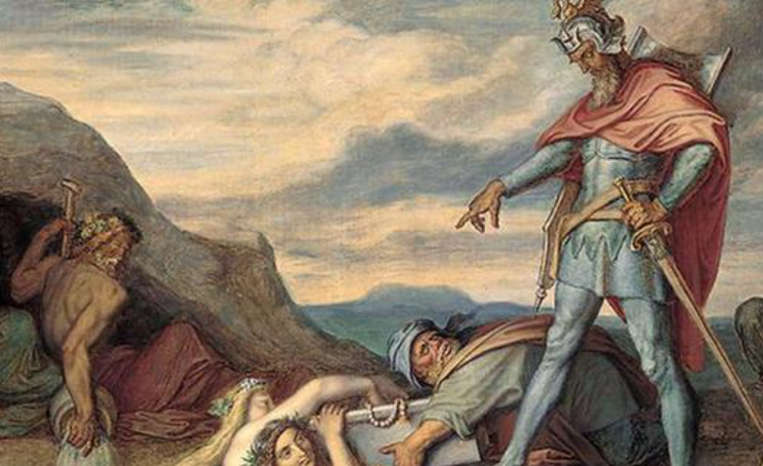
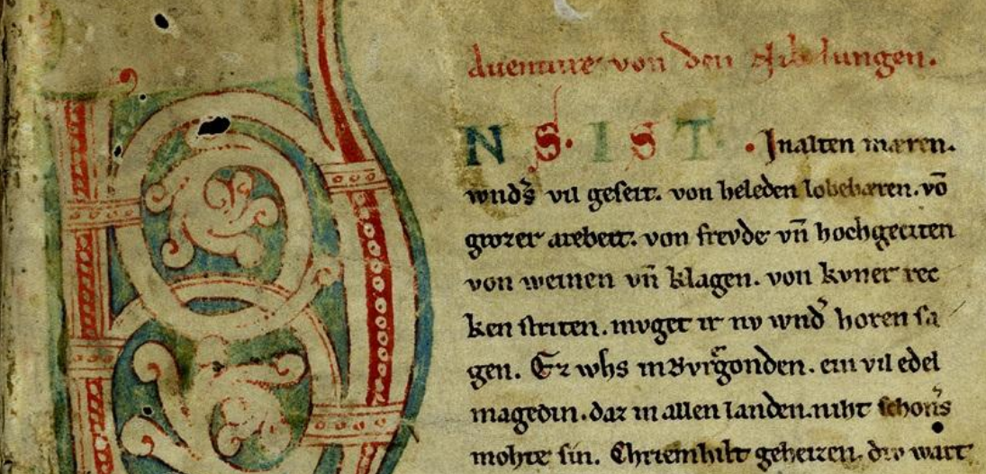
Spatio-temporal changes in Leipzig (1916-2018)
1916-1932
Treaty of Versailles
„Verloren aber nicht vergessen“
Annaberg-Buchholtz
Hindenburgstraße
germanophone poets
Nibelungen
non-ideological 343 (~20.2)
ideological 186 (~10.9)
Total (~mean) 529 (~31.1)

Slide 39
Spatio-temporal changes in Leipzig (1916-2018)
1933-1944
Annexation of
Austria
SS Officers
„Verloren aber nicht vergessen“
Germanic Gods
Military
German painters and architects
Adolf Hitler
Völkerschlacht
non-ideological 125 (~10.4)
ideological 226 (~18.8)
Total (~mean) 351 (~29.2)

Slide 40
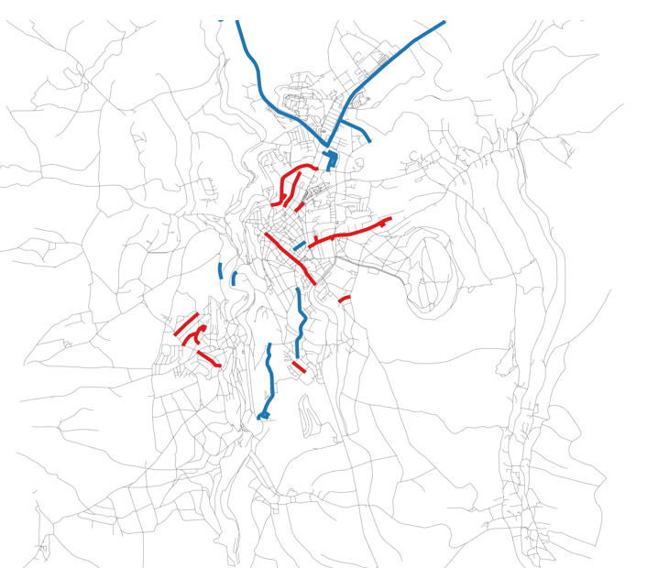
Spatio-temporal changes in Leipzig (1916-2018)
1933-1944
Annexation of
Austria
SS Officers
„Verloren aber nicht vergessen“
Annaberg-Buchholtz
Germanic Gods
A.-Mariella
Military
G. Spree
W. Blümel
Ludendorff
German painters and architects
Kaiser Maximilian
Adolf Hitler
Martin Mutschmann
Resolution from 30. Jan 1940
“Every old and historically meaningful denomination of streets, squares, bridges, houses and whole districts is to be pro-tected in all cases and to be safe-guarded, the more so the more unique and meaningful it is”.
Völkerschlacht
non-ideological 125 (~10.4)
ideological 226 (~18.8)
Total (~mean) 351 (~29.2)

Slide 41
Spatio-temporal changes in Leipzig (1916-2018)
1945-1988
Russ. artists +
scientists
Resistance fighters +
“degenerate” artists
germanophone poets
non-ideological 266 (~6.0)
ideological 523 (~11.9)
Total (~mean) 789 (~17.9)

Slide 42
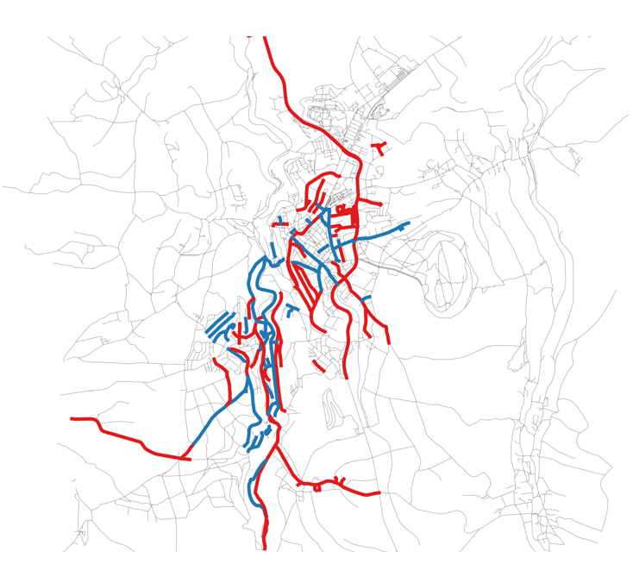
Spatio-temporal changes in Leipzig (1916-2018)
1945-1988
Russ. artists +
scientists
Annaberg-Buchholtz
Resistance fighters +
“degenerative” artists
Georg Schumann
Rudolf Breitscheid
Rosa Luxemburg
Georg Schwarz
Ernst Thälmann
Friedrich Jahn
Arthur Hoffmann
August Bebel
Richard Lehmann
Lenin
Karl Liebknecht
Gerhard Ellrodt
germanophone poets
Karl Marx
Streets are “propaganda carriers [since] … major political changes are reflected in the renaming of streets”
(Azaryahu 1986:581-7)
non-ideological 266 (~6.0)
ideological 523 (~11.9)
Total (~mean) 789 (~17.9)

Slide 43
The “socialist genitive” in naming strategies
Constructional frame:
STREET + ART.GEN3 + REFERENT [EVENT, GROUP/ORGANISATION OR VALUE]
Straße der Solidarität (‘Street of solidarity’)
Straße des Friedens (‘Street of peace’)
Straße der jungen Pioniere (‘Street of young pioneers’) [socialist youth organization]
Straße der Befreiung 8. Mai 1945 (‘Street of liberation 8th May 1945’) [from Nazis]
Areal distribution of streets fitting the constructional frame of communist-socialist naming strategies in Germany (n= 872).

Slide 44
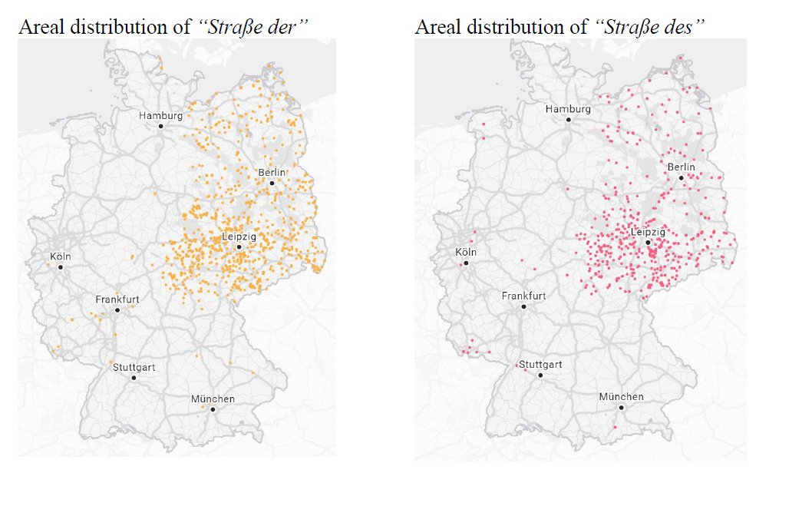
The “socialist genitive” in naming strategies
Areal distribution of “Straße der” Areal distribution of “Straße des”
.
.
Annaberg Buchholz
Annaberg Buchholz

Slide 45
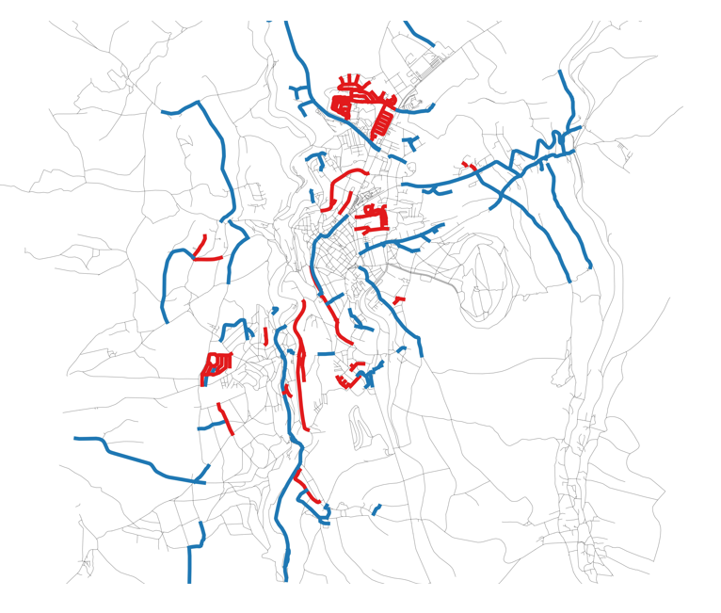
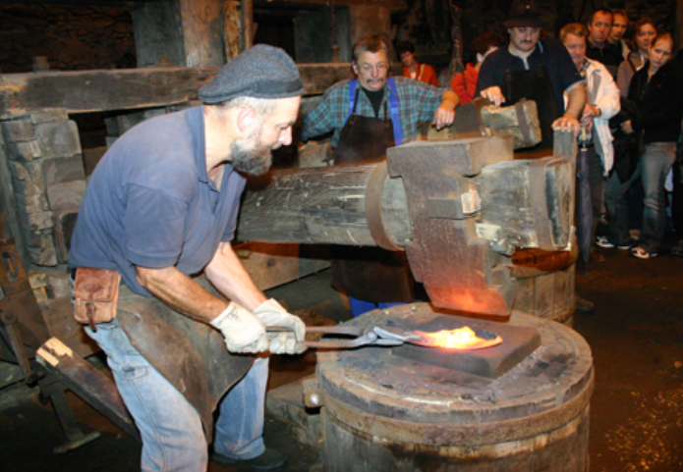
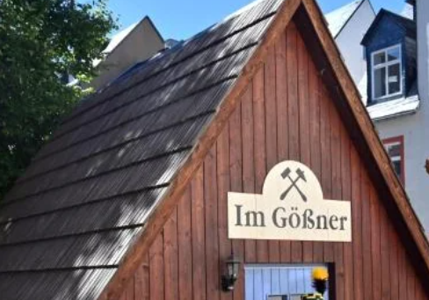
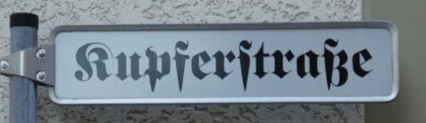
Spatio-temporal changes in Leipzig (1916-2018)
Righting the wrongs of the past
1989-2018
Hedwig Burgheim
Ephraim Carlebach
Annaberg-Buchholtz
Daniel Katzmann
Wolfgang Zill
Kurt Weill
Henri Hinrichsen
Luz Long
Max Spohr
Felix Mendelsohn
Commodification
of cultural heritage
‘copper street’
ore street
cobalt street
Else Staffelstein
non-ideological 379 (~12.6)
ideological 182 (~6.1)
Total (~mean) 561 (~18.7)

Slide 46
Conclusions
Commemorative change of street names is hegemonic process:
Public display of ((changes in)) state political / social / cultural identity.
Different versions of history exist + are sequentially replaced
Subversive potential of street name changes as "creation of a natural order of things" (Fairclough 2003:2).
Street names appropriate and construct space (Tufi 2019)
propaganda carriers, "as important political changes are reflected in the renaming of streets" (Azaryahu 1986:581-7).
Our project: interdisciplinary approach to changes in the "ideological robe of the city" (Zieliński 1994:195).
dynamic geographic visualization
CDA analysis of media data.

Slide 47
Conclusions
Street names are revelatory for tracing changes in representational politics as a result of successive political-ideological regimes (Arazyahu 2011).
Over time, what for older generations was a revolutionary wiping out of old heroes and values they stood for, for the younger generation becomes a “natural order of things” (Fairclough 2003:2).
The Eastern European nations are paradigm cases for radical upheavals in the political, economic and technological structures that impact upon and are reflected in the LL.

Slide 48
Conclusions
Combined methodology explores locally negotiated and renegotiated ways in which memory and identity are enshrined in and exculpated from public space.
The spatio-historical patterns that emerge suggest that commemorative renaming is a continuous struggle for representation in the cityscape, a barometer reflecting political changes and a tool for creating and displaying different types of identity.
Street renaming continues -- different world views and concepts encoded:
anti antisemitism
anti colonialism
civil liberties
feminism
marketing / commodification of identity (Weller 2003)

Slide 49
Thank you for listening
http://mill.wa.amu.edu.pl/beethoven_project

Slide 50

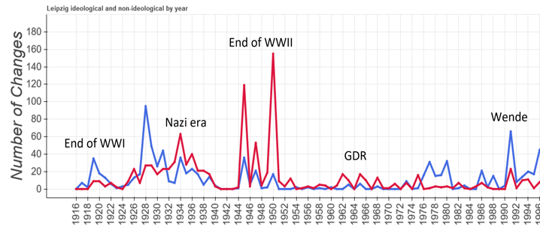
Methodological remarks
Line graph by year
+ detailed longitudinal viz. of ideological marking of the city
- too detailed variation, no geographical information
Spatiotemporal maps
+ extent of the ideological marking of the city
- compression of eras of different length into one frame
Normalised renamings by year
+ balanced representation of the intensity of ideological marking
- variation hidden behind average
Only a combination of
quantitative and qualitative analyses and
different types of quantitative data analysis
can give us comprehensive insights into the complex nature of commemorative cityscapes.

Slide 51
Spatio-temporal changes in Leipzig (1916-2018)
Weimar Republic
Nazi era
GDR
Post-1989

Slide 52
Average number of (re)namings by outcome (normalised by length of regime in years)

Slide 53
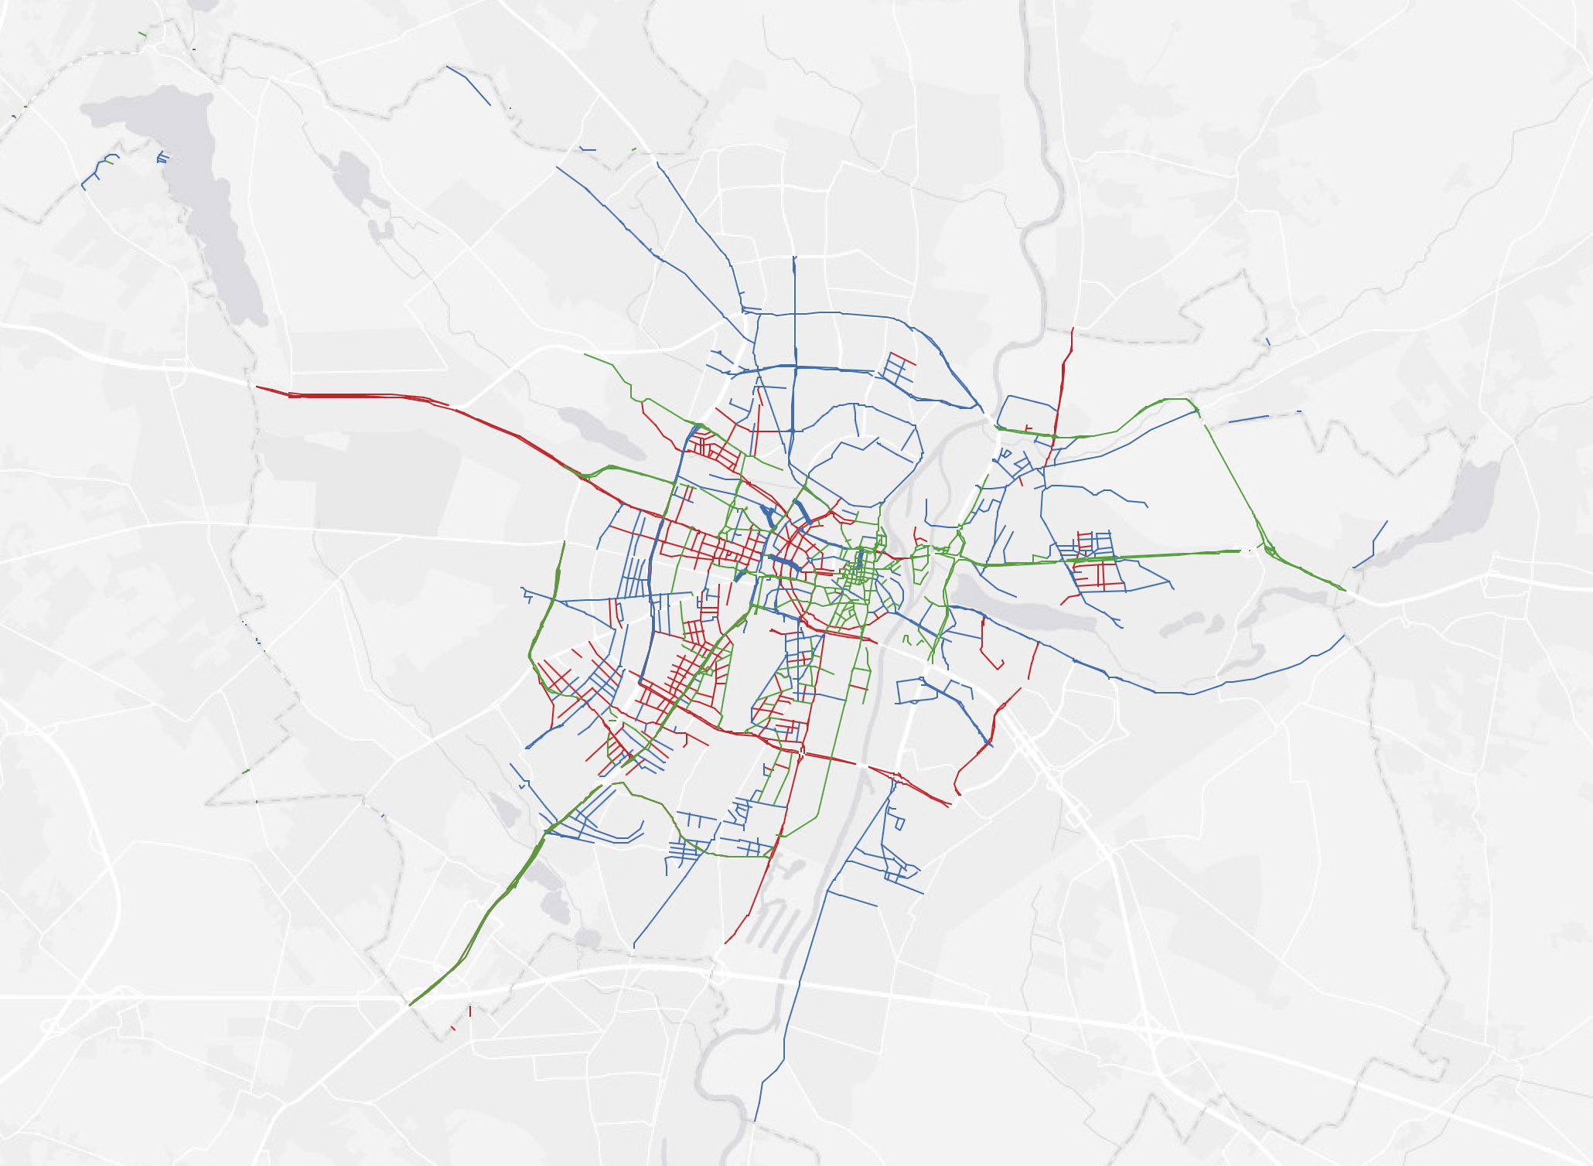
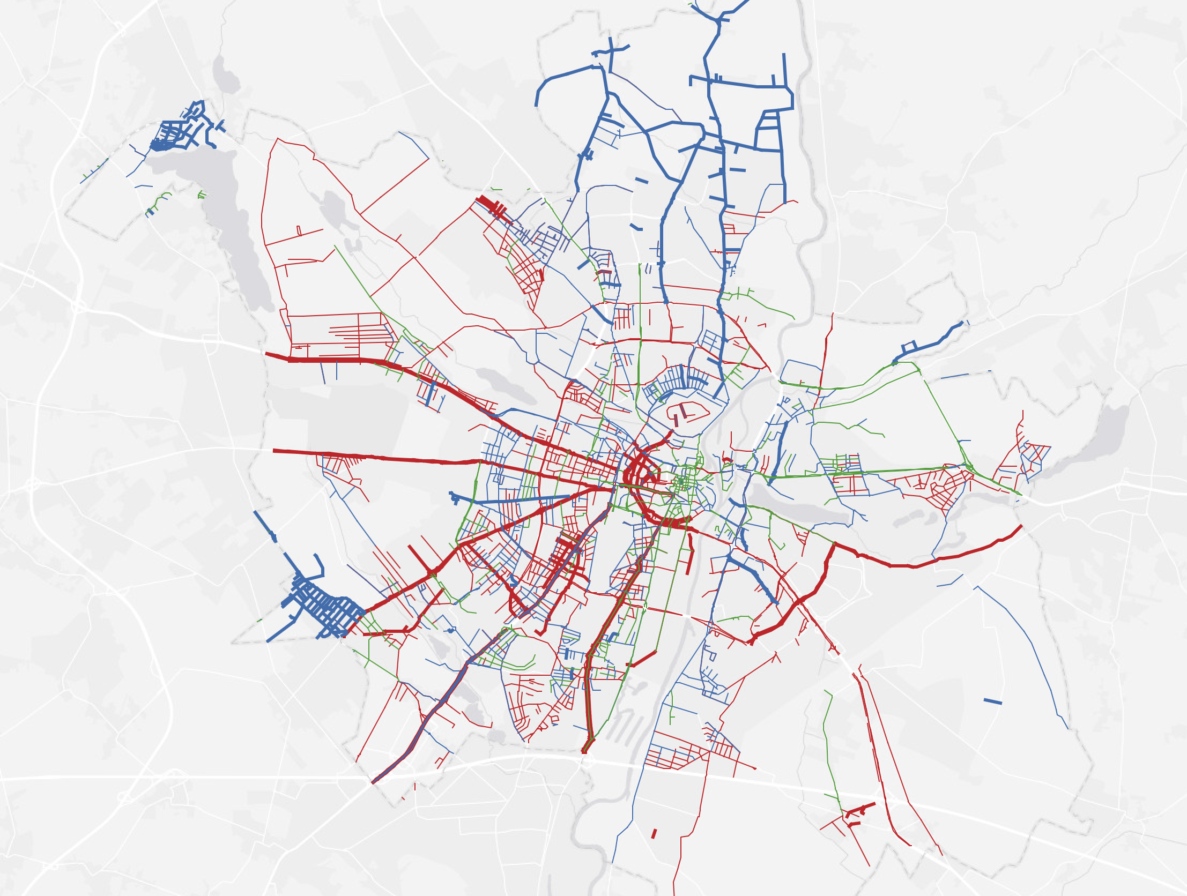
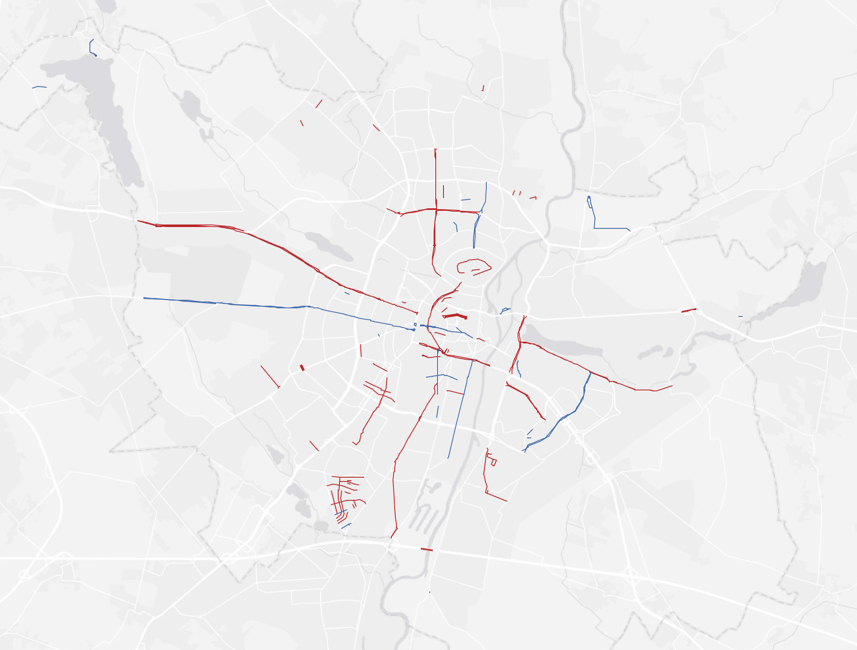
2nd Polish Republic
Nazi era
Spatio-temporal changes
in Poznań
1916-2018
communist Poland
post-1989
2nd Republic - 20 yrs
Nazi era - 5 yrs
Communist r. - 44 yrs
post-1989 - 29 yrs

Slide 54
Nazi era at home and in the occupied territories
Leipzig
Poznań

Slide 55
Poznań: additinal variables in renamings: national identity and language change
1916-1921
1921-1939
1939-1944
Prussian street names
> renaming into Polish
(translation and change)
> new Polish names
> renaming Polish back to Prussian
> changing Prussian to Nazi
> renaming new Polish to Nazi
Street name change | Change | Transl. | Total | % of change
1921 from Prussian to Polish | 166 | 149 | 315* | 53%
1919 Prussian to 1939 Nazi German | 134 | 191 | 325* | 41%
1939 Polish to Nazi German | 346 | 105 | 451 | 77%
*These two numbers should be identical, but Ring road has been divided into a bigger number of secions by the Polish administration, hence a different number of streets.

Slide 56
Conclusion 1:
Similarities in the patterns of change
peaks of change at the onset of a new regime with a lower
followed by more balanced rate of change as the system stablized
renamings focussed on personal names, in particular of political and military leaders
the long thouroughfares leading out of the city were most prone to change
Nazi and communist administration more extensive ideological marking of the commemorative cityscape than the democratic governments post WWI and post 1989

Slide 57
Conlusion 2: Idiosynchrasies
In Poznań:
2 additional variables influencing the spatio-temporal patterns of renamings:
(1) change in the national identity of the city administration
(2) change in the language of administration
Both resulted in the emergence of an additional analytic category – translated names.
→ Necessity to analyse the changes not only year by year, but across all periods.

Slide 58
Methodological remarks
Line graph by year
+ detailed longitudinal viz. of ideological marking of the city
- too detailed variation, no geographical information
Spatiotemporal maps
+ extent of the ideological marking of the city
- compression of eras of different length into one frame
Normalised renamings by year
+ balanced representation of the intensity of ideological marking
- variation hidden behind average
Only a combination of
quantitative and qualitative analyses and
different types of quantitative data analysis
can give us comprehensive insights into the complex nature of commemorative cityscapes.

Slide 59
Commemorative cityscapes: spatio-temporal patterns in street names in Eastern Germany and Poland
Serafeim Alvanides, Isabelle Buchstaller, Małgorzata Fabiszak, Frauke Griese, Patryk Dobkiewicz, Carolin Schneider, Anna Weronika Brzezińska
Thank you for listening
谢谢大家的聆听
http://mill.wa.amu.edu.pl/beethoven_project

